Slide 1





Slide 2

REPRODUCTIVE HEALTH
It is the state of physical, emotional, behavioral and social fitness for leading a reproductive life.
According to WHO: A total well being in all aspects of reproduction, i.e., physical, emotional, behavioral and social.

Slide 3




Reproductive Health- Problems Strategies
India was among the 1st countries to initiate actions & plans to attain total reproductive health as social goal.
These programs are called as ‘ FAMILY PLANNING’-initiated in
1951.
Improved programs covering reproduction related areas are in operation- ‘Reproductive & Child Health Care Programs’ (RCH)
Create awareness about various reproduction aspects & provide facilities and support to build reproductively healthy society

Slide 4



HOW HAS THE GOVERNMENT TAKEN MEASURES
Through the help of audio-visuals & print media to create awareness.
Family members, close relations are involved in the awareness.
Sex education is introduced in schools to provide awareness
Proper information about reproductive organs, adolescence & related changes , safe & hygienic sexual practices, sexually transmitted diseases (STD), AIDS etc.
Educating people about birth control options, care of pregnant women, post- natal care of mother & child, importance of breast feeding, equal importance to both male & female child- socially conscious healthy family
Awareness of uncontrolled population growth, social evils- build
socially responsible healthy society

Slide 5
Implementation of various action plan requires infrastructural facilities, professional expertise & material support to provide medical assistance and care to people in reproduction related problems, pregnancy, delivery, STDs, abortions, contraception, menstrual problems, infertility etc.
Statutory ban on Amniocentesis- legally check female foeticide,
massive child immunisation- programs
Researches on reproduction related areas, supported by gov. & non- governmental agencies to improve/ find new methods upon the existing ones. Saheli (Contraceptive)- Central Drug Research Institute (CDRI)
Improved reproductive healthy society- increased medically assisted deliveries, better post natal care, decreased maternal & infant mortality rate, small families, better detection & cure of STDs- increased facilities for sex related problems

Slide 6
POPULATION EXPLOSION AND BIRTH CONTROL
The increase in size and growth of human population is called population explosion.
Indian population- 350 million at independence and crossed 1 billion in May 2000
Alarming growth rate- scarcity of basic requirements (food, shelter & clothing)
The reason for high population explosion are,
Decline in death rate.
Longer life span.
Decline in maternal mortality rate (MMR)
Decline in infant mortality rate (IMR)
Some religious belief against birth control.
Lack of reproductive health knowledge.

Slide 7
Some steps to overcome population explosion:
Motivate smaller families using contraceptive methods
Awareness through media, posters/ bills- Hum Do Hamare Do (we two, our two)
Couples mostly young, urban, working ones adopted ‘one child norm’
Statutory raising of marriageable age, female- 18, male- 21
Incentives to couples with small families
Contraceptive methods, to prevent unwanted pregnancies

Slide 8

Contraception
Contraception aims to control birth, by using contraceptives
Prevention of conception or fertilization of ovum during sexual inter course is called contraception.
An ideal contraceptive should be user- friendly, easily available,
effective and reversible with no or least side effects.
The different types of contraceptives are:
Natural / Traditional method
Barrier method
Intra uterine device [IUD’s]
Oral contraceptives
Injection and implants
Surgical method

Slide 9
1. Natural methods:
It work on the principle of avoiding chances of ovum and sperms
meeting.
a) Periodic abstinence:
Is a method in which couple avoid or abstain coitus form day 10 to 17 of the menstrual cycle when ovulation could be expected.
b) Withdrawal or coitus interruptus:
In this method male partner withdraws his penis from the vagina just before ejaculation to avoid insemination.
c) Lactational amenorrhea:
Based on fact that ovulation/cycle absent during intense lactation following parturition. Hence chance of fertilization is absent.
Effective for 6 months, side effects are nil
Chances of failure are high

Slide 10
2. Physical contraceptive or Barrier methods:
This method prevents contact of sperm and ovum by barrier.
Available both for male and female.
a) Condoms:
Barriers made of thin rubber/ latex sheath, self inserted & disposable
Covers penis in male & vagina and cervix in female. It is used so that semen do not enter the female reproductive tract.
It also prevents AIDS and STDs.
b) Diaphragm, cervical caps and vaults:
Barrier, made of rubber latex.
Inserted into the female reproductive tract to cover the cervix
Block entry of sperm through cervix, reusable
Spermicidal cream, jellies, foams along with these barriers

Slide 11
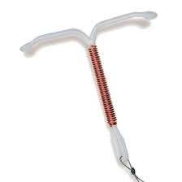
3.Intra Uterine Devices (IUDs )
These devices are only used by female
Inserted by doctor or nurses in the uterus through vagina.
They are available as:
Non-medicated IUDs e.g. Lippes loop:
Phagocytosis of sperm
Copper releasing IUDs (CuT, Cu7, Multiload 375):
Cu ion released suppresses sperm motility and fertilizing capacity of sperm.
IUDs increases phagocytosis of sperm
within the uterus.

Slide 12
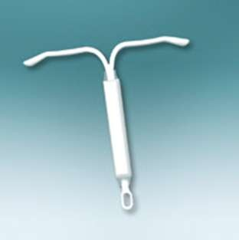
c) Hormone releasing IUDs (Progestasert, LNG-20):
make the uterus unsuitable for implantation and the cervix hostile to the sperm.
IUDs are ideal for female- to delay
pregnancy/ space children
Widely accepted contraception in India
3) Oral contraceptives:
Oral administration of small doses of progesterone or progesterone- estrogen combination
Female, tablets & so called pills, taken daily for a period of 21 days
Inhibit ovulation & implantation & alter the quality of cervical mucus to prevent entry of sperm
Effective less side effects, Eg. Saheli- non steroidal preparation, once a week

Slide 13
Oral Contraceptives

Slide 14
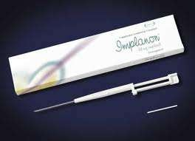

4) Injections or implants:
Progesterone alone or in combination with estrogen used as
injections or implants under the skin of female.
Action similar to pills, effective for long periods
Progesterone or combination of progesterone and estrogen or IUDs- within 72 hours of coitus are effective as emergency contraceptives to avoid possible pregnancy due to rape or unprotected intercourse

Slide 15
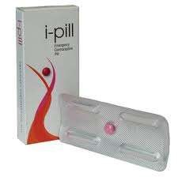
Emergency contraceptives:
These methods are used within 72 hours of coitus, casual in unprotected intercourse.
Administration of progesterone or progesterone-estrogen combination.

Slide 16
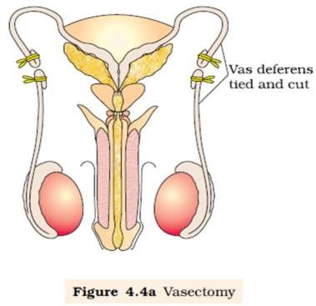
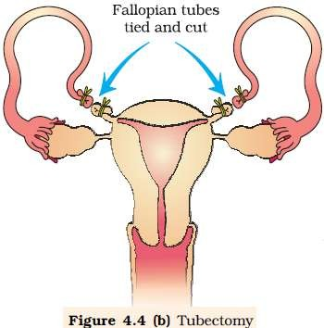
5) Surgical methods:
It is also called as sterilization method advised to male/ female partner to prevent any future pregnancy.
Blocks gamete transport, thus prevent conception
Sterilization in male is called-vasectomy & female- ‘tubectomy’
Vasectomy- a small part of the vas deferens is removed or tied up through incision made on scrotum
Tubectomy- small part of fallopian tube is removed or tied up through incision of abdomen/ vagina
Highly effective, reversibility is very poor

Slide 17
MEDICAL TERMINATION OF PREGNANCY (MTP)
Intentional or voluntary termination of pregnancy is called medical termination of pregnancy (MTP) or induced abortion.
45 to 50 million MTPs/ year- world
Decreases population- not meant for that purpose
Accept/ legalise is debated due to emotional, ethical, religious & social issues
Government of India legalized- 1971, with strict restrictions to check indiscriminate & illegal female foeticide
MTP- rid of unwanted pregnancy due to unprotected intercourse, failure of contraceptive, rapes, pregnancy which may fatal to mother or foetus
This method is safe within 1st trimester (12 weeks), 2nd trimester abortions are riskier
Illegal- unqualified quacks, unsafe & fatal- avoided by counselling
Misuse of amniocentesis, followed by MTP- avoided

Slide 18
SEXUALLY TRANSMITTED DISEASES (STDs)
Diseases or infections which are transmitted through sexual intercourse are called Sexually transmitted diseases (STDs)/ Venereal diseases (VD)/ Reproductive tract infections (RTI)
Gonorrhea, Syphilis, Genital herpes, Chlamydiasis, genital warts,
Trichomoniasis, hepatitis-B and HIV.
Mode of transmission- Hepatitis- B & HIV
Sexual contact with infected person
Sharing of injection needles
Sharing the unsterilized surgical instruments
Transfusion of blood from infected person to healthy person
Infected mother to foetus
Except hepatitis-B, genital herpes and HIV infections, others are curable.

Slide 19
Symptoms are minor- early stages:
Itching, fluid discharge, slight pain, swelling in the genital region.
STDs remain asymptomatic in female and remain undetected for long.
In the later stage it may leads to Pelvic inflammatory diseases (PID), abortion, still birth, ectopic pregnancy, infertility or even cancer in reproductive tract.
Preventions:
Avoiding sex with unknown partners or multiple partners.
Always using condoms during coitus.
In case of doubt, consult a doctor for early detection.
Getting complete treatment for diagnosed disease.

Slide 20
INFERTILITY
The couple unable to produce children in spite of unprotected sex is due to Infertility. Problems of infertility may be in male or female.
The reason of infertility may be:- physical, congenial, diseases,
drugs, immunological or even psychological.
Female are blamed often in India
Specialized Health care units like Infertility clinics- diagnose, corrective treatments to have child
When treatments are not enough, couple are assisted with techniques called assisted reproductive technologies (ART)

Slide 21
Methods of infertility control:
1. IVF- ET (In Vitro Fertilization- Embryo Transfer)
Test tube baby, fertilization takes place outside & embryo is transferred
Female is induced to produce multiple egg/ ova
Egg is then collected from wife/ donor & sperm collected from husband/ donor
Incubated in culture medium- fertilization & form zygote
It is then transferred to the uterus of wife, implants & pregnancy
continues
Two types
ZIFT (Zygote Intra fallopian Transfer)- Zygote/ Embryo with 8 blastomeres transferred to fallopian tube
IUT (Intra- Uterine Transfer)- Embryo transferred at 32 celled stage to uterus

Slide 22
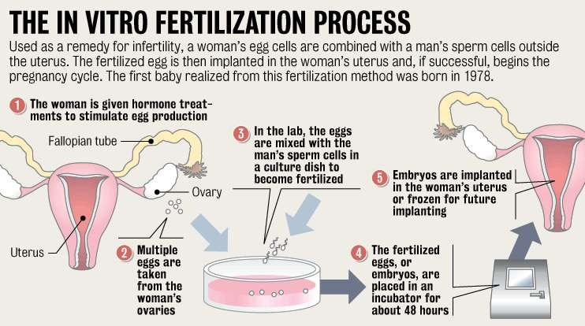
Significance:
Boon to infertile mother
Men with Oligospermia (low sperm count)
Embryos can be frozen & used for future

Slide 23
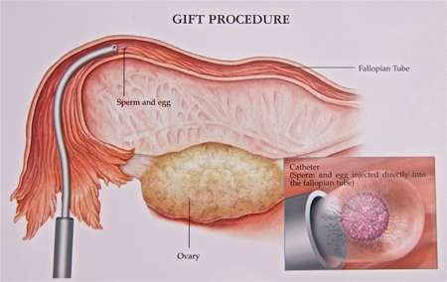
2. GIFT (Gamete Intra Fallopian transfer)
Ovum collected from donor & transferred to female who cannot
produce one but provide suitable environment for fertilization
Washed sperms & ova are transferred to the ampulla of fallopian tube with the help of laparoscope- fertilization & cleavage
Useful when fimbriae fail to capture ovum & females having sperm
antibodies in their cervical secretion

Slide 24
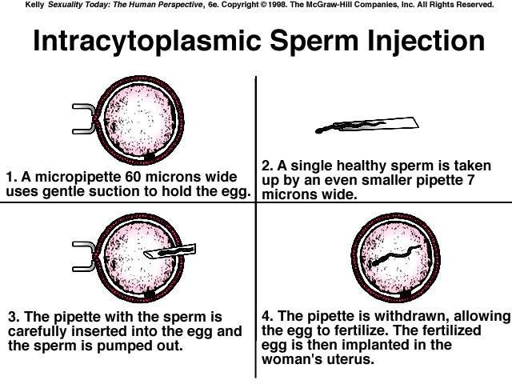
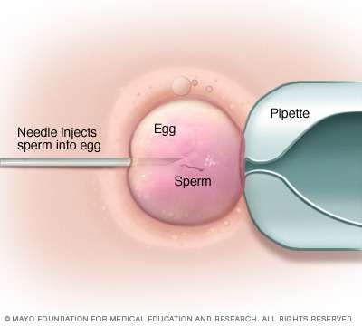
3. Intra Cytoplasmic Sperm Injection (ICSI)
Sperm is directly injected into the ovum in culture medium
Zygote or Embryo- transferred to fallopian tube or uterus

Slide 25
4. Artificial insemination (AI)
It is useful in cases either the male partner unable to inseminate
the female or very low sperm counts (oligospermia)
Semen of male partner/ donor is collected, concentrated & introduced into vagina or uterus of female- intra -uterine insemination (IUI)
Drawbacks:
These techniques are not possible with female with damaged
uterine wall.
Require high precision, specialized professional & expensive instrumentation & so available in few centers & available to few people only.
Raised several ethical, emotional, religious & moral issues in the society.

