Slide 1








Slide 2




Reproduction is a fundamental feature of
which transmission of genetic
involves the material from
living organisms
one generation to the next ensuring the survival of species over long periods of time.

Slide 3




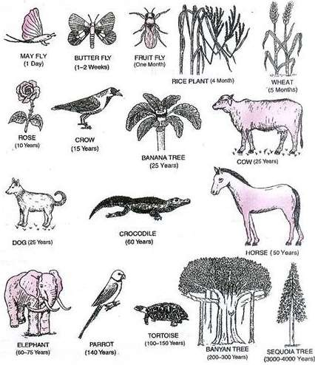
LIFE SPAN
The period from birth to the natural death of an organism is called its life span.
Life span of an organism may be few minutes to several thousand years.

Slide 4




Life span of some organisms
Organism | Life span
Fruit fly | 1 day
Butterfly | 1-2 weeks
Wheat plant | 6 months
Crow | 15 years
Dog | 25 years
Banana tree | 25 years
Crocodile | 60 years
Human | 100 years
Parrot | 140 years
Tortoise | 100- 150 years
Banyan tree | 200 years

Slide 5






Juvenile phase
Life span of an organism usually includes four phases:
Reproductive phase OR Maturity phase Ageing and Senescence
Death

Slide 6



REPRODUCTION
ASEXUAL REPRODUCTION
SEXUAL REPRODUCTION

Slide 7






























Asexual Reproduction
Fragmentation Eg. Spirogyra
Regeneration Eg. Planaria
Vegetative Propagation
Fission
Budding
Binary Eg. Amoeba
Multiple
Eg. Plasmodium
External Eg. Hydra
Internal Eg. Spongilla

Slide 8

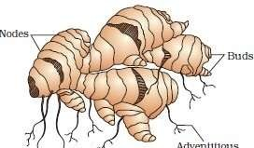

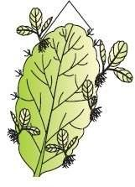

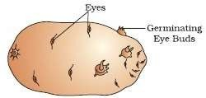

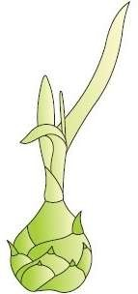

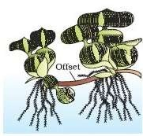
Vegetative Propagation
Runner eg. Mint
Rhizome eg. Ginger
Leaf buds eg. Bryophyllum
Tuber eg. Potato
Offset
eg. Eichhornia
Bulbil eg. Agava

Slide 9








zoospores
eg. Chlamydomonas
Conidia
eg. Penicillium
Buds
eg. Hydra
Gemmules eg. Sponges

Slide 10


SEXUAL
REPRODUCTION
Sexual reproduction involves formation of the male and female gametes, either by the same individual or by different individuals of the opposite sex.
These gametes fuse to form the zygote which develops to form the new organism.

Slide 11





Reproduction in Flowering Plants
Annual – The plant which completes its life cycle within one year and then dies. Eg. Peas
Biennial - The plant which completes its biological life cycle in two years. Eg. Onion
Perennial - The plant that lives for more than two years. Eg. Banana, Mango

Slide 12
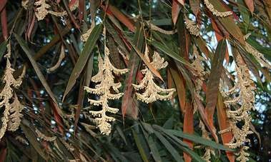
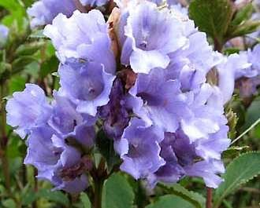
Unusual phenomenon of some flowering Plants
Bamboo species flower only once in their life
time, generally after 50- 100 years, produce large number of fruits and die.
Bamboo Flower
Strobilanthus (neelakuranji)
kunthiana
flowers
once in 12 plant flowered
years.
The
during
September-October 2006.
Neelakuranji Flower

Slide 13





Breeding of
Animals
On the basis of time of breeding, animals are of two types:-
Seasonal Breeders:
They reproduce at particular period of the year such as frog, lizards, most birds, deer, etc.
Continuous Breeders:
These animals continue to breed throughout their sexual maturity. Examples are honey bee, queen, poultry, rabbit, mice, cattle, etc.

Slide 14








Cyclical changes during Reproduction
Oestrus cycle
Non-primate Mammals
Eg. Cow, Sheep,Dog, Tiger
Menstrual cycle
Primate Mammals
Eg. Monkey, Apes, and Humans

Slide 15








Sexual Reproduction Events
Pre- fertilisation
Post- fertilisation
Fertilisation

Slide 16







Pre-fertilisation Events
Pre-fertilisation Events
Gametogenesis
Gamete transfer

Slide 17

Gametogenesis
Gametogenesis - The process of formation of male and female gametes. Gametes may be :
Homogametes or isogametes- the two gametes similar in appearance ,can not categorise into male and female gametes. eg. Cladophora
Heterogametes - two morphologically distinct gametes .
Male gamete is called antherozoid or sperm.
Female gamete is called the egg or ovum. eg. Fucus, Human being

Slide 18

Sexuality in Organisms
Homothallic and monoecious - terms used to describe bisexual condition of plant.
Heterothallic and dioecious - terms used to describe unisexual condition of plant.
Staminate - unisexual male flower bearing stamens
Pistillate - unisexual female flower bearing stamens.
Monoecious - both male and female flowers may be present on the same individual. Eg. cucurbits and coconuts
Dioecious - both male and female flowers may be present on separate individuals. Eg. papaya and date palm

Slide 19

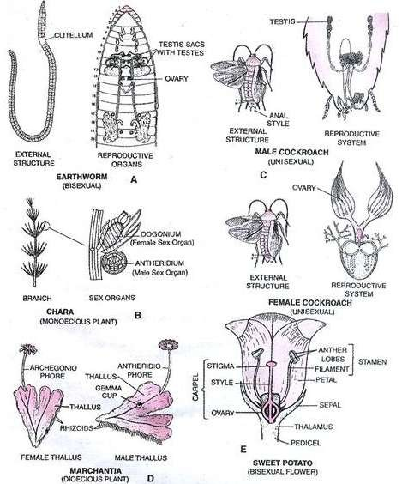
Diversity of Sexuality in
Organisms

Slide 20


Cell division during Gamete Formation
Parental body of organisms like monera, fungi, algae and bryophytes is haploid. They produce gametes by mitotic division.
Parental body of organisms like pteridophytes, gymnosperms, angiosperms and most of the animals including human beings is diploid. They produce gametes by meiotic cell division.
In diploid organisms, specialised cells called meiocytes (gamete mother cell) undergo meiosis.

Slide 21

Gamete Transfer
In majority organisms male gamete is motile where as female is stationary.
Exceptions , a few fungi and algae both types of gametes are motile.
A medium is required through which the male gametes move.
In algae, bryophytes and pteridophytes, water is the medium for gamete transfer.
To compensate loss of male gametes during transport, the number of male gametes produced is several thousand times the number of female gametes produced.

Slide 22


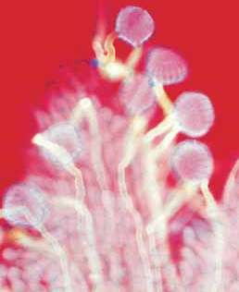
Pollination – The transfer of pollen grains from anther to the stigma is called pollination.
Self-pollination and Cross pollination
Pollen grains germinate on the stigma and the pollen tubes carrying the male gametes reach the ovule and discharge male gametes near the
Germination of Pollen grain on Stigma of a Flower

Slide 23







Pollination
Pollen tube Formation
Fusion of male and female gamete
Fertilisation (Syngamy)

Slide 24




FERTILISATION
Fertilisation results the formation of diploid zygote.
Parthenogenesis - Some female gametes undergo the development of new organisms without fertilisation. This phenomenon is called parthenogenesis.
Eg. Rotifers, Honey bees, and Turkey birds

Slide 25










TYPES OF
FERTILISATION
FERTILISATION
EXTERNAL FERTILISATION
(Syngamy outside the body of organism)
Eg. algae, fishes and amphibians
INTERNAL FERTILISATION
(Syngamy inside the body of organism)
Eg. Fungi, Reptiles, Birds, Mammals

Slide 26

Events in sexual reproduction after the formation of zygote are called post- fertilisation events.
Formation of the diploid zygote
In organisms belonging to fungi and algae, zygote develops a thick wall that is resistant to dessication and damage.
It undergoes a period of rest before germination.

Slide 27

Embryogenesis
The process of development of embryo from the zygote is called embryogenesis.
Zygote
cell division (Mitosis)
cell differentiation Specialised tissue Organs
Organism

Slide 28







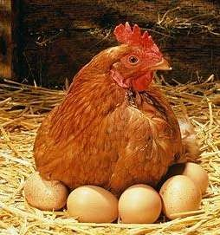
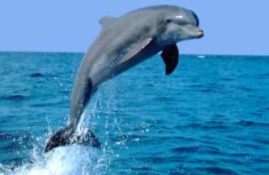
Oviparous
Lay fertilised / unfertilised eggs
Eg. reptiles and
birds
Animals
Viviparous
Eg. mammals
Give birth to young ones
Oviparous
Viviparous

Slide 29


Development of
Zygote
Oviparous
Fertilised eggs are covered by hard calcareous shell which laid in a safe place in the environment and young ones hatch out after a period of incubation.
Viviparous
Proper embryonic care and protection causes greater survival chances of young ones in viviparous organisms.

Slide 30


Zygote in flowering
plant
Zygote is formed inside the ovule of flowering plants.
After fertilisation the sepals, petals and stamens of the flower wither and fall off.
Zygote Ovules Ovary
embryo seed. fruit
Thick wall of fruit
pericarp

