Slide 1


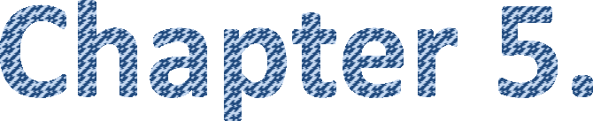








Slide 2
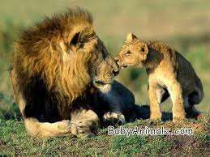
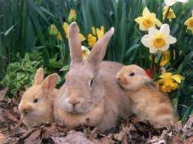
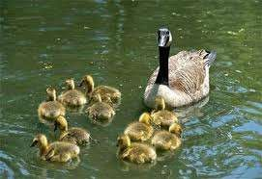
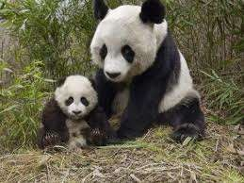
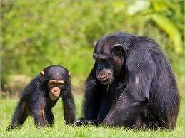
Mendelian Genetics
All living organisms reproduce.
It results in the formation of offspring of the same kind.
The resulting offspring most often do not totally resemble the parent.

Slide 3
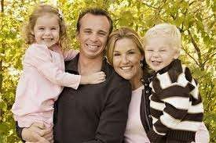


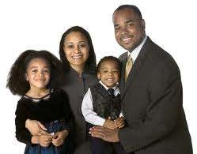
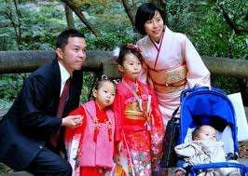
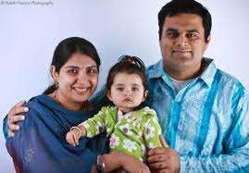

Slide 4
Genetics is the branch of life science that deals with the study of heredity and variation.
Heredity is the transmission of characters from parents to their offsprings.
Variation is the difference among the offsprings and with their parents.
Heriditary variations: These are genetical and inheritable.
Environmental variation: These are aquaired and non heritable.

Slide 5
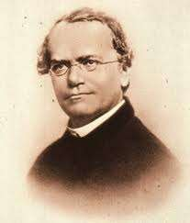
Gregor Johann Mendel: Father of Genetics
1822- 1884
Austrian monk
Hybridization Experiment with pea plants.
Published his results
“Translation of the characters” in the natural history of society of brunn
He is regarded as the 'father of genetics'

Slide 6
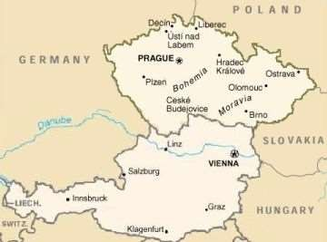
Gregor Johann Mendel
Mendel (1822-1884) was born in to the family of a poor peasant in Moravia, Austria.
He suspend his school education due to poverty in the family.
In 1843 he joined a church as a monk.
In 1847 he became the head of the monastery at Brunn, Austria (now called Bruno in Czechoslavakia).
In 1851 he went to University of Vienna to study natural history and mathematics, for two years. After his return he worked as a teacher in natural history and mathematics between 1856 and 1865.

Slide 7
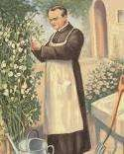
During this period, he designed breeding experiments in the pea plants.
He carefully analysed the results, gave a mathematical interpretation.
In 1865 he Published his results “Translation of the characters” in the natural history of society of brunn.

Slide 8
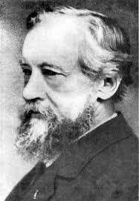
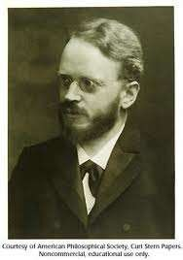
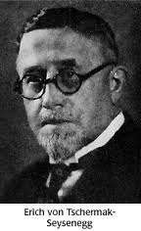
In 1900, that Mendel's work was rediscovered by three scientist independently.
Hugo de Vries in Holland,
Franz Correns in Germany,
Erich Tschermak in Austria
Mendel is regarded as father of classical genetics.

Slide 9
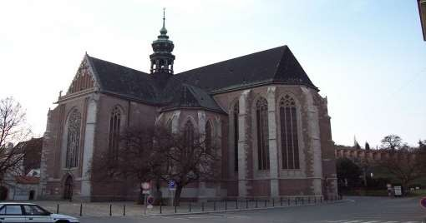
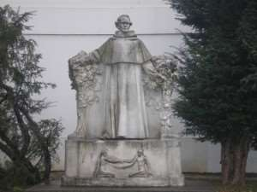
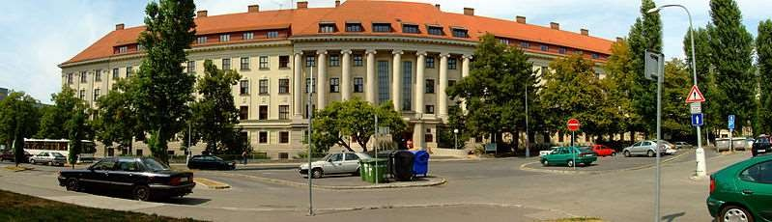
St Thomas's Abbey, mendel museum brno.
Mendel University Brno

Slide 10
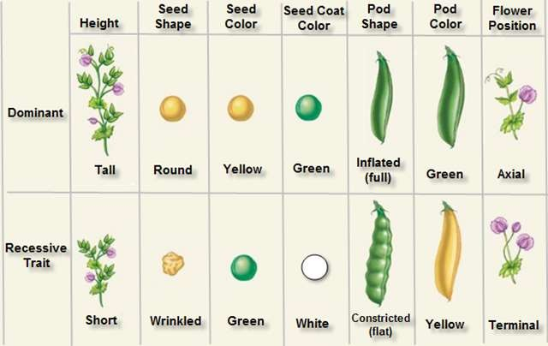
Seven pair of contrasting characters selected by mendel for his experiment.

Slide 11
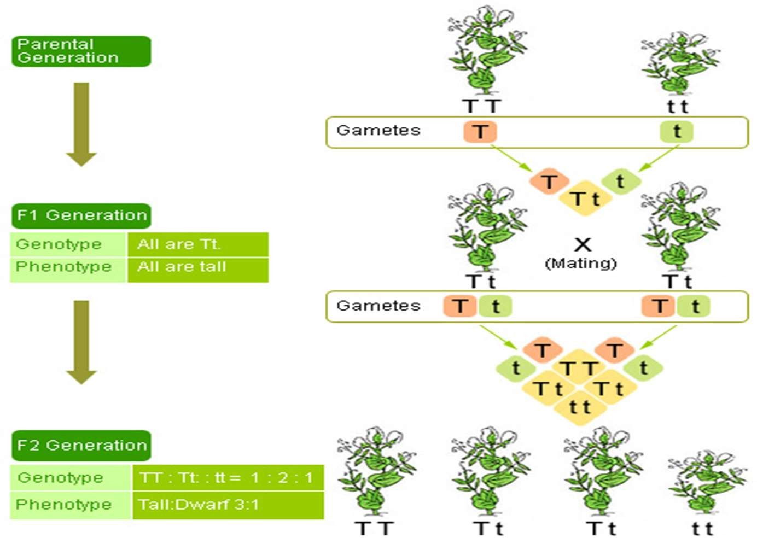

Slide 12
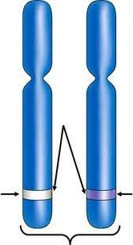
Terminologies in Genetics:
Factor or Gene: Functional unit of heredity responsible for the expression of character in the progeny.
Locus: The position of the gene on the chromosomes.
Allele: The alternative form of a gene for a contrasting character present on identical locus of homologous chromosomes.

Slide 13
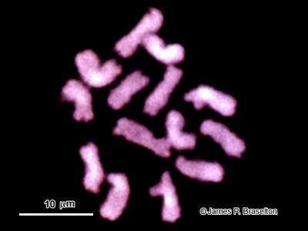
The 14 chromosomes in a root cell of a pea plant as seen with confocal scanning laser microscopy.

Slide 14
Phenotype: The external appearance of an organism due to the influence of genes and environmental factors.
Genotype: The genetic constitution of an individual responsible for the phenotype .
Phenotypic ratio: The correct proportion of phenotype in population.
Genotypic ratio: The correct proportion of geenotype in population.
Homozygous: The individual heaving identical genes in an allelic pair for a character. Ex: TT, tt.
Heterozygous: The individual heaving un- identical genes in an allelic pair for a character. Ex: Tt.

Slide 15
Dominant gene: The gene that expresses its character in heterozygous condition.
Recessive: The gene that fails to express its character in heterozygous condition.
Hybrid: The progeny obtained by crossing two parents that differ in characters.
Back cross: The cross between F1 hybrid and one of its parents.
Test cross: The cross between hybrid and its homozygous recessive parent. It is used to identify the genotype of the hybrid.

Slide 16
Mendel selected pea plant bcoz,
Pure variety are available.
Pea plants are easy to cultivate.
Life cycle of plants are only few months. So that result can be got early.
Contrasting trait are observed.
Flowers are bisexual and normally self pollinated.
Flowers can be cross pollinated only manually.
Hybrids are fertile.

Slide 17
Seven pair of contrasting characters selected by mendel for his experiment.

Slide 18
Mendelian laws of heredity.
Law of paired factors: Factors are responsible for transmission of characters. These are present in pairs.
Law of dominance: In hybrid dominant character suppresses the expression of recessive character.
Mendel’s 1st law or Law of segregation or Law of purity of gametes:
It states that, ‘when a pair of factors for a character brought together in a hybrid, they segregate (separate) during the formation of gametes.

Slide 19
Inheritance of one gene.
Inheritance of one gene can be explained by monohybrid cross.
The cross between two parents differing in one pair of contrasting character is called monohybrid cross.

Slide 20
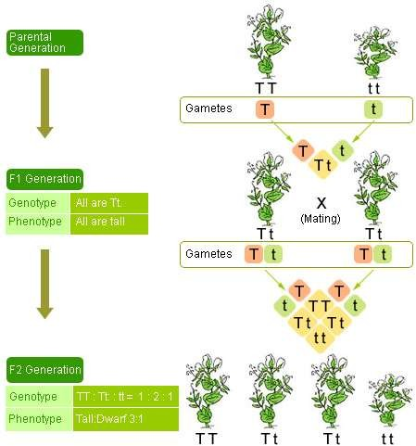
Monohybrid cross.

Slide 21
Monohybrid cross : mendel’s 1st law
Phenotype Genotype
Tall TT
x
Dwarf
tt
Homozygous Recessive
P
Homozygous Dominant
Tt
F1
All Tall
Tall is dominant to
Dwarf
Self pollinated
Heterozygous
Gamets | T | t
T | TT tall | Tt tall
t | Tt Tall | tt dwarf
F2
Phenotypic ratio 3:1
Genotypic ratio: 1:2:1

Slide 22
test cross
Test cross: The cross between hybrid and its homozygous recessive parent I called test cross. It is used to identify the genotype of the hybrid.
Hybrid Tall
Tt
X
Recessive Dwarf
tt
genotype
Gametes
T
t
t
Tt
Tall
tt
Dwarf
Phenotypic ratio: 1 : 1
genotypic ratio: 1 : 1

Slide 23
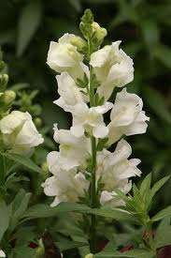
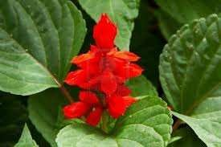
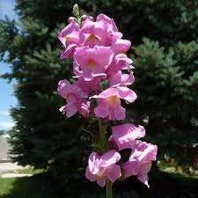
Incomplete dominance: Ex snapdragon. ( Dog flower plant)

Slide 24
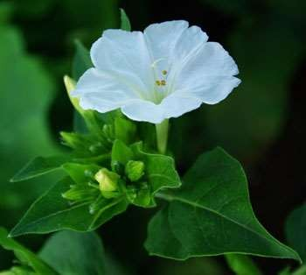
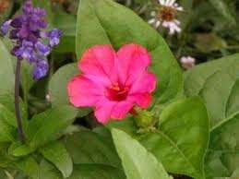
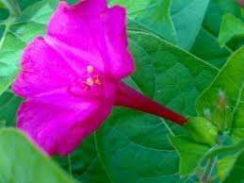
Incomplete dominance: Ex mirabilas jalapa. ( 4 o clock plant)

Slide 25
Incomlpet dominance:
Correns discovered Incomplete dominance in merabilis jalapa.
It is also called partial dominance, semi dominance.
The inheritance in which allele for a specific character is not completely dominant over other allele is called Incomplete dominance.

Slide 26
White WW W
Parent:
Genotype.
Gametes
F1 generation
Red
RR R
X
Pink
(Hybrid)
RW
selfpollination
F2 generation
The phenotypic ratio is 1:2:1.
The genotypic ratio is 1:2:1
Gametes | R | W
R | RR Red | RW Pink
W | RW Pink | WW white

Slide 27
co-dominance: Both the alleles for a character are dominant and express its full character is called co-dominance.
Ex AB blood group of human being.
Blood group in humans are controlled by 3 alleles of a gene I.
They are I^{A} I^{B} and i.
The ABO locus is located on chromosome 9.
I^{A} is responsible for production of antigen –A.
I^{B} is responsible for production of antigen –B.
i does not produces any antigen.

Slide 28
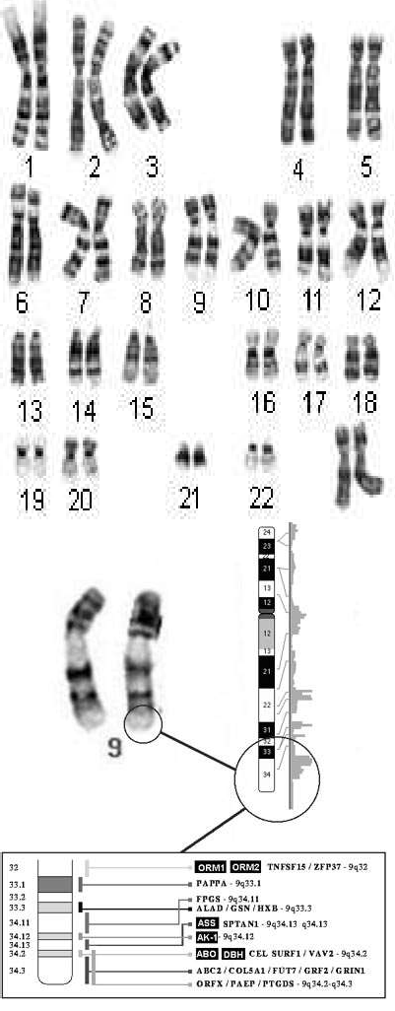
9q34 is the location, or locus of the ABO gene on chromosome 9, which codes for the ABO blood group.

Slide 29
I^{A} and I^{B} are co-dominant and dominant over i.
Blood Group | Genotype
A- Group | I^{A}I^{A} or I^{A} i
B-Group | I^{B}I^{B} or I^{B}i
AB-Group | _{I}A_{I}B
O-Group | ii

Slide 30
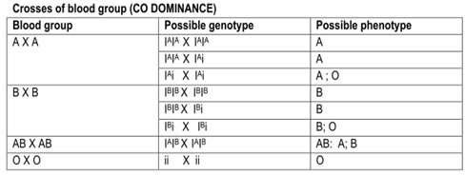

Slide 31
Parent | Parent | Child
A group | A Group | A or O
A Group | B Group | A, B, AB or O.
A Group | AB Group | A, B or AB
A Group | O Group | A or O
B Group | B Group | B or O
B Group | AB Group | A, B or AB
B Group | O Group | B or O
AB Group | AB Group | A, B or AB
AB Group | O Group | A or B
O Group | O Group | O

Slide 32
Inheritance of two gene:
Mendel’s 2nd law or Law of independent assortment:
It states that, ‘factors for different pairs of contrasting characters in a hybrid assorted (distributed) independently during gamete formation.
Mendel’s 2nd law can be explained by dihybrid
cross.
Dihybrid cross: The cross between two parents, which differs in two pairs of contrasting characters.

Slide 33
Dihybrid cross:
Parents phenotype
Round Yellow
Wrinkled Green
RRYY
RY
rryy
ry
genotype
gametes
RrYy
Round Yellow
F1 generation

Slide 34
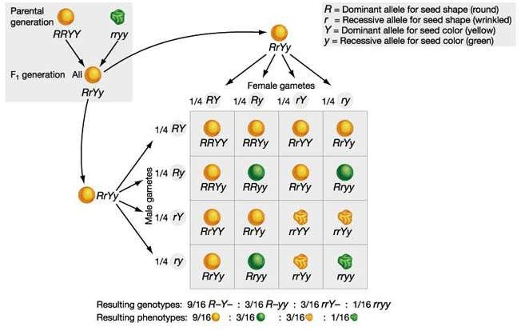
Phenotypic ratio : 9 : 3 : 3 : 1

Slide 35
Dihybrid test cross.
F1 hybrid is crossed with recessive green wrinkled pea plant.
Recessive green wrinkled – rryy, Gamet ry
F1 hybrid : round yellow- RrYy, Gamets: RY, Ry, rY, ry.
Gam ets | RY | Ry | rY | ry
ry | RrYy | Rryy | rryY | rryy
Phenotypic ratio – 1 : 1 : 1 :1

Slide 36
Chromosomal theory of inheritance:
It was proposed by Walter Sutton and Theodore Bovery .
They work out the chromosome movement during meiosis.
The movement behavior of chromosomes was parallel to the behavior of genes. The chromosome movement is used to explain Mendel’s laws.
The knowledge of chromosomal segregation with Mendelian principles is called chromosomal theory of inheritance.
According to this,
Chromosome and genes are present in pairs in diploid cells.
Homologous chromosomes separate during gamete formation (meiosis)
Fertilization restores the chromosome number to diploid condition.

Slide 37
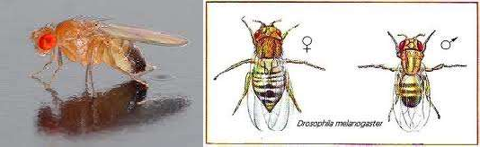
Thomas Hunt Morgan and his colleagues conducted experimental verification of chromosomal theory of inheritance .
Morgan worked with tiny fruit flies, Drosophila melanogaster.

Slide 38
He selected Drosophila because,
It is suitable for genetic studies.
Grown on simple synthetic medium in the laboratory.
They complete their life cycle in about two weeks.
A single mating could produce a large number of progeny flies.
Clear differentiation of male and female flies
Many types of hereditary variations can be seen with low power microscopes.

Slide 39
SEX DETERMINATION:
Henking (1891) traced specific nuclear structure during spermatogenesis of some insects.
50 % of the sperm received these specific structures, whereas 50% sperm did not receive it.
He gave a name to this structure as the X-body.
This was later on named as X-chromosome.

Slide 40
XX-XO type: Sex-determination of grass hopper:
The grasshopper contains 12 pairs or 24 chromosomes. The male has only 23 chromosome.
All egg bears one ‘X’ chromosome along with autosomes.
Some sperms (50%) bear’s one ‘X’ chromosome and 50% do not.
Egg fertilized with sperm having ‘X’ chromosome became female (22+XX).
Egg fertilized with sperm without ‘X’ chromosome became male (22 + X0)

Slide 41
XX-XY type: Sex determination in insects and mammals
In this type both male and female has same number of chromosomes.
Female has autosomes and a pair of X chromosomes. (AA+ XX)
Male has autosomes and one large ‘X’ chromosome and one very small ‘Y- chromosomes. (AA+XY)
In this type male is heterogamety and female homogamety.

Slide 42
ZZ – ZW type: Sex determination in birds:
In this type female birds has two different sex chromosomes named as Z and W.
Male birds have two similar sex chromosomes and called ZZ.
In this type of sex determination female is heterogamety and male is homogamety.

Slide 43
Sex linked inheritance in drosophila.
Wild verity drosophila has red eye, brown colour body and normal sized wing.
The mutated drosophila has white eye, yellow colour body short wing.
The genes responsible for colour of eye, body and wing size are present on x –chromosome.
When a red eye female drosophila is crossed with male white eye, F1 generation are red eyed.
When males and females of F1 are crossed, in F2 all females are red eyed, while 50% male are white and 50 % are red eyed.

Slide 44
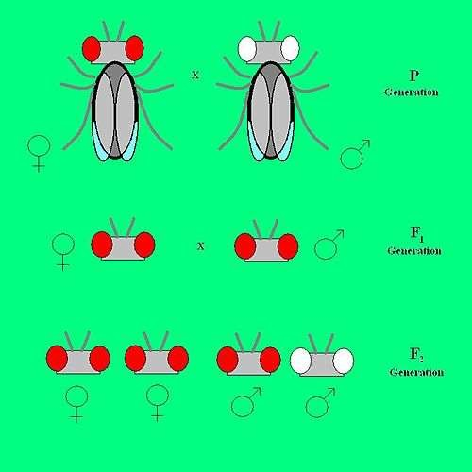

Slide 45
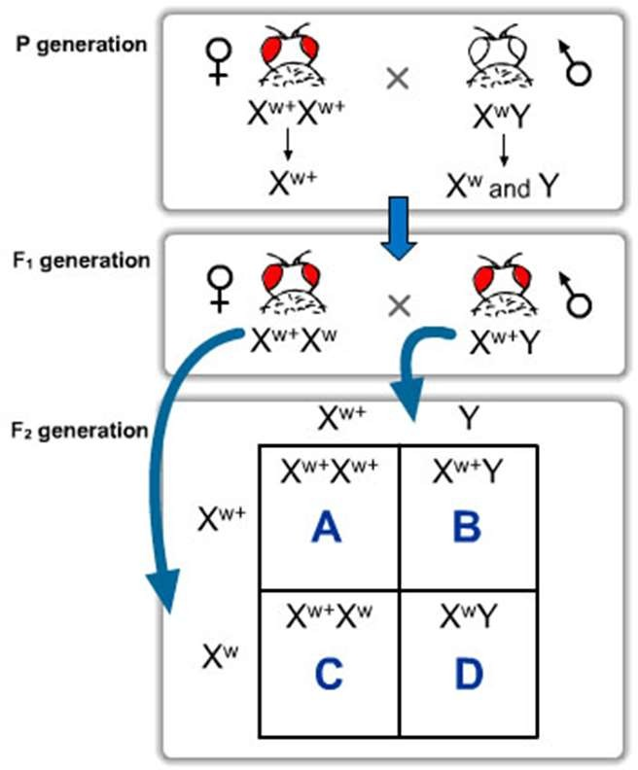

Slide 46
linkage:
Morgan crossed yellow bodied, white eyed mutant females to brown-bodied, red eyed wild type male. In f1 he got female are wild type. and intercrossed their F1 progeny.
He observed that the two genes did not segregate independently of each other. The F2 ratio deviated from 9:3:3:1 ratio.
Gene that inherited together with the other gene as they are located on the same chromosome are called linked genes. Inheritance of two genes together is called linkage.

Slide 47
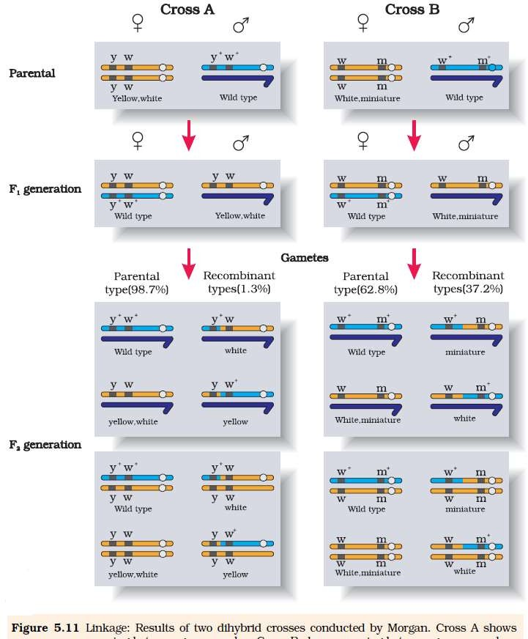

Slide 48
Morgan found that when genes were grouped on the same chromosome, some genes were very tightly linked, while others were loosely linked
Linage: physical association of genes on a chromosome is called linage.
Recombination: The generation of non-parental gene combinations is called recombination.
It occurs in crossing over of chromosomes during meiosis.

Slide 49
MUTATION:
The phenotypic variation occurs due to change in gene or DNA sequence is called mutation. The organism that undergoes mutation is mutant.
The loss (deletion) or gain (insertion/duplication) of a segment of DNA results in alteration in chromosomes. It is called Chromosomal aberrations
Gene Mutations: The mutation takes place due to change in a single base pair of DNA is called gene mutation or point mutation. E.g. sickle cell anemia.
frame shift mutations: Deletion or insertions of base pairs of DNA is called frame shift mutations.

Slide 50
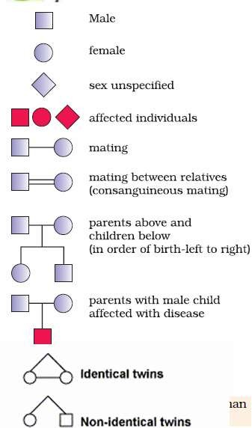
Pedigree Analysis:
The study of inheritance of genetic traits in several generations of a family is called the pedigree analysis.
It helps in genetic counseling to avoid genetic disorders.

Slide 51
Genetic disorders :
Genetic disorders grouped into two categories –
Mendelian disorder
Chromosomal disorder
Mendelian disorders are mainly determined by alteration or mutation in the single gene.
It obey the principle of Mendelian inheritance during transmission from one generation to other.
E.g. Haemophilia, colorblindness, Cystic fibrosis, Sickle cell anemia, Phenylketonuria, Thalasemia etc.

Slide 52
Chromosomal disorder
Caused due to absence or excess or abnormal arrangement of one or more chromosome.
Ex: Down syndrome, Klinefelter’s syndrome, Turner’s syndrome.

Slide 53
Hemophilia:
It is a sex linked recessive disease.
The defective individual continuously bleed to a simple cut.
The gene for hemophilia is located on X chromosome.
In this disease a single protein that involved in the clotting of blood is affected.
The diseases transmitted from unaffected carrier female to some of the male progeny.

Slide 54
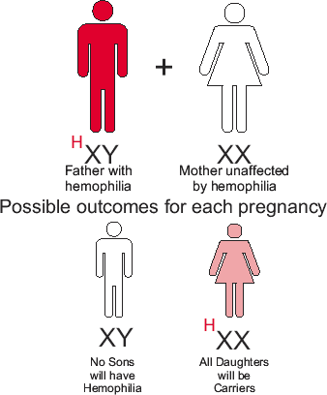

Slide 55
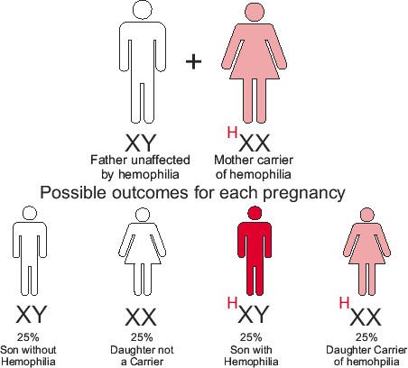

Slide 56
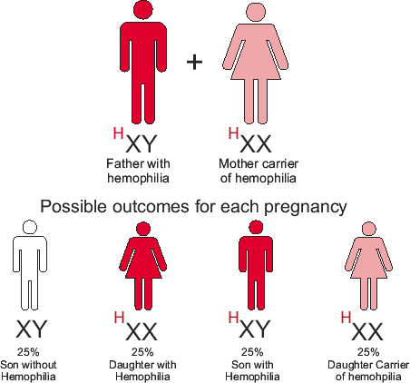
H

Slide 57
Female suffering from the disease only in homzygous condition.
Female becoming hemophilic is extremely rare because mother of such a female at least carrier and the father should be hemophilic.
Affected transmits the disease only to the son not to the daughter.
Daughter can receive the disease from both mother and father.

Slide 58
Colour blindness
The x-linked disorder in which person can not identify few colours.
The normal human retina contains two kinds of light sensitive cells: the rod cells (active only in low light) and the cone cells (active in normal daylight and responsible for color perception).
Normally, there are three kinds of
cones (each one sensitive to a specific range of wavelengths):
"red" cones (64%)
"green" cones (32%)
"blue" cones (2%)

Slide 59
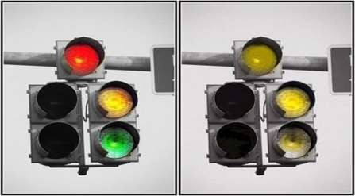
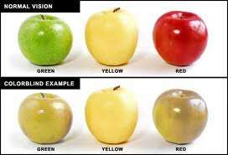
Types of colour blindness.
Monochromatism: The condition of complete colour blindness in which all colors appear as shades of gray.
Dichromatism: The condition of partial color blindness in which only two colors are perceptible
– Ex: red-green , blue-yellow.
Deltonism: the condition of colour blind peron who unable to identify Red – Green colour.

Slide 60
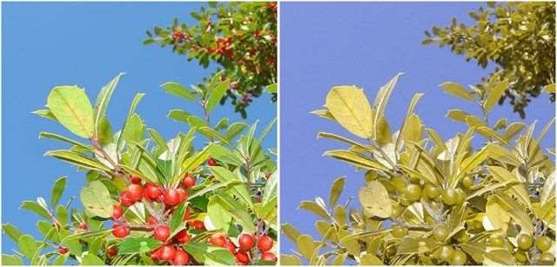
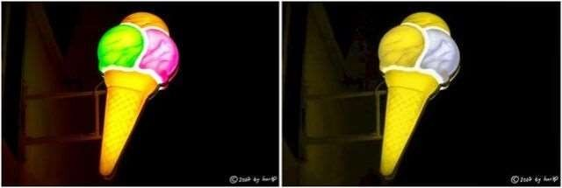
Protonopia: The colorblindness characterized by defective perception of red and confusion of red with green or bluish green.
Deuteraponia: A form of colorblindness characterized by insensitivity to green.

Slide 61
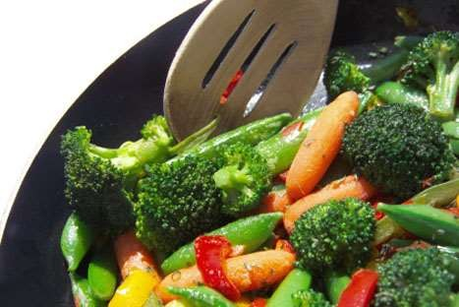
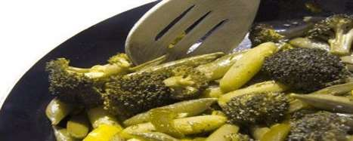
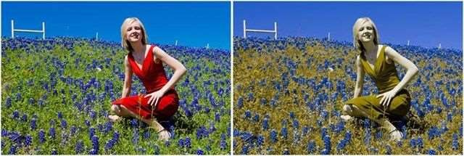
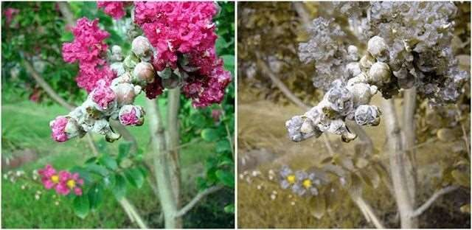

Slide 62
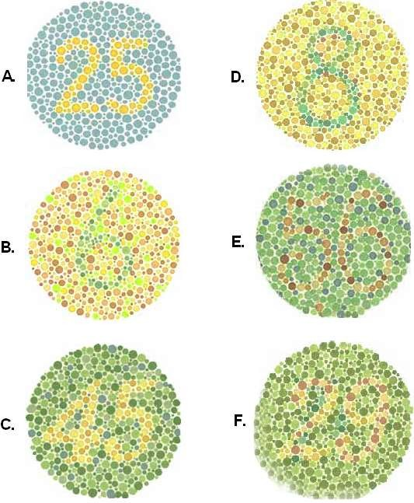


Slide 63

sickle cell anemia

Slide 64


Slide 65

down's syndromes

