Slide 1
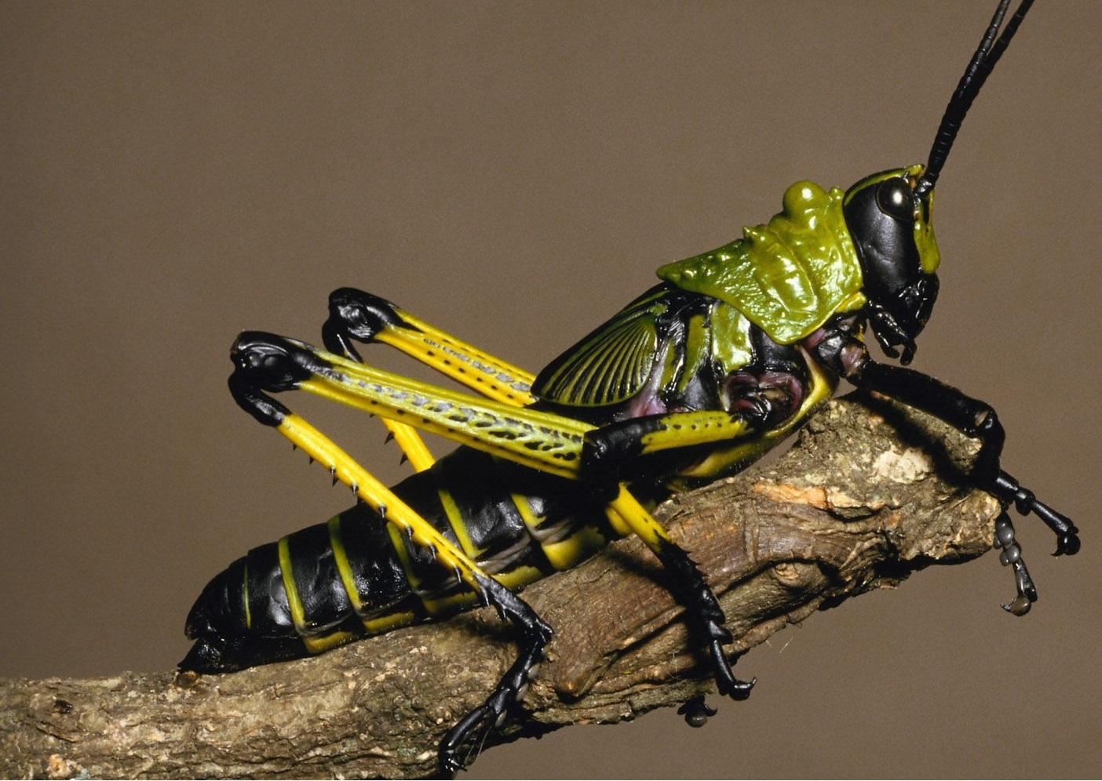

Slide 2
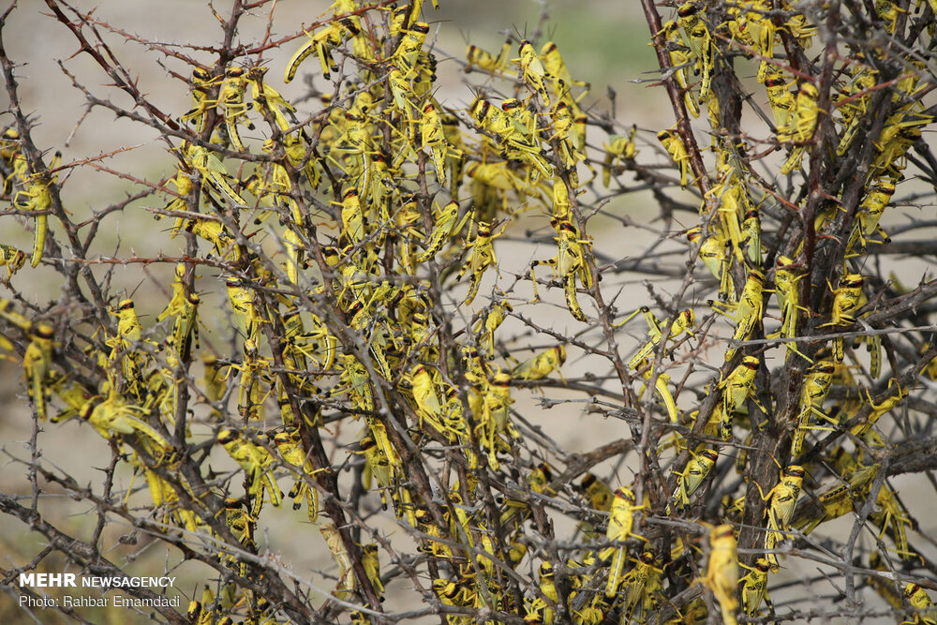

Slide 3
Population Growth and Growth Models

Slide 4
A universal characteristic of living things is that sexually mature individuals have the ability to produce ≥1 offspring.
Thus, natural populations have the ability to grow.

Slide 5
A population is the number of organisms of the same species that live in a particular geographic area at the same time, with the capability of interbreeding.
Population biology is the study of population characteristics and the factors that affect their size and distribution. The characteristics which are studied include the population density, the demographics (the birth and death rates, sex ratio and age distribution), the population genetics, the life history traits and the group dynamics (the interactions within and between populations)

Slide 6
Factors that govern Population Size
1.Crude Birth Rate (CBR)
2.Crude Death Rate (CDR)
3.Immigration
4.Emigration

Slide 7
Population growth
Population growth refers to how the number of individuals in a population increases or decreases with time
- Reflects the difference between rates of birth and death
Population Growth Models : Two types
- Exponential
- Logistic

Slide 8
The best example of exponential growth is seen in bacteria. Bacteria are prokaryotes that reproduce by prokaryotic fission. This division takes about an hour for many bacterial species.
If 1000 bacteria are placed in a large flask with an unlimited supply of nutrients (so the nutrients will not become depleted), after an hour there will be one round of division (with each organism dividing once), resulting in 2000 organisms. In another hour, each of the 2000 organisms will double, producing 4000; after the third hour, there should be 8000 bacteria in the flask; and so on.
The important concept of exponential growth is that the population growth rate, the number of organisms added in each reproductive generation, is accelerating; that is, it is increasing at a greater and greater rate. After 1 day and 24 of these cycles, the population would have increased from 1000 to more than 16 billion. When the population size, N, is plotted over time, a J-shaped growth curve is produced.

Slide 9
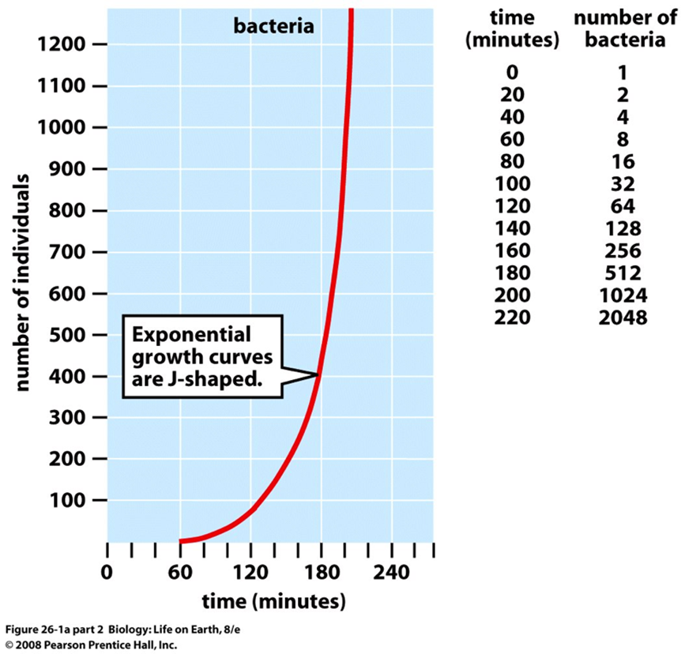

Slide 10
A population growing exponentially increases according to the equation:
N_{t} = N_{o}e^{rt} , where:
Nt = the number of individuals in the population after t units of time;
No = the initial population size (t = 0); r = the exponential growth rate; t = time unit (usually in years); e = the base of the natural logarithms

Slide 11
. The rate of increase of a population undergoing exponential growth at a particular instant in time—the instantaneous rate of increase—is the differential of the exponential equation: dN = rN , dt where: dN = change in number dt = change in time r = the per head maximum potential growth rate
N = number of individuals in a population.

Slide 12
The formula by which exponential population growth is generally represented is: dN = rN. dt
This is a differential equation in which dN is the population growth rate. dt
It refers to the change in numbers (dN) per time interval (dt) when this interval is very small, so that we are taking an instantaneous reading--a quick snapshot--of rate of growth.
If we wish to look instead at the population size at various times during exponential population growth, an equivalent expression is the integral equation:
N_{t} = N_{o}e^{rt}.

Slide 13
Exponential growth cannot continue indefinitely. Exponential growth may occur in environments where there are few individuals and plentiful resources, but when the number of individuals becomes large enough, resources will be depleted, slowing the growth rate.
Eventually, the growth rate will plateau or level off. This population size, which represents the maximum population size that a particular environment can support, is called the carrying capacity, or K.

Slide 14
Carrying capacity (K) is the number of individuals of a population the environment can support.

Slide 15
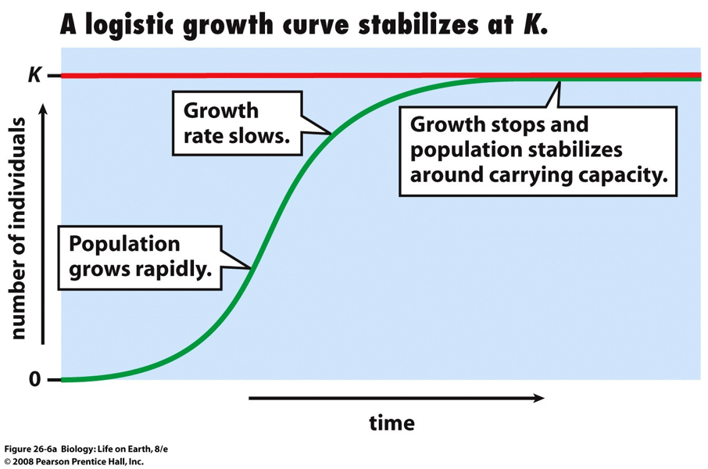

Slide 16
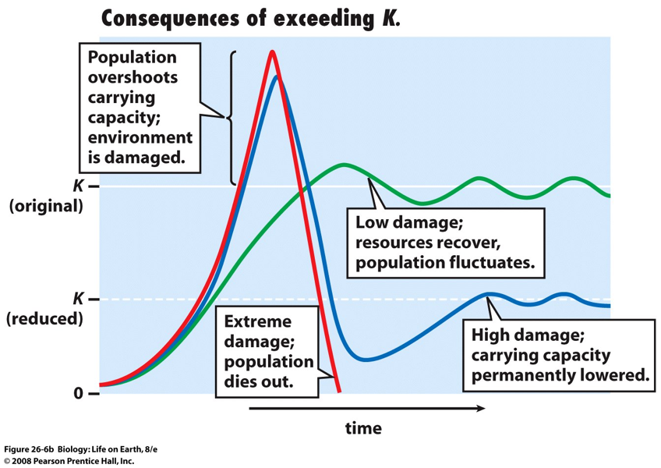

Slide 17
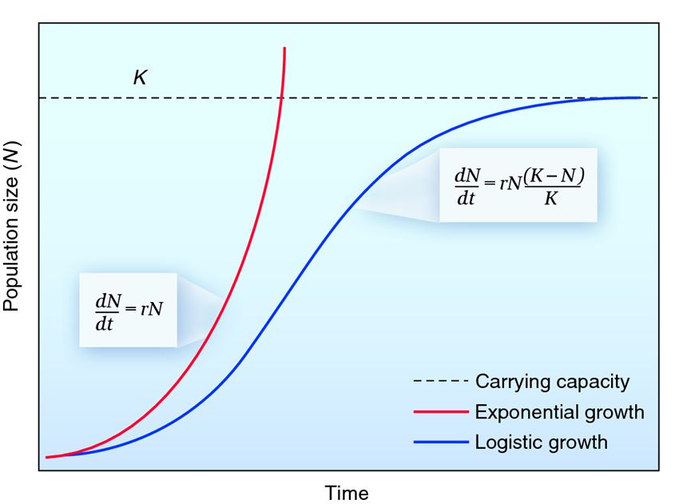

Slide 18
Some limiting factors come into play depending on the density of the population, and others are unrelated to the population density. The latter are referred to as density-independent factors.
Density dependent limiting factors are related to living organisms while density-independent limiting factors are related to the environment.

Slide 19
Density Dependent Limiting Factors
Density dependent limiting factors cause the per capita (per individual) growth rate of a population to change as the population gets larger. Some factors include:
- Competition
- Predation
- Diseases, Parasites, and Accumulation of Waste

Slide 20
Density Independent Limiting Factors
Density independent limiting factors cause abrupt and erratic shifts in population size. Small populations are particularly at risk of being wiped out by density independent limiting factors.
The category of density independent limiting factors includes fires, natural disasters (earthquakes, floods, tornados), and the effects of pollution.

Slide 21
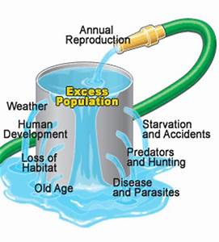

Slide 22
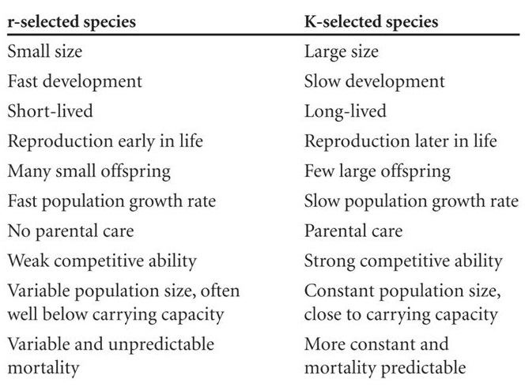

Slide 23
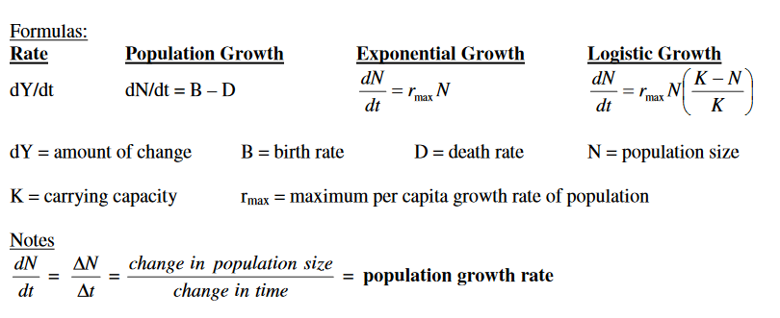

Slide 24
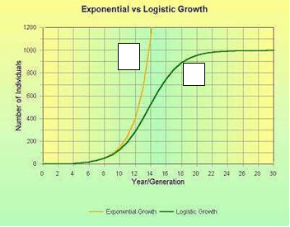
Graphs Activity : Exponential Growth and Carrying Capacity
1. Which of the two curves exhibits exponential growth?
2. Which of the two curves exhibits a carrying capacity?
3. What is the carrying capacity of this graph?
4. In what generation does this population reach its carrying capacity?

Slide 25
1. Curve 1
2. Curve 2
3. ~1000 individuals
4. Around Generation 23

Slide 26
