Slide 1

PLANT LIFE CYCLES
&
ALTERNATION OF GENERATIONS
DR. T. SAI BABU, PGT (BIOLOGY),
KENDRIYA VIDYALAYA, NAD, VISAKHAPATNAM

Slide 2
PLANT LIFE CYCLES & ALTERNATION OF GENERATIONS
In Plants, both haploid and diploid cells divide by mitosis.
Two types of different plant bodies:
a) Haploid (n)
b) Diploid (2n)
Haploid and Diploid generations alternate in plant life cycles.

Slide 3
PLANT LIFE CYCLES & ALTERNATION OF GENERATIONS
Mitosis
R D (Meiosis)
Mitosis
Haploid plant body (Gametophyte) (n)
Gametes (n)
Fertilisation
Zygote (2n)
Diploid Sporophytic Plant Body (2n)
Haploid Spores (n)

Slide 4
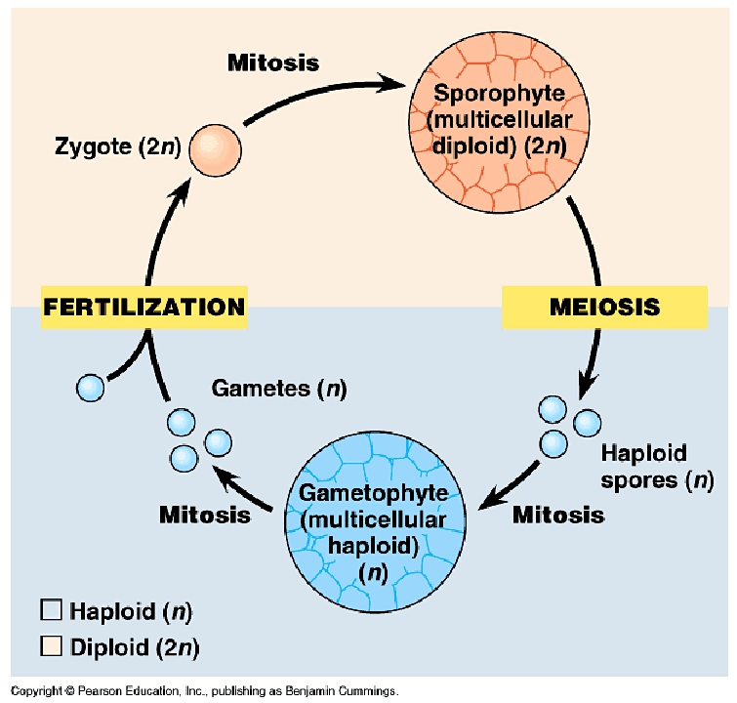

Slide 5
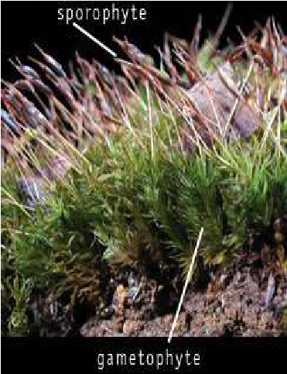
What is alternation of generations?
• First time demonstrated by Hofmeister(1851)
• Life cycle of a plant is called alternation of
generations.
• Haploid and diploid generation
alternating during life cycle
-Sporophyte ie. Multicellular ,
spore forming diploid plant str.
-Gametophyte ie. Multicellular
haploid plant structure, forms
gametes.

Slide 6
Alternation of generations in different
plants
• Depends on type of plant
• Bryophytes(mosses and ferns)
- dominant generation-haploid phase
- main plant body is composed of gametophyte
• Pteridophytes and gymnosperms
- dominant generation- diploid phase
- main plant body is composed of sporophyte.

Slide 7
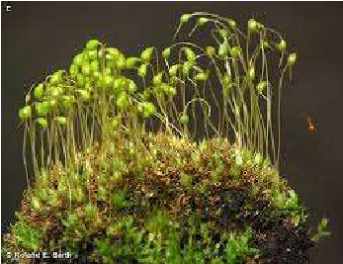
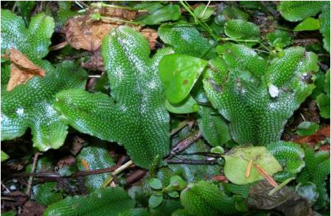
Significance:
Better chance for survival
Better adapted to environment
Newer varieties develop
Variations are produced during meiosis
•
•
•
•

Slide 8
Haplontic Life Cycle
Sporophytic generation is represented only by the one-celled zygote.
There are no free-living sporophytes.
Meiosis in the zygote results in the formation of haploid spores.
The haploid spores divide mitotically and form the gametophyte.
The dominant, photosynthetic phase in such plants is free-living gametophyte.

Slide 9
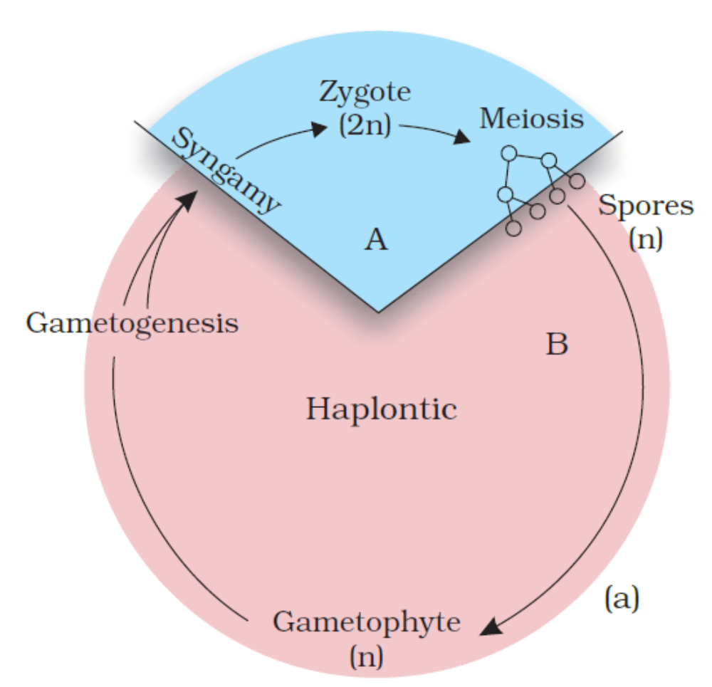
Haplontic Life Cycle
E.g. Many algae such ash Volvox, Spirogyra, Some species of Chlamydomonas.

Slide 10
Diplontic Life Cycle
Diploid sporophyte is the dominant, photosynthetic, independent phase of the plant.
The gametophytic phase is represented by the single to few-celled haploid gametophyte.

Slide 11
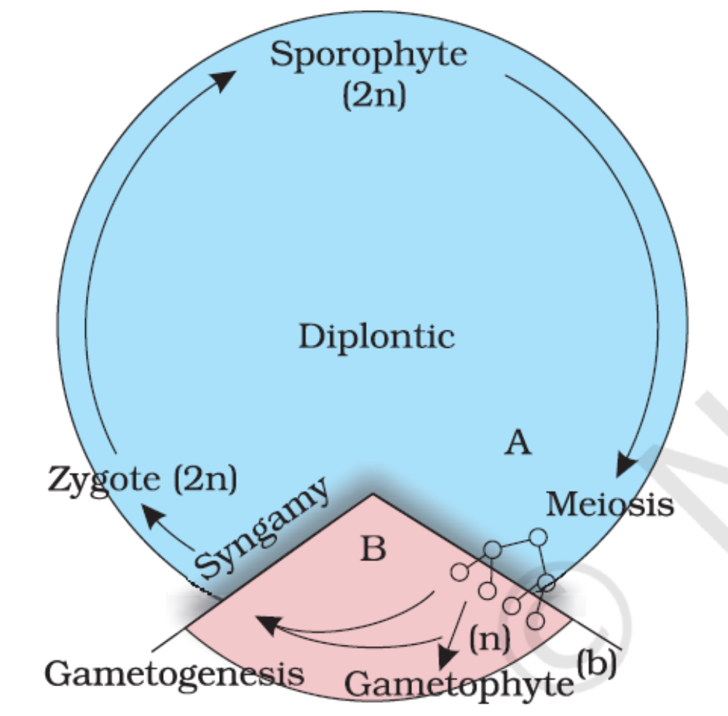
Diplontic Life Cycle
E.g. An algaFucus sp, Gymnosperms & Angiosperms.

Slide 12
Seed Plants
• About 95% of all plants, including all seed plants,
have a dominant sporophyte generation in their life
cycle
• The evolution of pollen, produced by the
sporophyte, was a key step in the adaptation of
seed plants to dry land

Slide 13
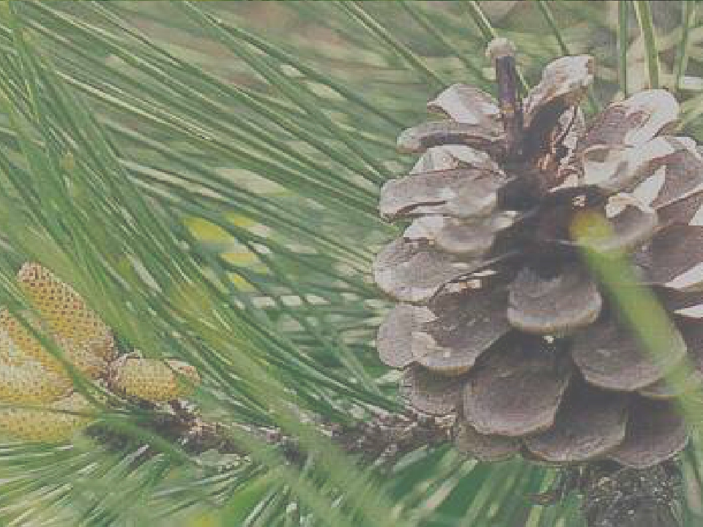
Alternation of generation
in
gymnosperms

Slide 14
-GAMETOPHYTIC STAGE
• Dependent on sporophyte for protection and
nutrition
• Haploid gametophyte found within mature
sporophyte.
• Two type of spores produced:
- Microspore ie. Male spore, undergoes mitosis to
form multicellular male gametophyte ie. Pollens
grain which are contained within the pollen cones.
- Megaspore ie.large, female spore, undergo
mitosis in order to produce the multicellular female
gametophyte. The female gametophyte is housed in
the ovulate cones which are larger and generally
easier to see than the male pollen cones.

Slide 15
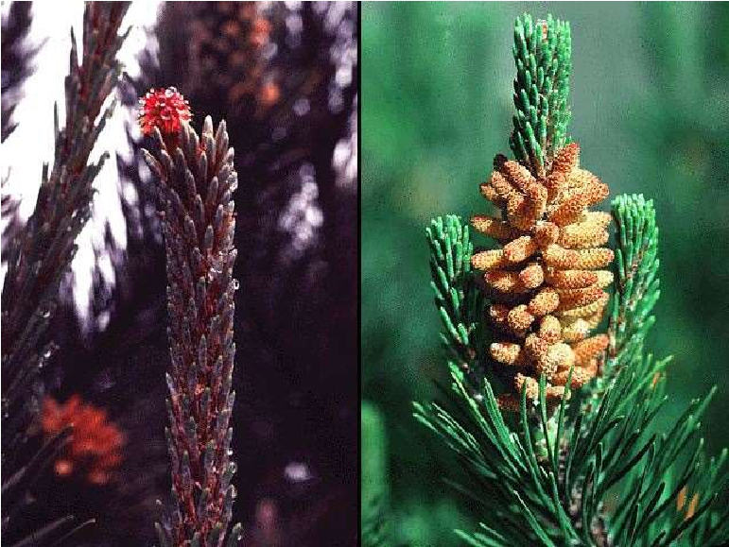
Male cone

Slide 16
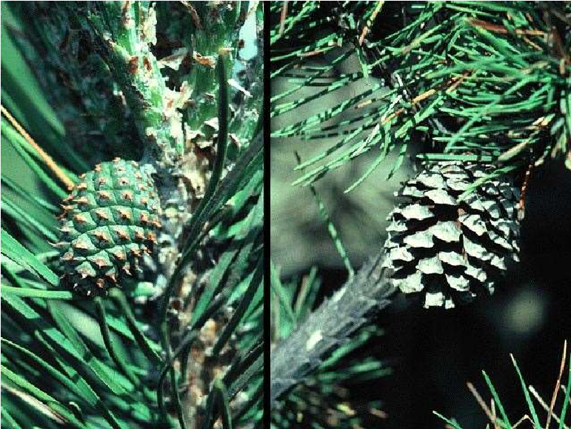
Female cone

Slide 17
• The haploid stage will continue as long as the
male and female gametophytes are kept
separate.
• In spring, the tree release large amounts of
pollen
- pollen grains that contain the male
gametophyte travel by air and hopefully land
on an ovulate cone.
• pollen tube develops in order for the newly
produced male gamete to reach and fertilize
the female gamete.

Slide 18
Seed
• Following fertilization, the zygote develops into a
sporophyte embryo, and the whole ovule
transforms into the seed.
• The seed contains the embryo’s food supply and
has a tough seed coat
• In a typical pine, seeds are shed from the cones
about 2 years after pollination
• When conditions are favorable, it germinates
• Eventually, it grows into a sporophyte.

Slide 19
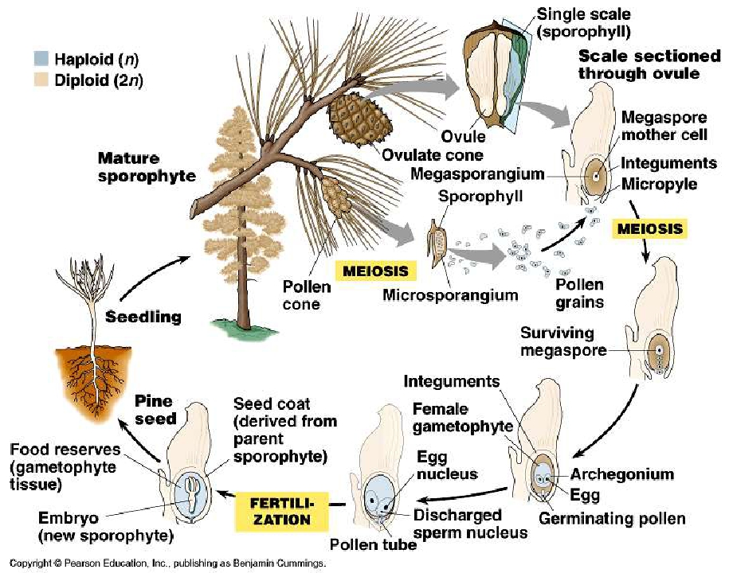

Slide 20
Gymnosperms
• A pine tree is a sporophyte
• The gametophyte generation consists of
microscopic stages that grow inside the trees cones
• Cones hold all of a conifer tree’s reproductive
structures:
–
–
–
–
Diploid sporangia- produce haploid spores by meiosis
Haploid female and male gametophytes
Gametes
Zygotes
• A pine tree bears two types of cones

Slide 21
Cones
• Female cone has many hard, radiating scales, each
bearing a pair of ovules; ovule starts out as a
sporangium
• Male cones are generally much smaller, soft, and
short-lived
– Each scale on a male cone produces many sporangia, each
of which makes numerous spores
• Male gametophytes, or pollen grains, develop from the
spores
• When male cones are mature, the scales open and
release a cloud of pollen

Slide 22
Pollination
• Pollination occurs when a pollen grain lands on
and enters an ovule
• After pollination, meiosis occurs in the ovule, and a
haploid spore cell begins developing into the
female gametophyte
• A tiny tube grow out of the pollen grain and
eventually a sperm into the egg
– Fertilization does not occur until more than a year after
pollination

Slide 23
Seed
• Following fertilization, the zygote develops into a
sporophyte embryo, and the whole ovule transforms
into the seed
• The seed contains the embryo’s food supply and has
a tough seed coat
• In a typical pine, seeds are shed from the cones
about 2 years after pollination
• The seed falls to the ground, or is dispersed by wind
or animals
• When conditions are favorable, it germinates
• Eventually, embryo grows into a tree

Slide 24
Angiosperms and Flowers
• The flower is the trademark of angiosperms
• Basic anatomy of a flower:
– Sepals- modified leaves; usually green; enclose the
flower before it opens
– Petals- usually important in attracting animal pollinators
– Stamens- the flower’s male parts; may be few or many
• Anther- sac on stamen in which pollen grains develop
– Carpel- female; consists of a stalk an ovary at the base
and a sticky tip known as the stigma
• Stigma traps pollen
• Ovary is a protective chamber containing one or more
ovules, in which the eggs develop

Slide 25
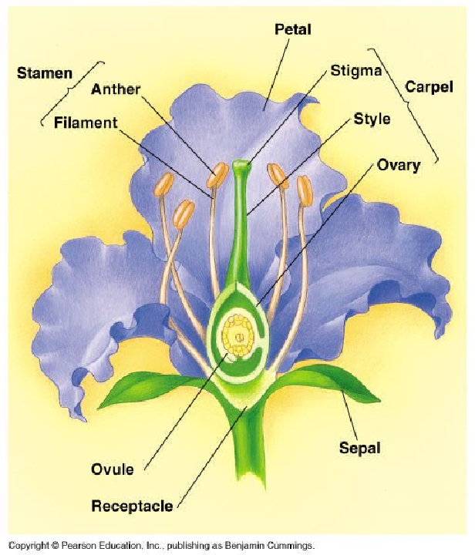

Slide 26
• Plant we see is sporophyte and tiny gametophyte
lives on it
• An angiosperm has its gametophytes in its flowers
and its seeds packaged inside fruits
• Meiosis occurring in the anthers of the flower leads
to the male gametophytes, or pollen grains
• Meiosis in the ovules leads to the female
gametophytes, each of which produces an egg

Slide 27
• Pollination occurs when a pollen grain, carried by
the wind or an animal, lands on the stigma
• A tube grows from the pollen grain to an egg, and a
sperm ferilizes the egg creating a zygote
• A seed develops from each ovule
• As the seeds develop, the ovary’s wall thickens,
forming the fruit that enclose the seeds
• The seed germinates and the embryo grows into a
mature sporophyte
• http://www.sumanasinc.com/webcontent/animations/co

Slide 28
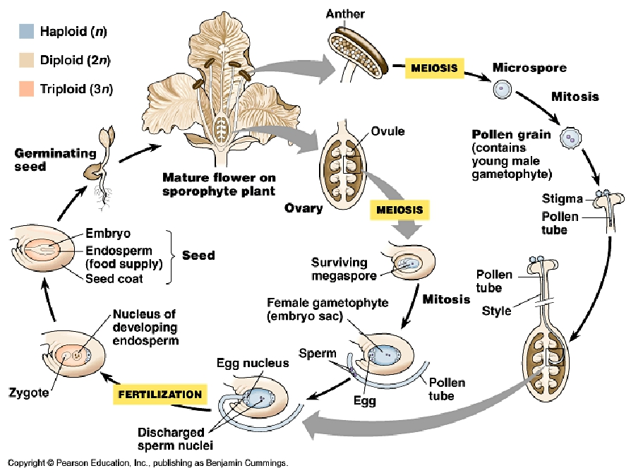

Slide 29
Haplo-Diplontic Life Cycle
Both phases are multicellular.
But they differ in their dominant phases.

Slide 30
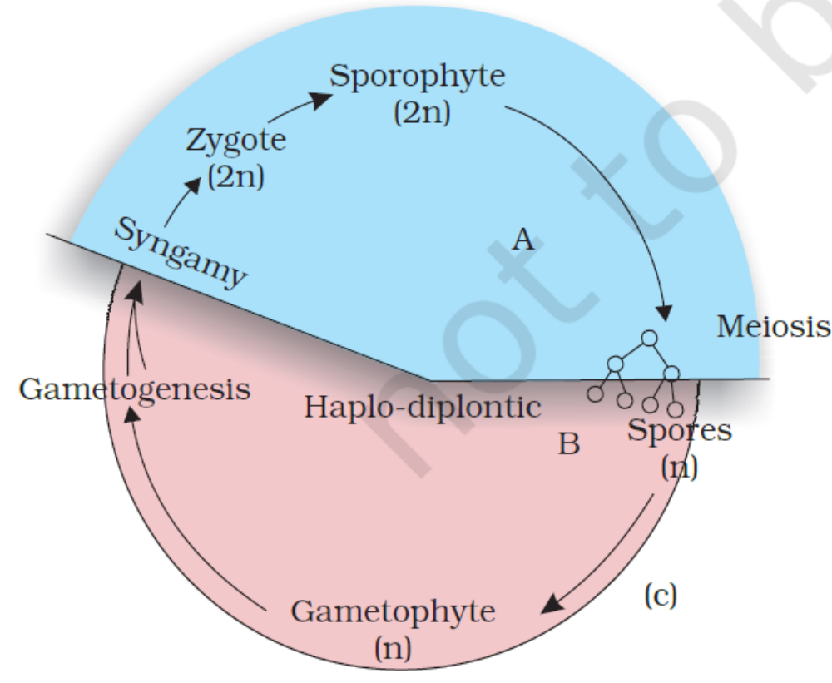
Haplo-Diplontic Life Cycle
E.g. Bryophytes & Pteridophytes.
E.g. Algae like Ectocarpus, Polysiphonia, Kelps.

Slide 31
Alternation of generation in
Bryophytes
• Haploid phase (n) is gametophytic generation or
sexual phase.
• Bears reproductive organs
- produce antherozoids and eggs
• Gametophytic stage - longer lived ,conspicuous
as compared to sporophyte.
• Gametophytic stage is dominant in life cycle.

Slide 32
• Diploid phase (2n) or the sporophytic stage
- gametic union results into the formation of zygote
which develops into sporophyte.
• Meiosis in SMC(spore mother cell)
- spore formed
- germinate to form gametophyte again.
- cycle continues with alternation b/w gametophye
and sporophyte.
• Sporophyte dependent on gametophyte
• Heteromorphic alternation of generation.

Slide 33
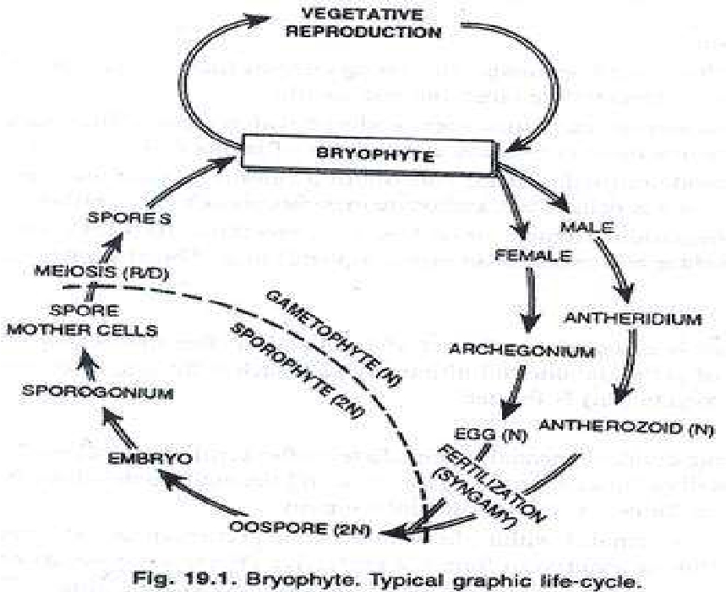

Slide 34
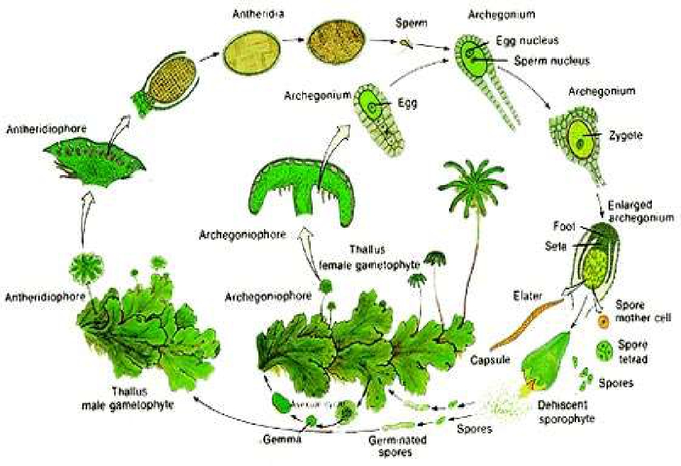
Life cycle : Marchantia sp.

Slide 35
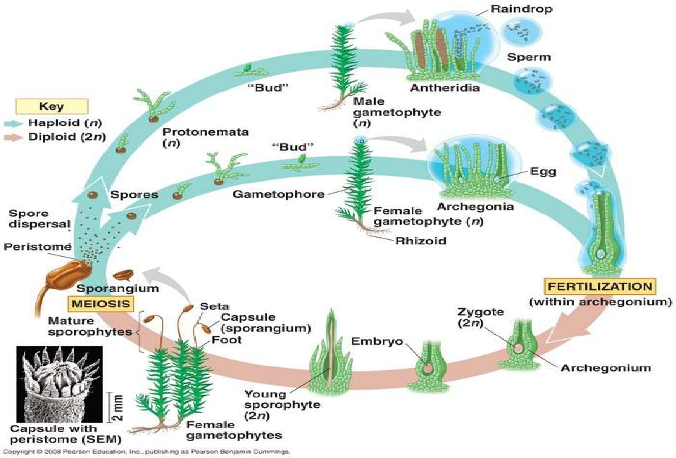
Funaria (moss): life cycle

Slide 36
Difference between moss and liverwort
life cycle
• GAMETOPHYTE
I. presence of protonema
II. Symmetry
III. Rhizoids
• SPOROPHYTE
I. Development of embryo
II. Capsule organization.
III. Photosynthetic system in cell layers of capsule in
mosses and absence in liver worts.
IV. Presence of air pores,columella

Slide 37

Alternation of generation
in
Pteridophytes

Slide 38
• Haploid phase (n) is gametophytic generation or
sexual phase.
• Bears reproductive organs
-anthredia and archegonia
• Anthredia and archegonia
- flagellate antherozoids and egg respectively.
• Gametophyte may be monoecious as in
homosporous sp. / dioecious in heterosporous sp.
• Gametophyte is independent in Pteris and
dependent in Selaginella.

Slide 39
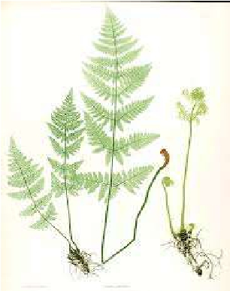
• Diploid phase (2n) or sporophytic stage
• Formed from zygote after fertilization.
• Meiosis in SMC(spore mother cell)
- non motile haploid spore formed
- germinate to form gametophyte
again.
- cycle continues with alternation
b/w gametophye and sporophyte.
• All spore formed may be of one type
ie.homosporous species(Lycopodium,Dryopteris)

Slide 40
• Spores formed may be of two types ie. Heterosporous
species (Selaginella,Marsilea):
- microspores/male spores developed in male
sporangia
-germinate to form male gametophyte
• Megaspores/female spore developed in
megasporangia.
- -germinate to form female gametophyte
• Sporophyte is dominant phase in life cycle
• independent of the gametophyte (prothallus) and
grows to a much greater size.
• sporophytes are differentiated into stems, leaves and
roots and shows well developed conducting tissues

Slide 41
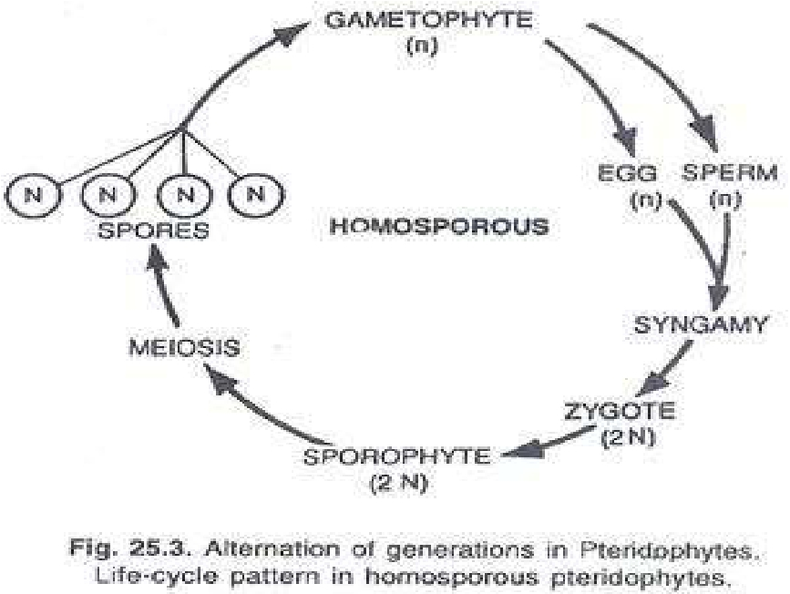

Slide 42
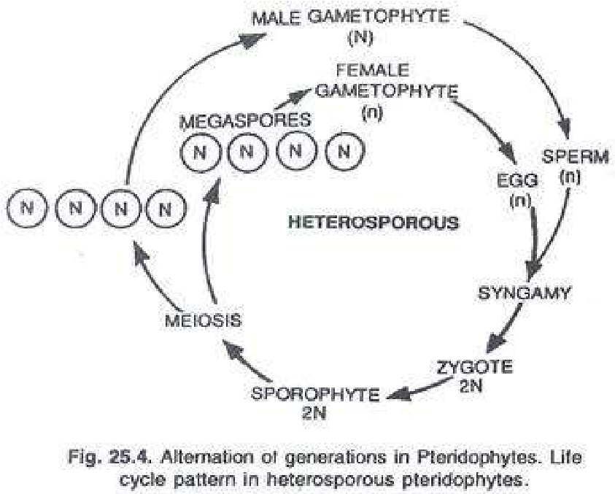

Slide 43
Ferns
• Dominant sporophyte generation
• Fern gametophytes have distinctive heartlike shape
and are small
• After fertilization, the zygote remains on the
gametophyte where it develops into the sporophyte
• Cells in sporangia undergo meiosis, producing
haploid spores
• Spores develop into gametophytes by mitosis

Slide 44
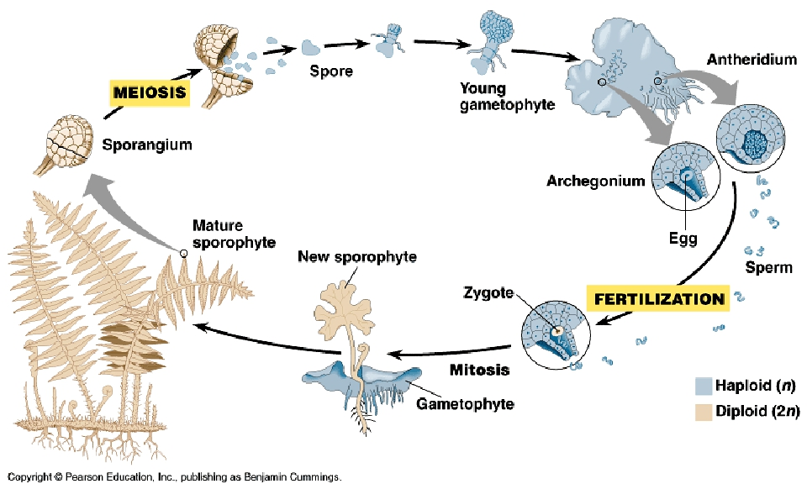

Slide 45



Slide 46





