Slide 1
RESPIRATION AS AN AMPHIBOLIC PATHWAY
BY:
SHIVANI PANDEY
PGT-BIOLOGY
KENDRIYA VIDYALAYA NO.1, JAIPUR

Slide 2
TYPES OF RESPIRATION
Anaerobic Respiration Aerobic Respiration

Slide 3
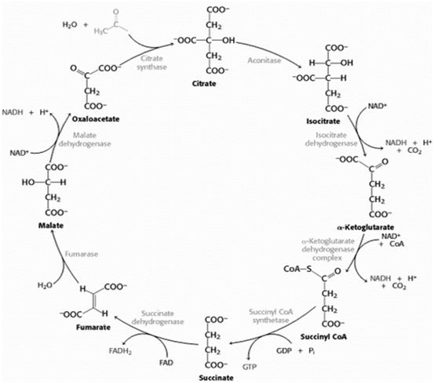

Slide 4
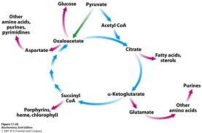

Slide 5
REFERENCES
NCERT TEXTBOOK
http://microbiollogy.blogspot.com/2013/03/microbial-metabolism-contd_3329.html
https://www.google.co.in/search?q=kreb+cycle&rlz=1C2CHBD_enIN722IN722&source=lnms&tbm=isch&sa=X&ved=0ahUKEwiTjsziyNfiAhViguYKHU3rAeAQ_AUIECgB&biw=1366&bih=657#imgrc=4_CD0HvRlpuMaM:

Slide 6
THANK YOU

