Slide 1
SHERLI KS
KV, KELTRON NAGAR
ERNAKULAM REGION
INSERVICE COURSE AT KV WALTAIR
1ST SPELL
DEMO LESSON

Slide 2
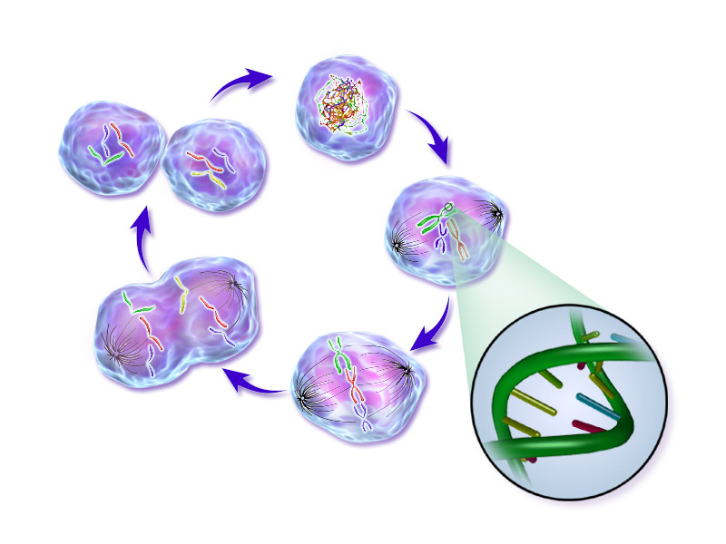
CELL CYCLE

Slide 3
Definition:
The sequence of events by which a cell duplicates its genome, synthesises the other constituents of cell and eventually divides into two daughter cells is called “ Cell Cycle”.

Slide 4
The cell cycle divided into two basic phases
Interphase :- Last more than 95% of the duration of the cell cycle (Resting Phase).
Duration of Cell Cycle: A typical eukaryotic human cell cycle- 24 Hours.
An yeast cell -90 Minutes
M Phase: Multiplicative phase.

Slide 5
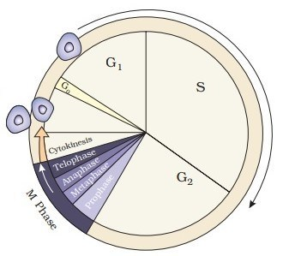
Phases of Cell Cycle

Slide 6
The cell cycle divided into two basic phases
Interphase
M Phase
Divided into three further phases,
G1 Phase (Gap I): Cell growth and protein synthesis.
S Phase (Synthesis): Duplication of DNA
G2 Phase ( Gap II): protein synthesis.
Some of the cases the cells enter into G₀ Phase (Quiescent Stage)
Karyokinesis : Prophase, Metaphase, Anaphase, Telophase
Cytokinesis: Division of the Cytoplasm

Slide 7
Evaluation:
Define cell cycle
Mention different phases of cell cycle.
Mention different phases of interphase
Mention the changes taking place during the different phases of interphases.
What do you mean by quiescent stage ?
Mention the duration of cell cycle in yeast and human cell.
Two key events take place during S-phase in animal cells; DNA replication and duplication of centriole. In which part of the cell do these events occur ?
A plant cell X has 2n=36 chromosomes, what would be the number of chromosomes and DNA after completion of G1, S and G2 phase?

Slide 8
https://www.youtube.com/watch?v=HyJ86mS2Nao&t=407s

Slide 9

Thank you………..

