Slide 1
IMAGINE THAT LIGHT IS REMOVED AND THERE IS COMPLETE DARKNESS, HOW WOULD PLANTS BE INFLUENCED?
WHY DO YOU THINK PLANTS ARE IMPORTANT IN BIOSPHERE?
HOW DO PLANTS PROPOGATE,ESPECIALLY ANGIOSPERMS?
WOULD YOU THINK ANY ENVIRONMENTAL FACTORS AFFECT PLANT PROPOGATION? IFYES,NAME THE FACTOR OR FACTORS?
CAN ANBODY NAME THREE EVENTS IN PLANT’S LIFE THAT ARE LIGHT DEPENDENT?

Slide 2
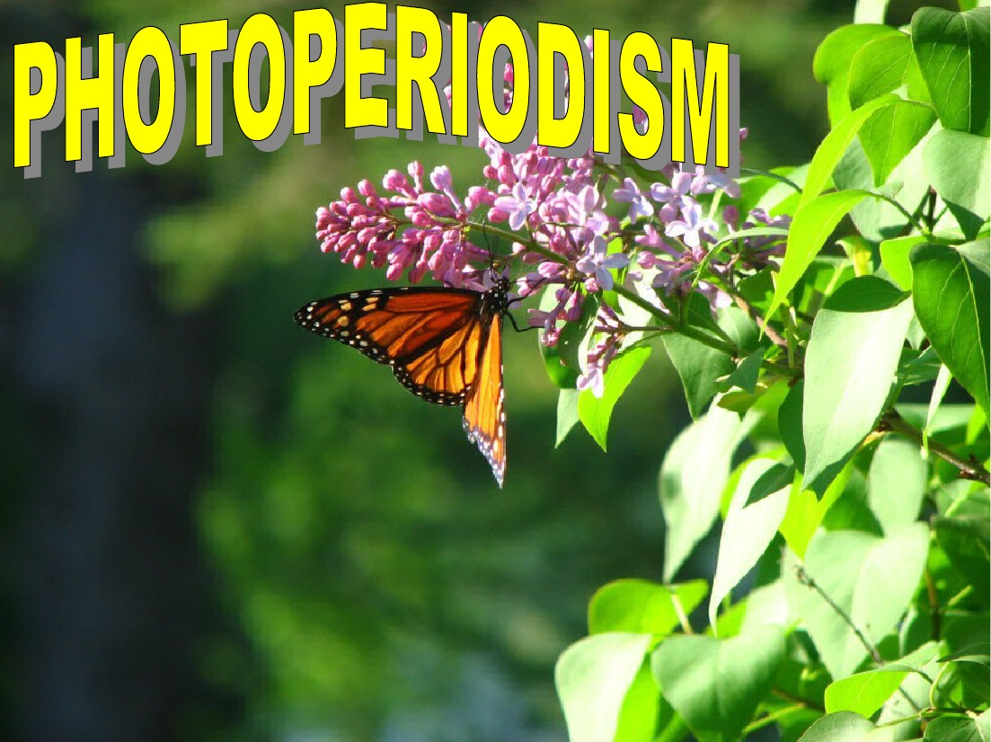
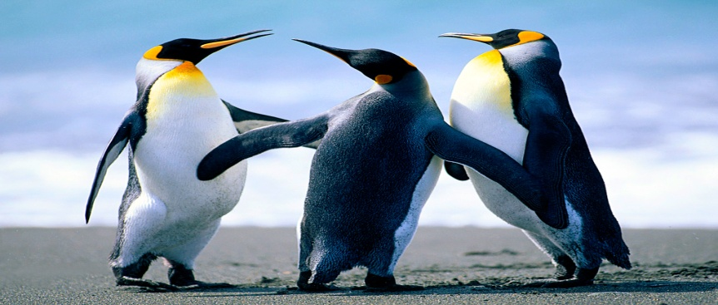

Slide 3
With a few exceptions, virtually all organisms(plants and animals) need exposure to light for a given number of hours per day for a variety of growth and reproductive functions. This day length is called PHOTOPERIOD and the phenomenon is called PHOTOPERIODISM. VERNALISATION is the term used to describe the dependence of some plants on exposure to low temperature for flowering qualitatively and quantitatively .

Slide 4
'PHOTOPERIODISM' -derived from 2 Greek words i.e., 'photos' (light) & periods(length of time).
Photoperiodism is a transducer(a mechanism that supplies signals from the environment).

Slide 5
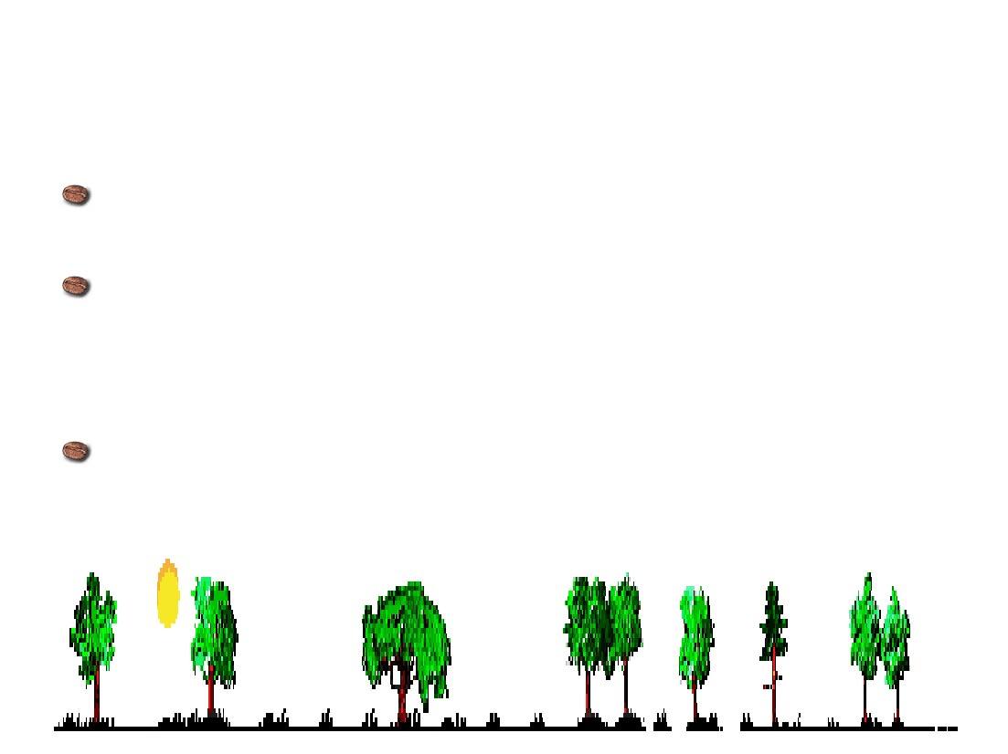
Flowering plant comprises of 2 phases i.e,vegetative & reproductive.
Under an appropriate photoperiod,plant switches from vegetative to reproductive phase,responding to synthesis of flowering hormones & its subsequent translocation to buds.(Bartholomew,1977)
The effect of daily duration of light hours(& dark periods) on the growth & development of plants, especially flowering is called PHOTOPERIODISM.

Slide 6
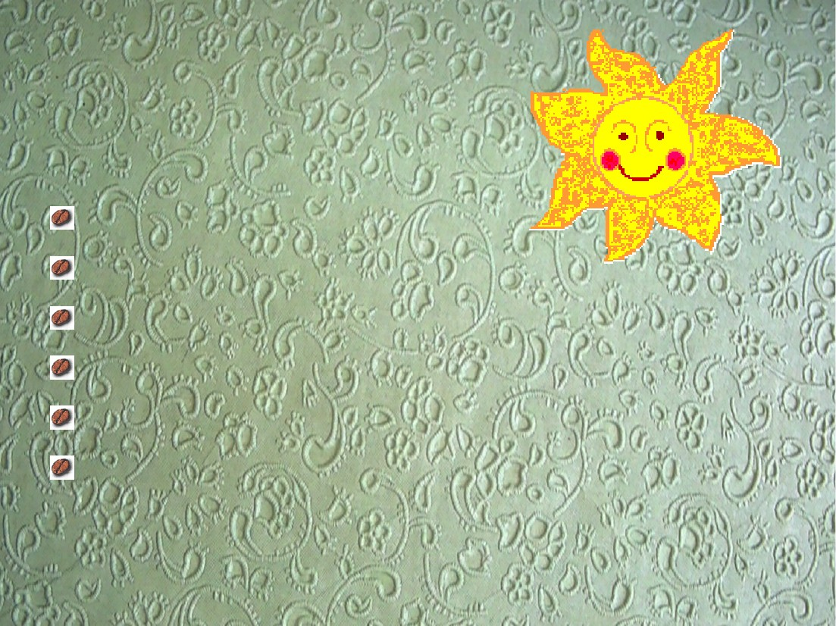
It has significant role in bud dormancy Control of vegetative trait Tuberization in plants Bulb formation Simultaneous leaf fall in deciduous tree Dark carbon fixation in CAM plants
It has a significant role in bud dormancy Control of vegetative trait Tuberization in plants Bulb formation Simultaneous leaf fall in deciduous tree Dark carbon fixation in CAM plants

Slide 7
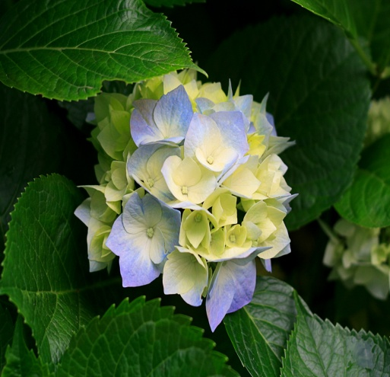
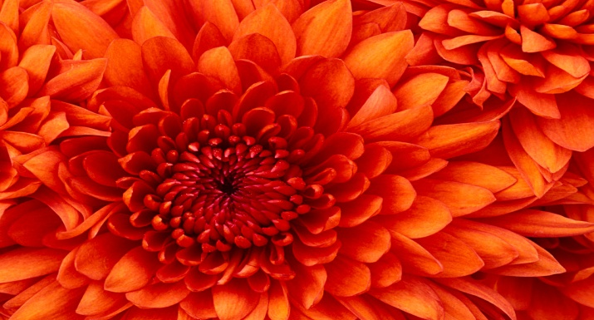
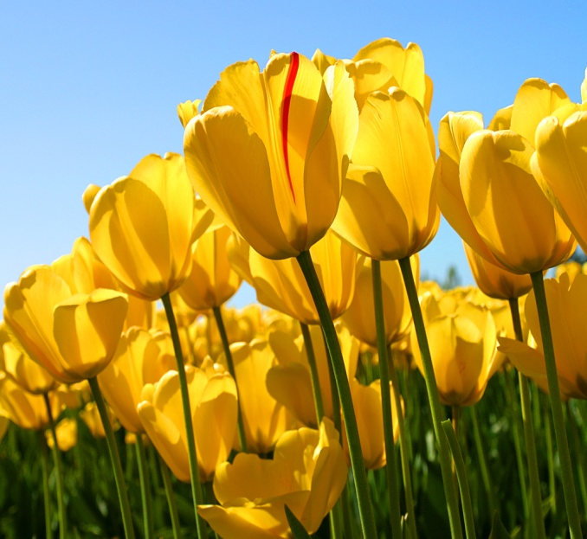
CLASSIFATION OF PLANTS BASED ON PHOTORIODISM:
SDP:-flowers when day length is shorter than critical day length. e.g. -soya bin, chrysanthemum
LDP:-flowers when day length is longer than critical day length.e.g-oat,radish,spinach
DNP:-are insensitive to day length. Flowering is controlled by endogenously.e.g-balsam,maize

Slide 8
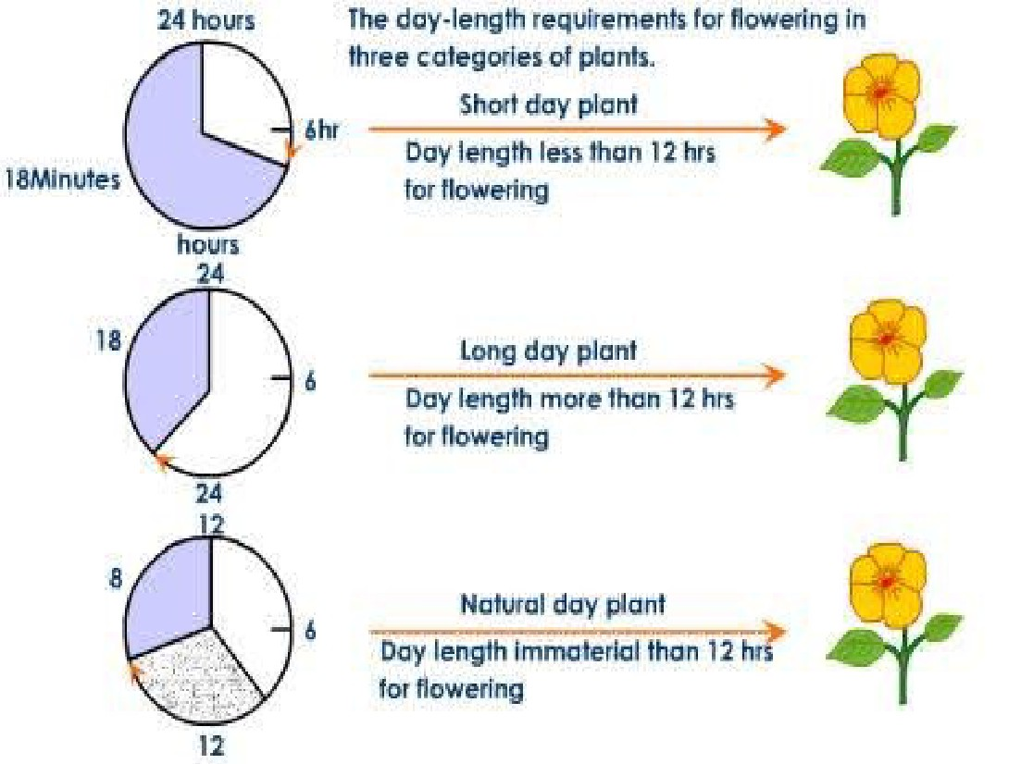

Slide 9
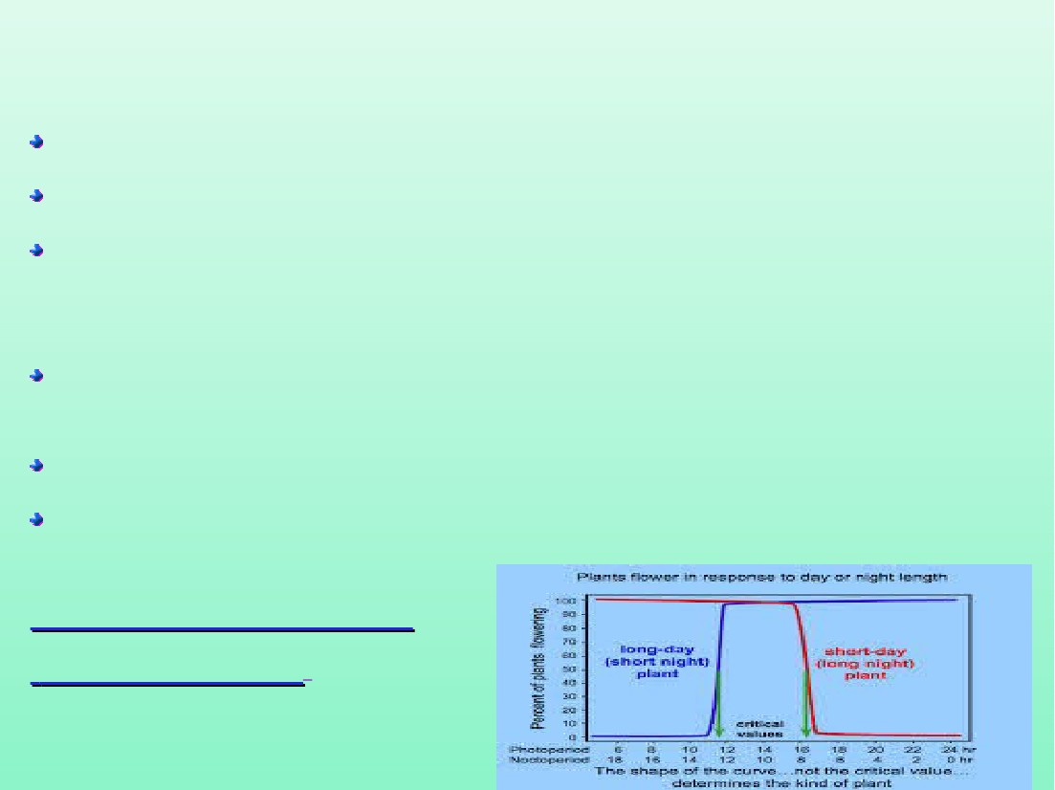
Critical Day Length
Critical day length is the photoperiod required to induce flowering
It varies from species to species.
e.g-Xanthium(SDP) requires a critical day length of 15.5hrs(15.5 light/8.5 dark).if the plant gets less than 8.5hrs of dark it fails to flower.
There is no relation with total day length.
Critical photoperiod mustn't be exceeded in short day plants & should always be exceeded in long day plants.
A single photoperiodic cycle which induces flowering-Inductive cycle is called photoperiodic induction.

Slide 10
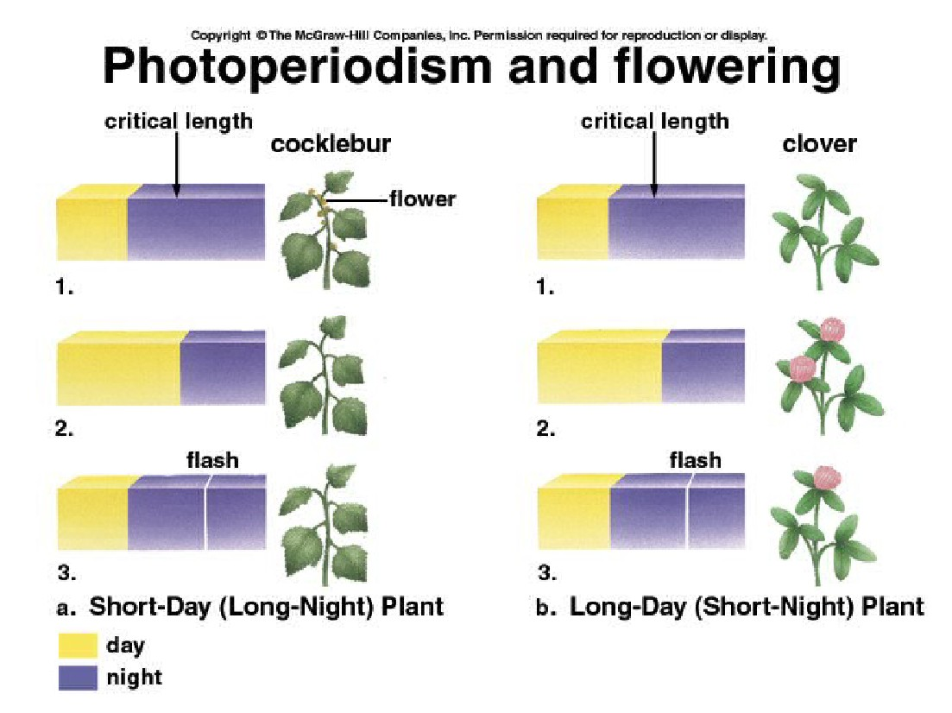

Slide 11
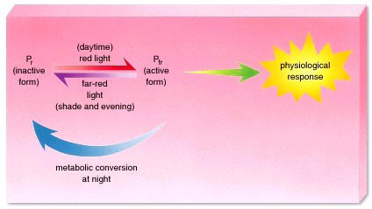
The above observations indicate presence of some pigment in the leaf which must be photoreversible.
Several expt.s indicate that light is absorbed by a
photoreversible pigment -PHYTOCHROME
● This is a bluish biliprotein and exists in 2 interconvrtible forms- Pr & Pfr
● Pr form of phytochrome absorbs Red light & converts into Pfr form.
● The Pfr form of phytochrome absorbs far red light &
converts to Pr form under continuous darkness.

Slide 12
Flowering stimulus :Florigen
The hormone which induces flowering-florigen is produced in leaves & apices and conveyed to meristem.
M.K. Chailakhyan(1953) gave the concept of 'florigen‘
{Greek word meaning- flower maker}
It hasn't yet been identified or extracted;hence hypothetical.
It is only synthesized in favourable photoperiodic conditions.

Slide 13
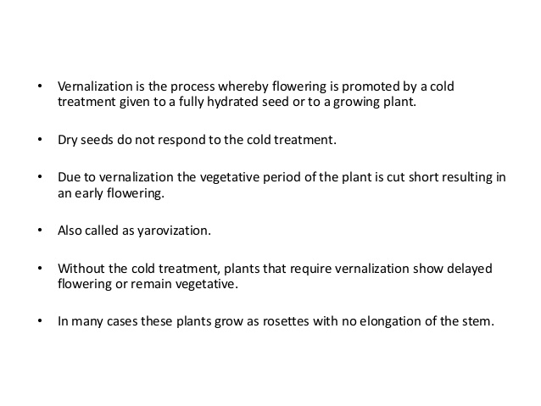

Slide 14
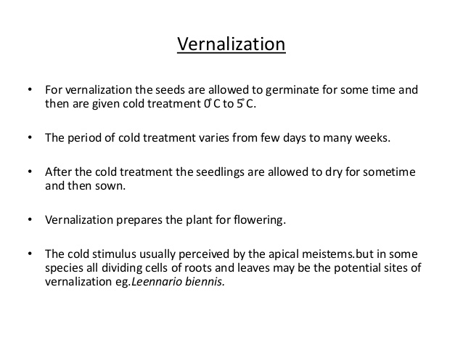

Slide 15
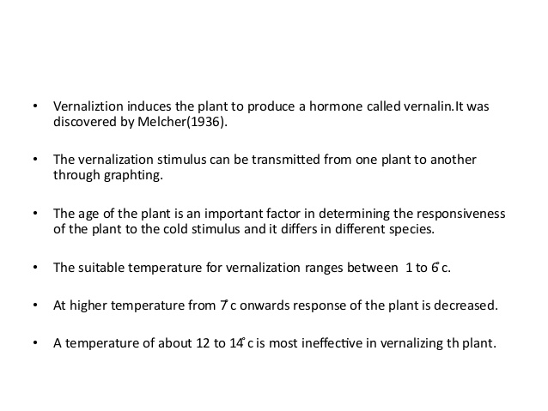

Slide 16
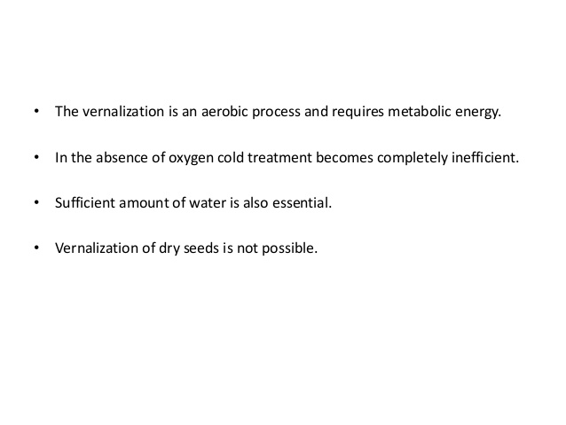

Slide 17
QUESTIONS FOR RECAPITULATION
1.Photoperiodism is
a.Growth curve in response to light b.Recurrence of day & night
c.Flowering plant d.Effect of day length on plant growth
2.Photoperiodism is associated with
a.Chiorophyll b.florigen c.auxin d.gibberellin
3.When the dark period of short day plant is interruptedby a brief exposure of light,then the plant
a.Will not flowerat all b.flower immediately c.give more flowers
d. Turn into long day plants
4.Which of the flowering hormonescan replace vernalisation
a.auxin b.gibberellin c.cytokinin d.ethylene
5.Which one of the following is theexample of physiological preconditioning
a.Photosynthesis b.respiration c.photoperiodism d.vernalisation

Slide 18
SUGGESTED READING :
Links for extra information,online study material and question banks:
https://www.extramarks.com.syllabus
https://www.quora.com
Websites :
Khan academy
MIT Open Courseware
edX
Academic Earth
Biology on tips etc.
Reference Books:
Plant Physiology-Salisbury &Ross
Outline of Plant Physiology-Robert M Devlin
Fundamentals of Plant Physiology-Dr.V K Jain
Plant Physiology-S N Pandey & B K Sinha

Slide 19
Thank you
E Vandana
PGT Biology
KV AFS Hakimpet

