Slide 1
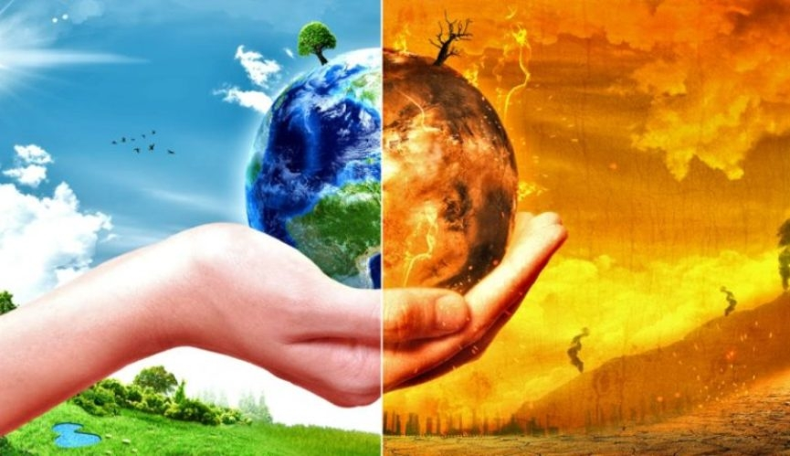
Ozone layer depletion and its effects

Slide 2
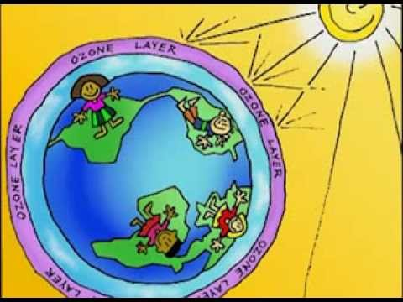
Ozone layer
Ozone is the highly reactive form of oxygen.
It exists both within the troposphere and stratospheric zones of the earth’s atmosphere.
In the troposphere, ground level ozone is a major air pollutant.
In the stratosphere it acts as an essential protector of life on earth as it absorbs harmful UV radiation before it reaches the earth.

Slide 3
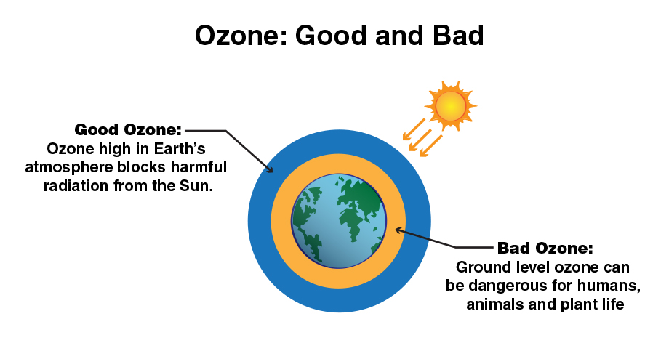

Slide 4
UV rays are highly injurious to living organisms.
DNA and proteins of living organisms preferentially absorb UV rays, and its high energy breaks the chemical bond within these molecules.
The thickness of ozone is measured in terms of Dobson units [DU].

Slide 5
How is ozone formed?
Chemically forms when UV hits on stratosphere, oxygen molecules dissociate into atomic oxygen.
O₂→O+O
Atomic oxygen quickly combines oxygen molecules to form ozone.
O+O₂→O₃

Slide 6
OZONE DEPLETION
There should be a balance in the production and degradation of ozone in the stratosphere.
Of late, the balance has been disrupted due to enhancement of ozone degradation by chlorofluorocarbons[CFCs], commonly used as refrigerants.
CFCs from lower part of atmosphere move up to the stratosphere.

Slide 7
In stratosphere, they get broken down by powerful UV radiations, releasing chlorine free radical.
CF₂Cl₂ → Cl + CF₂Cl
The chlorine radical then react with
stratospheric ozone to form chlorine monoxide
radicals and molecular oxygen.
Cl + O₃ → ClO + O₂

Slide 8
Reaction of chlorine monoxide radical with
atomic oxygen produces more chlorine radicals.
ClO + O → Cl + O₂
The chlorine radicals are continuously
regenerated and cause the breakdown of ozone.
Thus, CFCs are transporting agents for
continuously generating chlorine radicals into
the stratosphere and damaging the ozone layer.

Slide 9
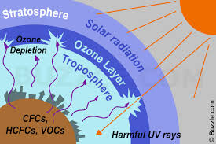

Slide 10
OTHER CAUSES OF OZONE DEPLETION
Man-made Causes
Halons [HCFCs]
Methyl Chloroform
Natural Causes

Slide 11
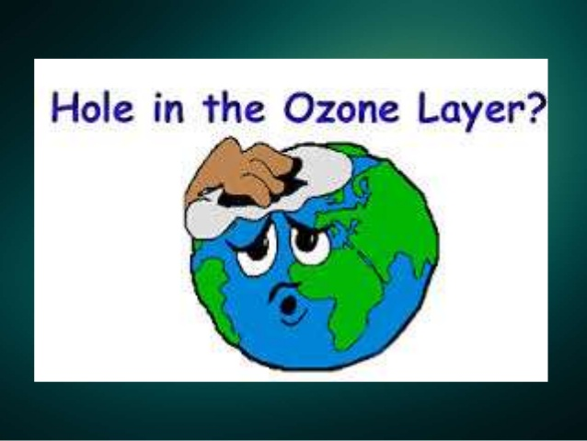

Slide 12
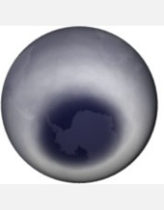
THE OZONE HOLE
Although ozone depletion is occurring widely in the stratosphere, the depletion is particularly marked over the Antarctic region.
This has resulted in the formation of a large area of thin ozone layer, commonly called the ozone hole.

Slide 13
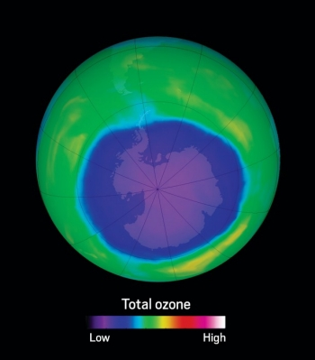

Slide 14
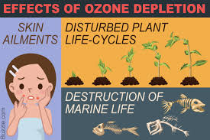

Slide 15
With the depletion of ozone layer, more UV-B radiation filters into troposphere.
UV-B radiations lead to ageing of skin, cataract, sunburn, skin cancer, killing of many phytoplanktons, damage to fish productivity etc.
It has also been reported that plant proteins get easily affected by UV radiations which leads to the harmful mutation of cells.
It also increases evaporation of surface water through the stomata of the leaves and decreases the moisture content of the soil.
Increase in UV radiations damage paints and fibers, causing them to fade faster.

Slide 16
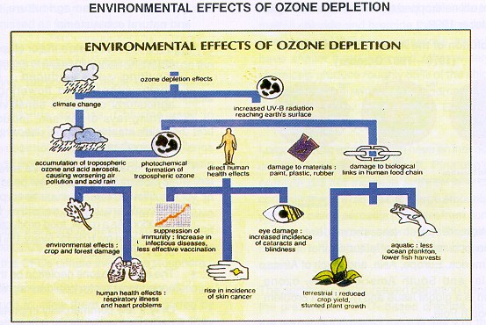

Slide 17
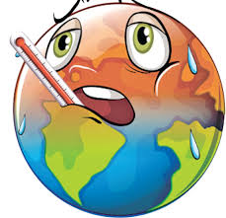
Ozone depletion and global warming
While the general public tends to see global warming as a subset of ozone depletion, in fact ozone and chemicals such as chlorofluorocarbons (CFCs) and other halocarbons, which are held responsible for ozone depletion, are important greenhouse gases.
The same CO₂ radiative forcing that produces global warming is expected to cool the stratosphere. This cooling, in turn, is expected to produce an increase in ozone depletion in polar area and frequency of ozone holes.

Slide 18
MEASURES TO PREVENT OZONE DEPLETION
Limit private vehicle driving.
Use eco-friendly household cleaning products.
Avoid using pesticides.
Developing stringent regulations for rocket launches.
Banning the use of dangerous nitrous oxide.

Slide 19
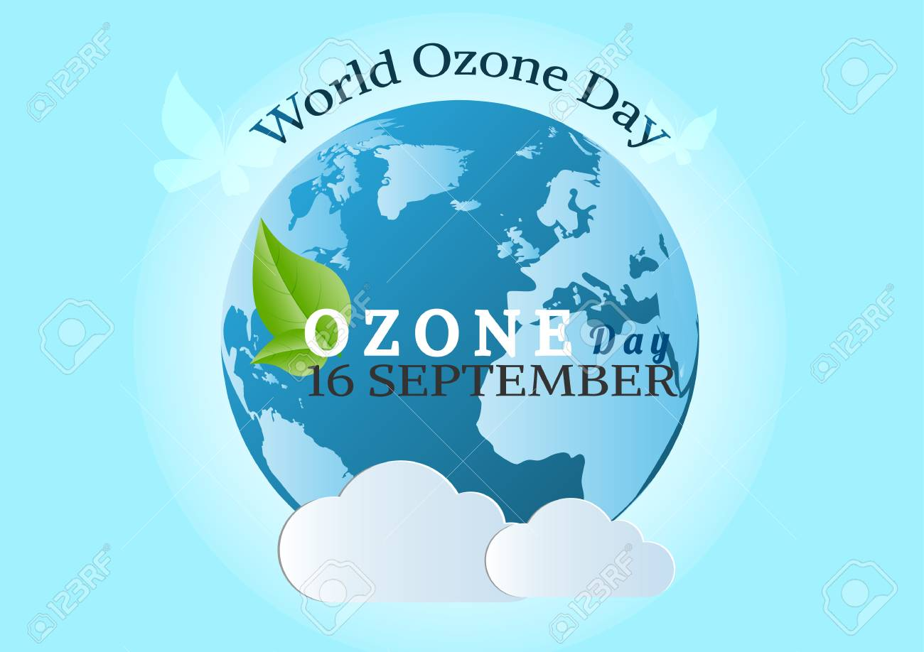

Slide 20

In 1994, the United Nations General Assembly voted to designate September 16 as “World Ozone Day”, to commemorate the signing of the Montreal Protocol in 1987 to control the emission of ozone depleting substances.
Subsequently many more efforts have been made and protocols are laid down definite roadmaps for reducing the emission of ozone depleting chemicals.

Slide 21

CONCLUSION
There is no doubt that the problem of ozone depletion exists and deserves extensive research and attention. With the release of each and every CFC, our ozone layer takes one small step towards its destruction. The decision to ban CFCs completely should be taken. The entire world must unite in order to expel this problem forever.

Slide 22
REFERENECS
https://www.epa.gov/ozone-layer-protection/health-and-environmental-effects-ozone-layer-depletion
https://en.wikipedia.org/wiki/Ozone_depletion
https://socratic.org/questions/what-are-the-causes-and-effects-of-ozone-depletion
https://www.scirp.org/journal/PaperInformation.aspx?PaperID=63065

Slide 23
Thank you

