Slide 1
RECOMBINANT DNA AND SELECTION OF RECOMBINANTS

Slide 2
GIST
Preparation of rDNA
Introduction into host
Selection of host having gene of interest

Slide 3
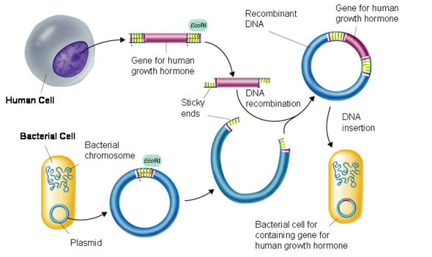

Slide 4
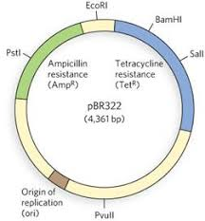
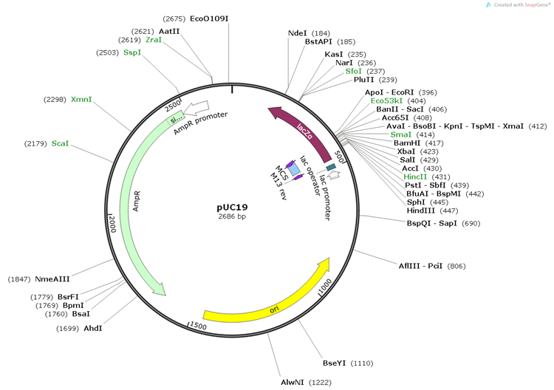

Slide 5
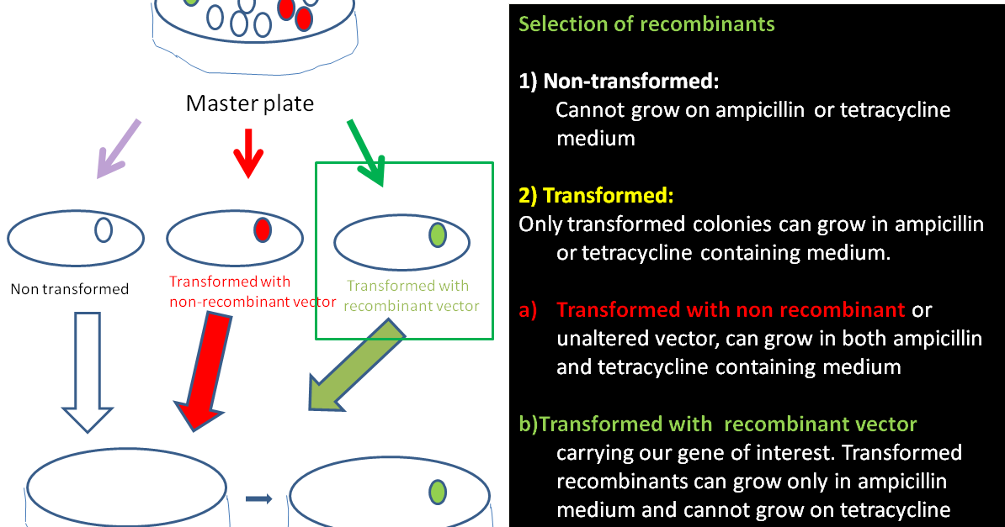

Slide 6
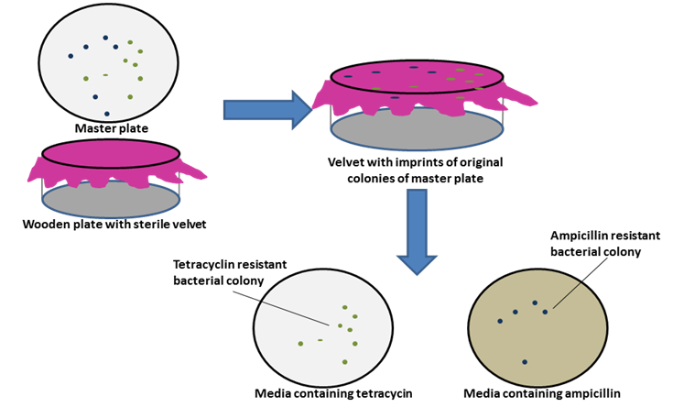

Slide 7
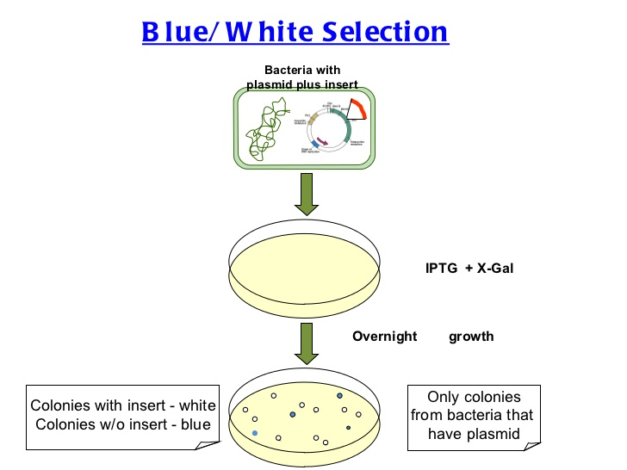

Slide 8

https://youtu.be/eA9Kw4d_O9Y?t=8

Slide 9
EVALUATION
1. 'Restriction' in Restriction enzyme refers to:
a. Cleaving of phosphodiester bond in DNA by the enzyme b. Cutting of DNA at specific position only
c. Prevention of the multiplication of bacteriophage in bacteria d. All of the above
2. A recombinant DNA molecule can be produced in the absence of the following:
a. Restriction endonuclease b. DNA ligase c. DNA fragments d. E.coli
3. An antibiotic resistance gene in a vector usually helps in the selection of:
a. Competent cells b. Transformed cells c. Recombinant cells d. None of the above
4. Significance of 'heat shock' method in bacterial transformation is to
facilitate:
a. Binding of DNA to the cell wall b. Uptake of DNA through membrane transport proteins c. Uptake of DNA through transient pores in the bacterial cell wall d. Expression of antibiotic resistance gene

Slide 10
5. The role of DNA ligase in the construction of a recombinant DNA
molecule is:
a. Formation of phosphodiester bond between two DNA fragments b. Formation of hydrogen bonds between sticky ends of DNA fragments c. Ligation of all purime and pyrimidine bases d. None of the above
6. Which of the following bacteria is not a source of restriction endonuclease?
a. Haemophilus influenzae b. Escherichia coli c. Agrobacterium tumefaciens d. Bacillius amyloli
7. A plasmid without a selectable marker was chosen as vector for cloning a gene. How does this affect the experiment?
8. Blue coloured colonies are:
a. Transformed with recombinant plasmid b. Transformed with non recombinant plasmid

Slide 11
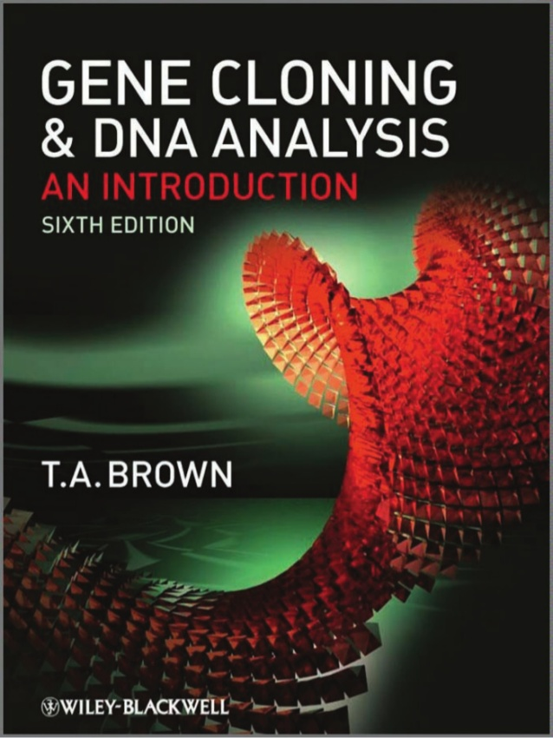
SUGGESTED READING
Pg No.72-93

