Slide 1



Slide 2


Slide 3
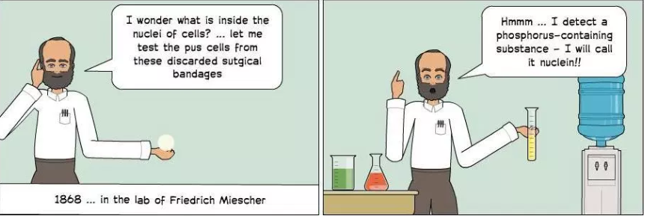
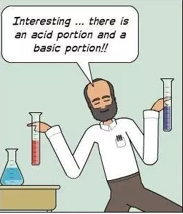
HISTORY OF DISCOVERY
In 1906, Albrecht Kossel described the 4 bases in nucleic acids.
Albrecht Kossel (Nobel prize, 1910) differentiated RNA and DNA in 1882.

Slide 4
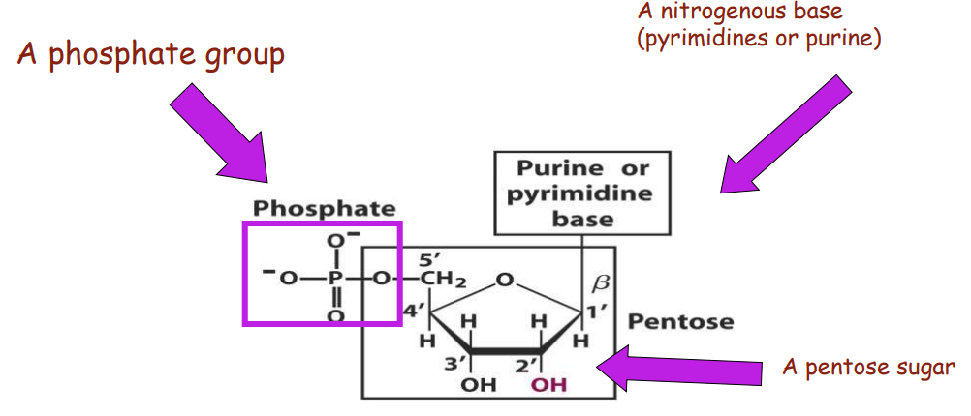
Composition of Nucleotides
A nucleotide is made up of 3 components:
a. Nitrogenous base (a purine or a pyrimidine)
b. Pentose sugar, either ribose or deoxyribose
c. Phosphate groups esterified to the sugar.

Slide 5
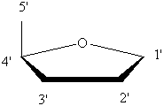
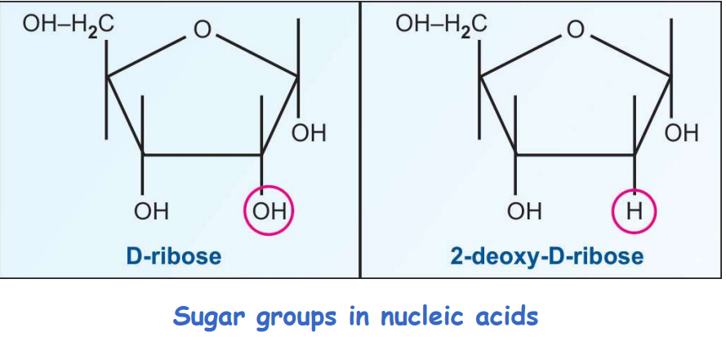
Sugars
Pentoses (5-C sugars)

Slide 6
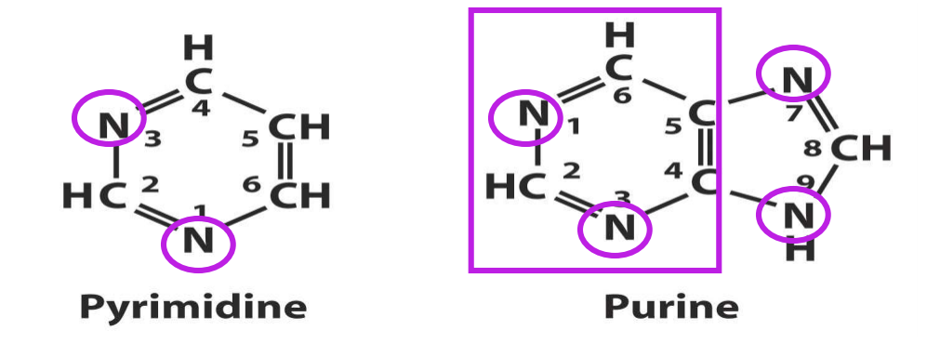
Nitrogenous Bases
Planar, aromatic and nitrogen containing heterocyclic.
Two types of nitrogenous bases - Purines and Pyrimidines

Slide 7
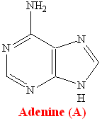
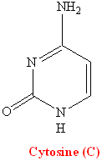
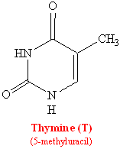
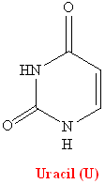
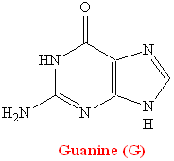
Nitrogenous Bases
Purines
Pyrimidines
The bases are abbreviated by their first letters (A, G, C, T, U)

Slide 8
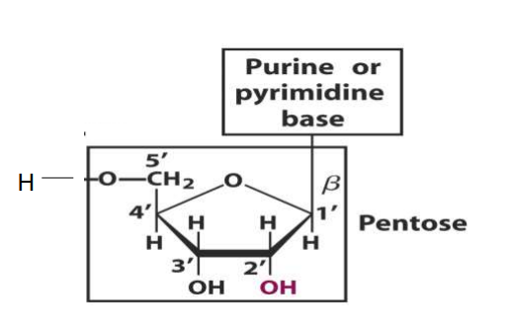
Nucleosides
Result from linking one of the sugars with a purine or pyrimidine base through an N-glycosidic linkage
Purines bond to the C1’ carbon of the sugar at their N9 atom
Pyrimidines bond to the C1’ carbon of the sugar at their N1 atoms

Slide 9
Phosphate Groups
Mono-, di- or triphosphates
Phosphates can be bonded to either C3 or C5 atoms of the sugar
When the nucleoside is esterified to a phosphate group, it is called a nucleotide or nucleoside monophosphate.
When a second phosphate gets esterified to the existing phosphate group, a nucleoside diphosphate is generated.
The attachment of a 3rd phosphate group results in the formation of a nucleoside triphosphate.

Slide 10
Function of Nucleotides
RNA (ribonucleic acid) is a polymer of ribonucleotides
DNA (deoxyribonucleic acid) is a polymer of deoxyribonucleotides
Both deoxy- and ribonucleotides contain Adenine, Guanine and Cytosine
Ribonucleotides contain Uracil
  Deoxyribonucleotides contain Thymine
  Nucleoside Triphosphates are important energy carriers (ATP, GTP)
Important components of coenzymes FAD, NAD⁺ and Coenzyme A

Slide 11
Naming Conventions
Nucleosides:
  Purine nucleosides end in “-sine”
  Adenine : Adenosine, Deoxyadenosine
  Guanine : Guanosine, Deoxyadenosine
  Pyrimidine nucleosides end in “-dine”
  Cytosine : Cytidine, Deoxycytidine
  Thymine : Thymidine
  Uracil : Uridine
Nucleotides:
  Purine
  Adenine : Adenylic acid, deoxyadenylic acid
  Guanine : Guanylic acid, deoxyguanylic acid
  Pyrimidine
  Cytosine : Cytidylic acid, deoxycytidylic acid
  Thymine : Thymidylic acid
  Uracil : Uridylic acid

Slide 12
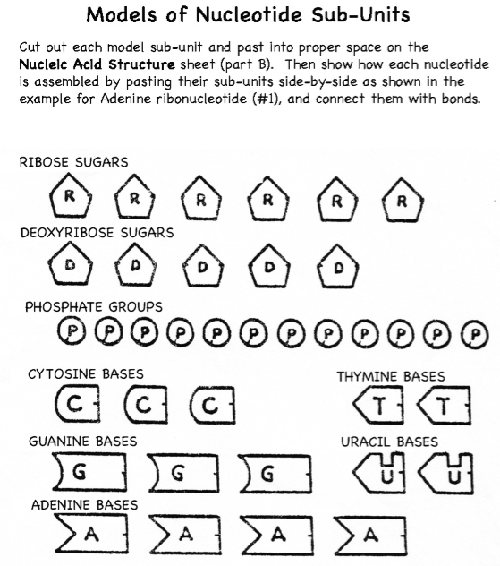
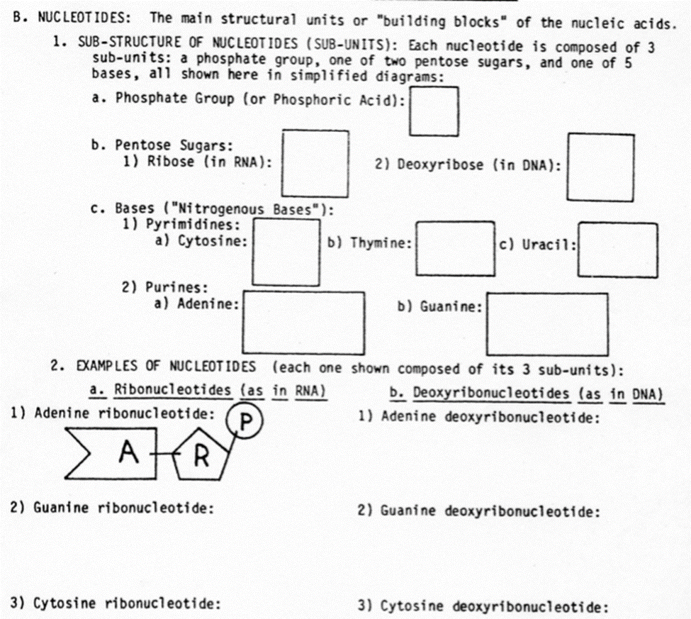
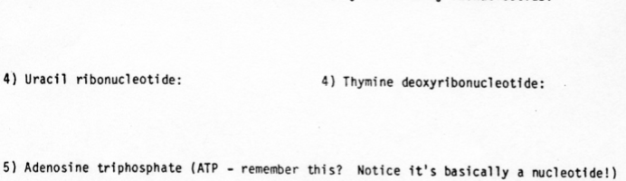

Slide 13


