Slide 1
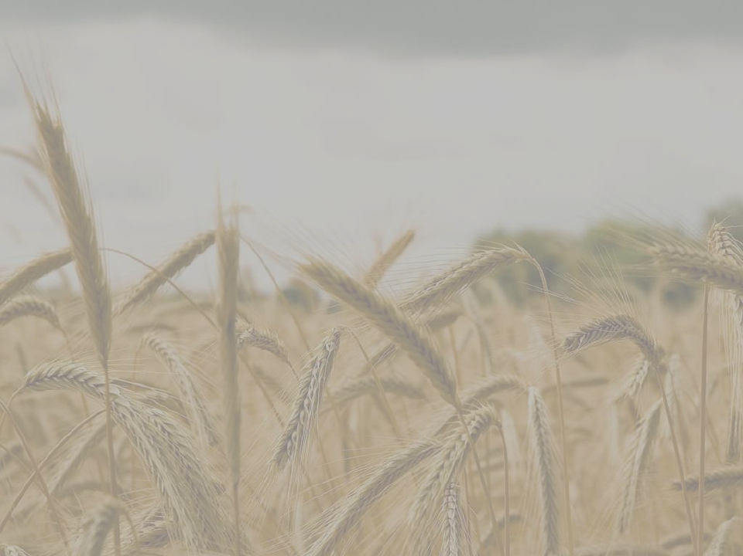
Photorespiration

Slide 2
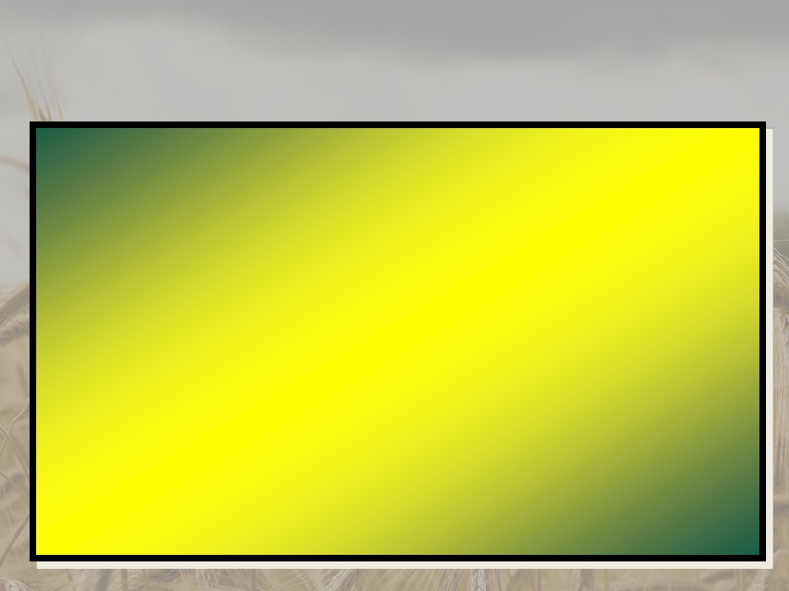

What is
PHOTORESPIRATION?
• The aberrant use of oxygen by chloroplasts
• An interference with carboxylation caused by
the deviant interaction of RuBisCO with oxygen
•A process that leads to only one 3PGA being
produced in the dark reaction in chloroplasts
*RuBisCO- ribulose 1,5-biphosphate carboxylase/oxygenase
*3PGA- 3-phosphoglyceric acid

Slide 3
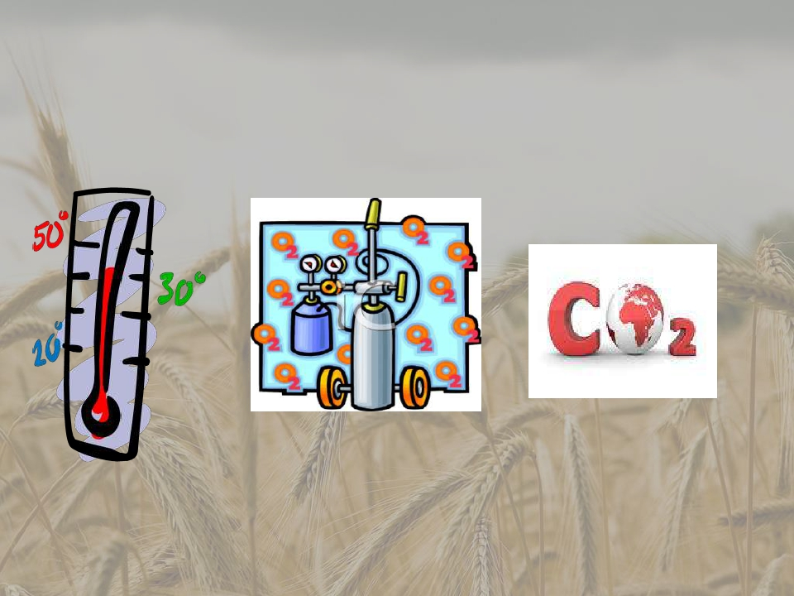
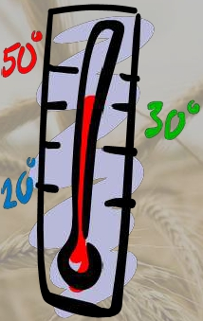
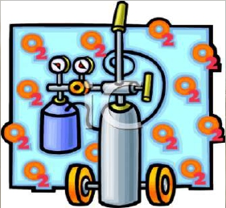
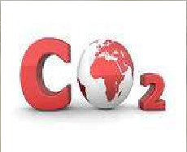
Factors that Increases
Photorespiration
Low CO2
concentration
High O2
concentration
High temperature

Slide 4
How
Photorespiration
Happens??

Slide 5
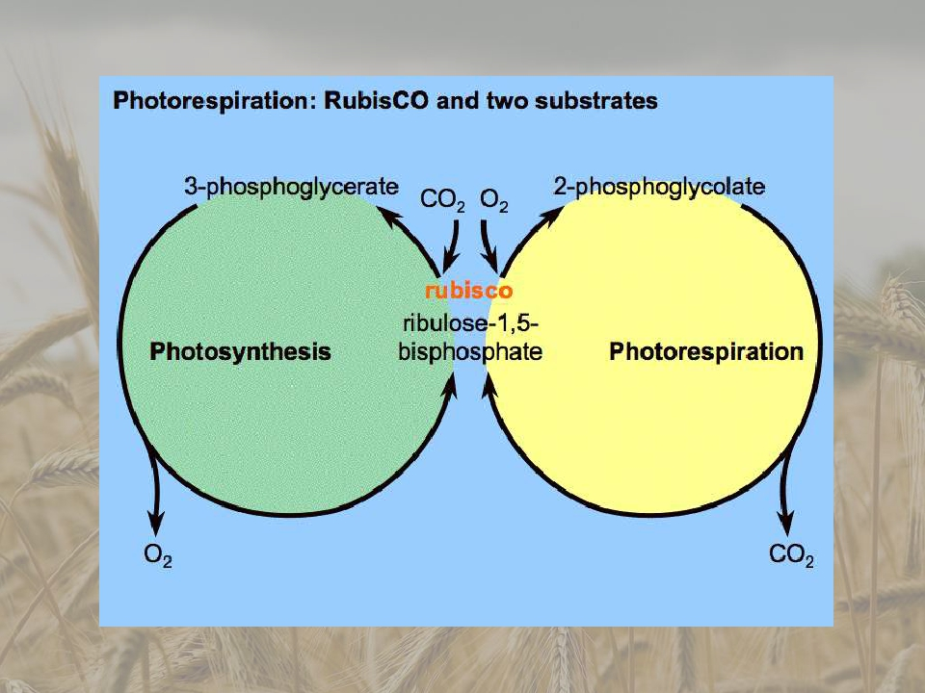
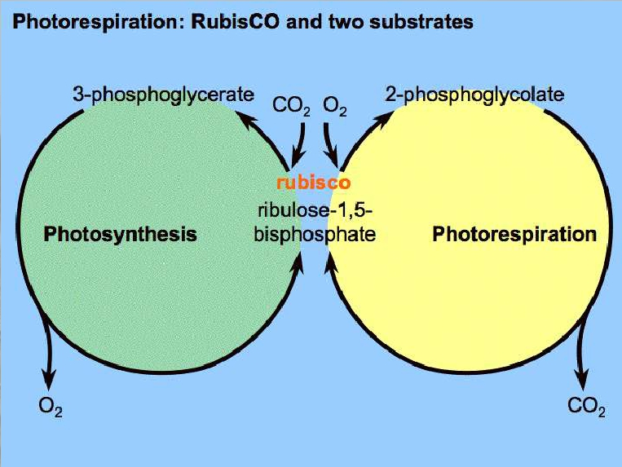

Slide 6
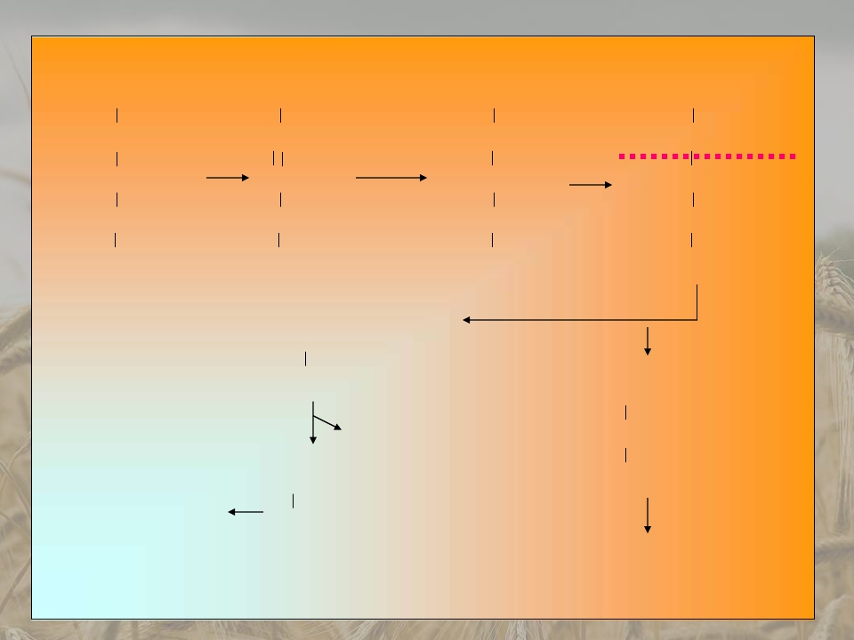
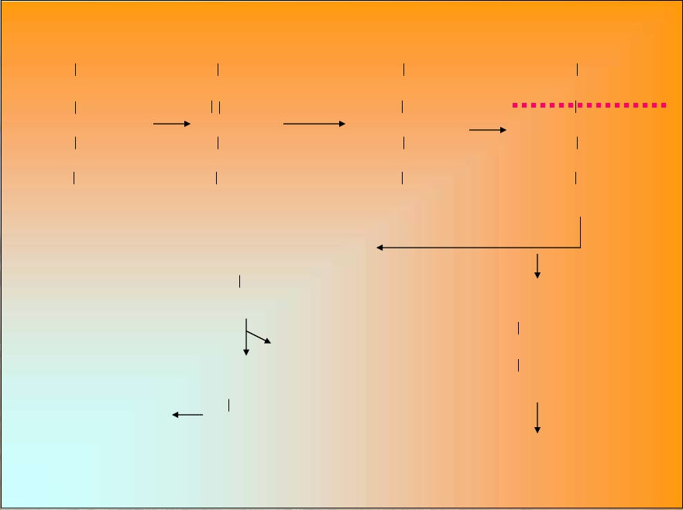

CH2OP
C=O
C-OH
C-OH
CH2OP
CH2OP
C-OH
C-OH
C-OH
CH2OP
CH2OP
HO- C-O-OH
C=O
C-OH
CH2OP
CH2OP
HO- C-O-OH
HO- C-OH
C-OH
CH2OP
O2
H2O
RuBP
Ribulose-1,5-bisphosphate
Phospho-
glycolate
CH2OP
COO
COO
PO4
3PGA
C-OH
CH2OH
CH2OP
Peroxisomes
Glycolate
COO
Calvin Cycle

Slide 7
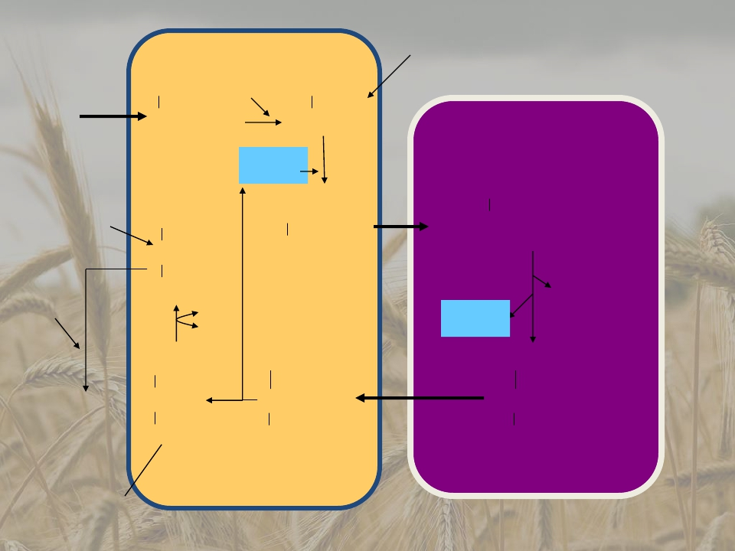





From
Glyoxylate
Chloroplasts
CH2OH
O2
CHO
COO
COO
Mitochondria
Glycolate
NH3+
2
CH2NH3
Glycerate
CH2OH
CHOH
CH2NH3
COO
COO
COO
CH2OH
C=O
COO
Glycine
CH2OH
CHNH3
COO
CO2
CH2OH
CHNH3
COO
ATP
3PGA
NAD+
NADH
NH3+
Serine
Peroxisomes
Hydroxy
pyruvate

Slide 8
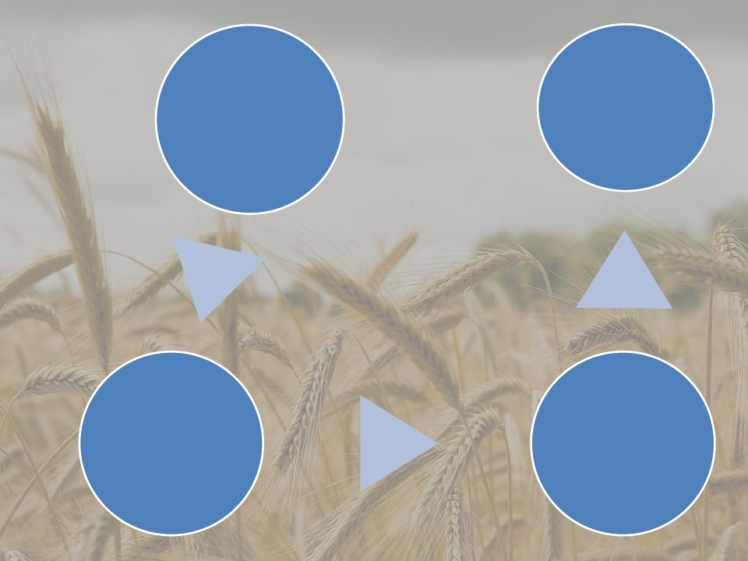
From
Chloroplast
Serine
Phosphoglycolate
Mitochondria
Peroxisome
Glycolic acid
Glycine

Slide 9
Functions of Photorespiration
• Photorespiration Removes Toxic Metabolic
Intermediates
• Photorespiration Protects from
Photoinhibition
• Photorespiration Supports Plant Defense
Reactions
• Photorespiration is Intimately Integrated Into
Primary Metabolism

Slide 10
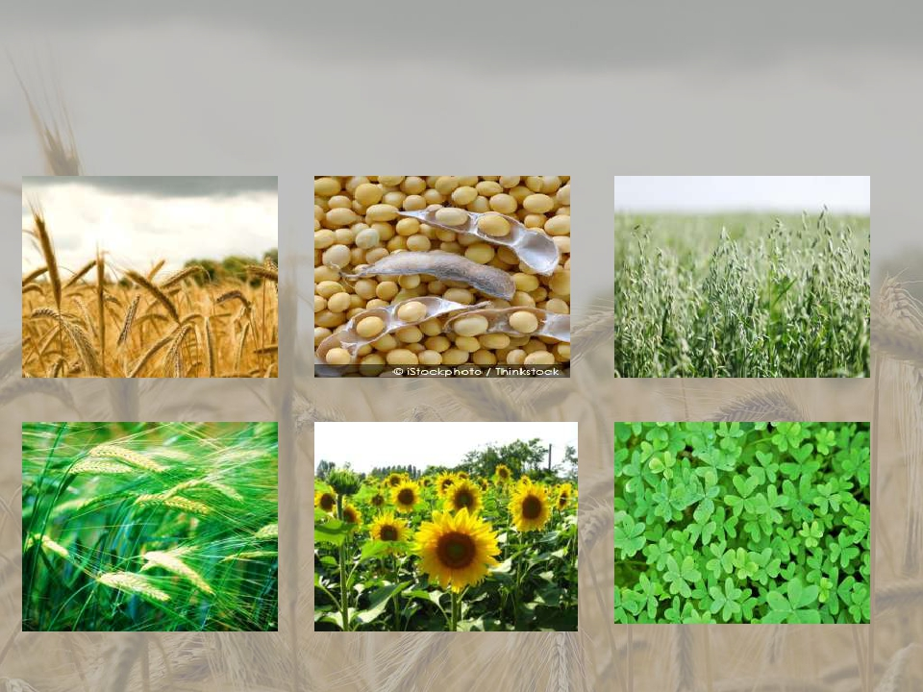
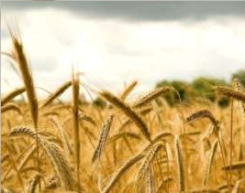
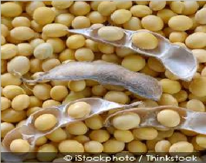
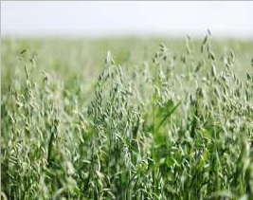
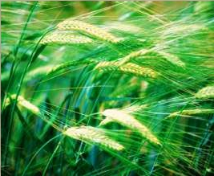
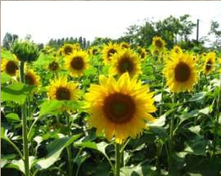
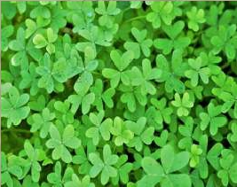
Examples of C3 Type of Plants
Wheat
Soybean
Oat
Barley
Sunflower
Alfalfa

Slide 11
The End of
Photorespiration
Next report:
C4 CARBON CYCLE

