Slide 1
BASIS OF CLASSIFICATION OF ANIMAL KINGDOM
UTHAYAKUMAR A.S
PGT BIO
KV NO:1 ARAKKONAM RO CHENNAI

Slide 2
BASIS OF CLASSIFICATION
Arrangement of cells
Body symmetry
Nature of coelom
Patterns of digestive system
Circulatory or reproductive systems

Slide 3
LEVELS OF ORGANISATION
Cellular level of organisation
Tissue level of organisation
Organ level of organisation
Complete digestive system
Incomplete digestive system

Slide 4
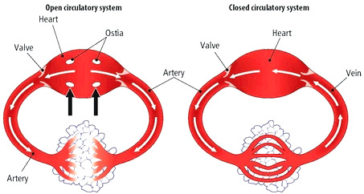
Circulatory system
Open type
Closed type

Slide 5
SYMMETRY
Asymmetrical e.g.,sponges
Radial symmetry e.g.,coelenterates,ctenophores,echinoderms
Bilateral symmetry e.g.,annelids,arthropods

Slide 6
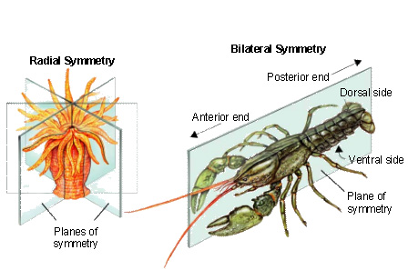

Slide 7
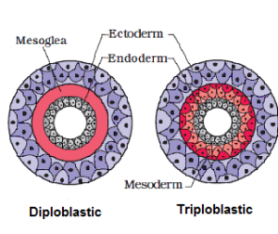
Diploblastic and Triploblastic organisation
Diploblastic(ectoderm,endoderm) e.g.,coelenterates
Triploblastic(ectoderm,endoderm,mesoderm)
ex: Platyhelminthes to chordates

Slide 8
COELOM
Coelomates e.g.,molluscs etc
Pseudocoelomates e.g.,aschelminthes
Acoelomates e.g.,platyhelminthes

Slide 9
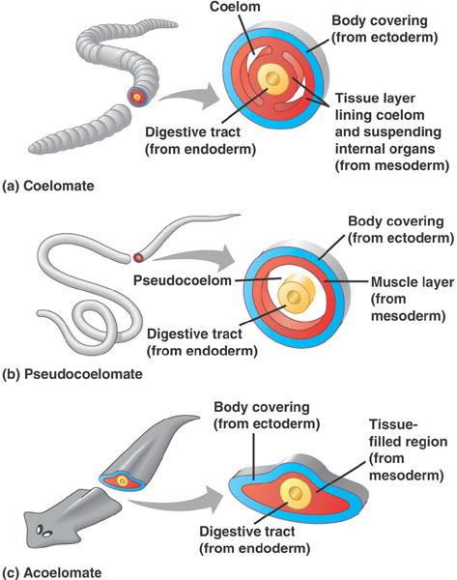

Slide 10
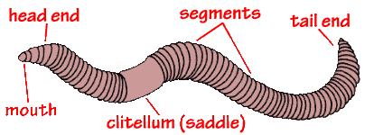
SEGMENTATION
The body is externally and internally divided into segments with a serial repetition of at least some organs known as metamerism

Slide 11
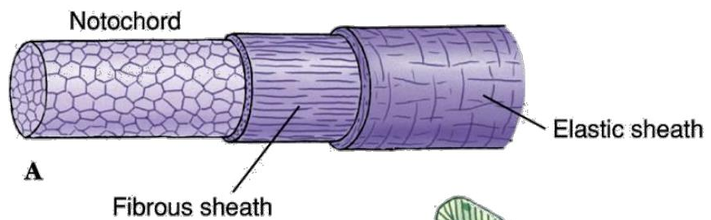
NOTOCHORD
Notochord is derived from mesoderm on the dorsal side during embryonic development e.g.,porifera to echinoderms

Slide 12
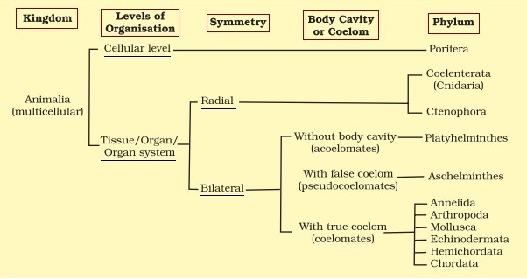
CLASSIFICATION OF ANIMALS

Slide 13
THANK YOU

