Slide 1

Strength training

Slide 2
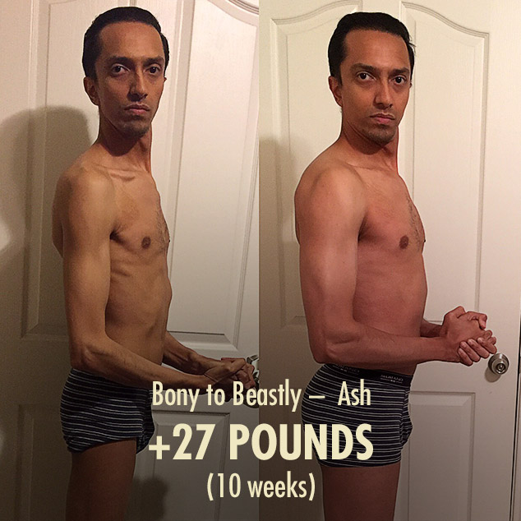
Structural proteins are added to muscle fibre cell diameter increases.

Slide 3
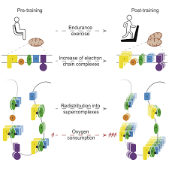
More mitochondria, more ATP production , more aerobic metabolism

Slide 4
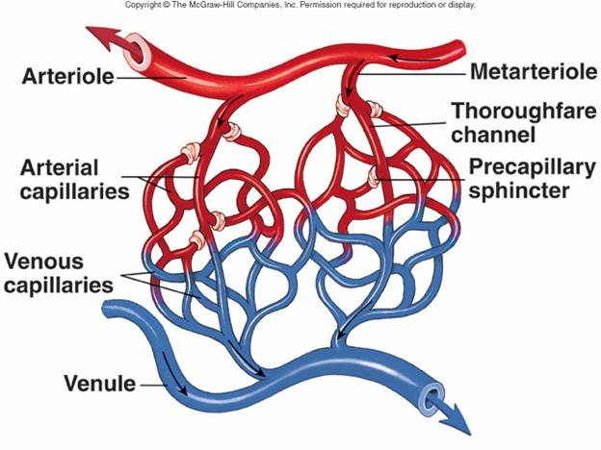
More capillary network around the muscle after exercise

Slide 5
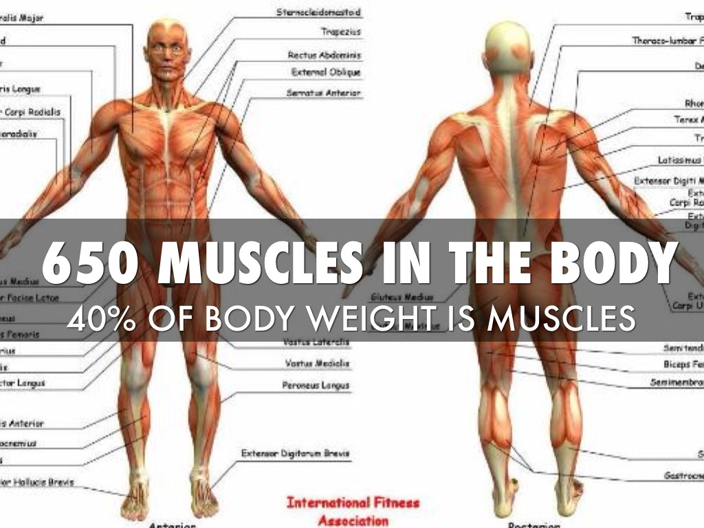

Interesting facts
Derived from latin word musculus= little mouse
650 skeletal muscles are there

Slide 6
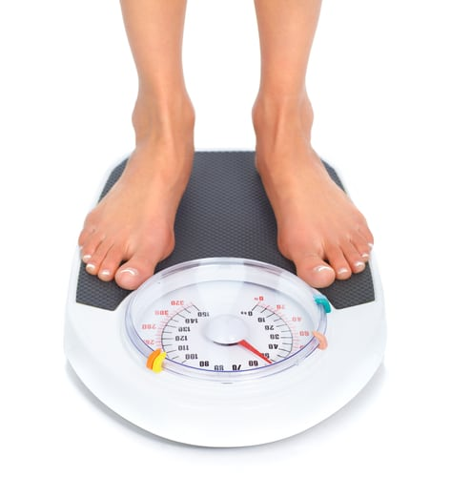

Interesting facts
Muscles make 40% of the body weight
Heart : hardest working muscle , immuned to fatigue

Slide 7
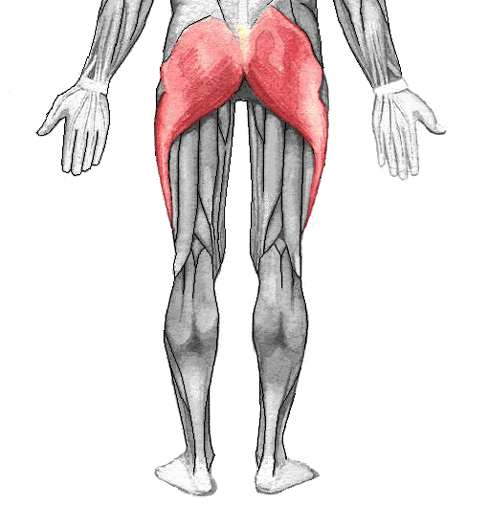
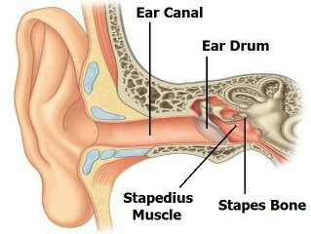
Interesting facts
Largest muscle : hip muscle
Smallest :: in the middle ear

Slide 8

17 muscles required for smile &
43 to frown

Slide 9
Structure of skeletal muscles and contractile protein

Slide 10
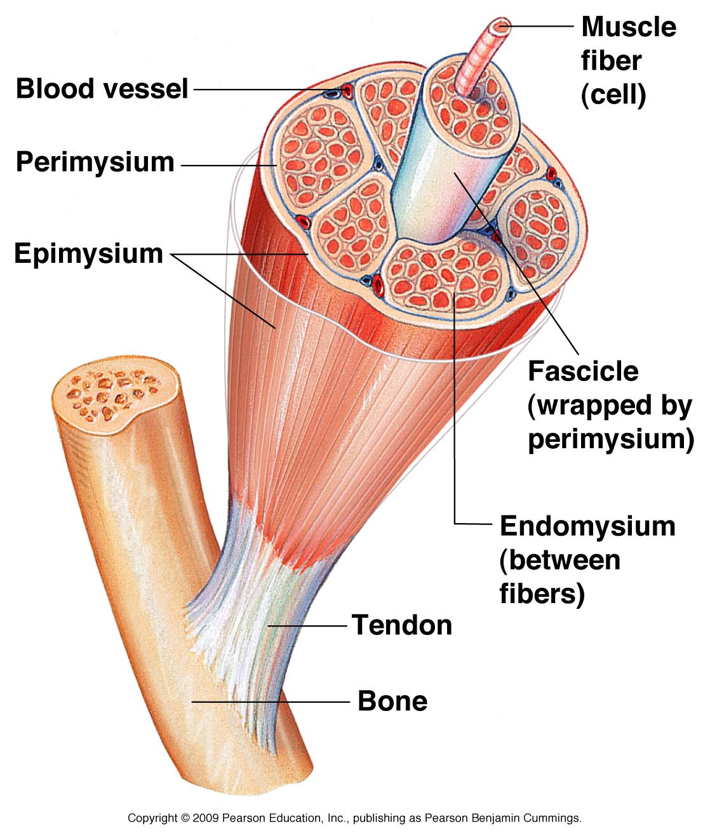
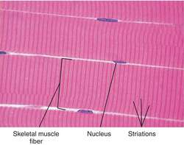
Features of skeletal muscles

Slide 11
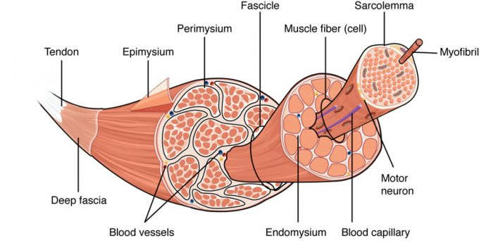
Sectional view of muscle showing muscle bundles and muscle fibres

Slide 12
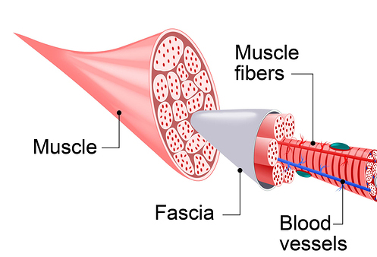
Fascicles & Fascia

Slide 13
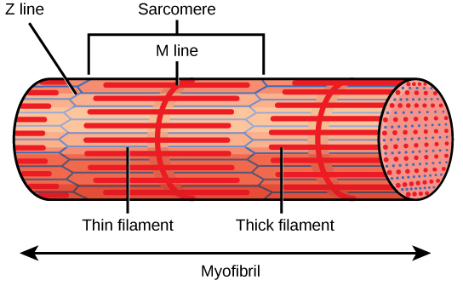
Myofibril(sarcomere structure)

Slide 14
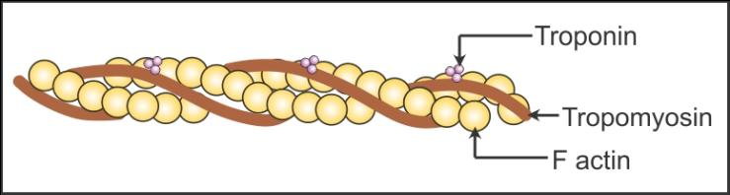
Actin structure

Slide 15
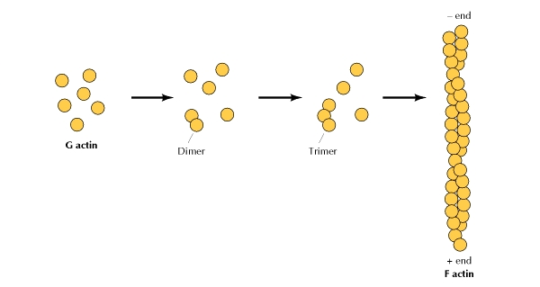
G Actin & F Actin

Slide 16
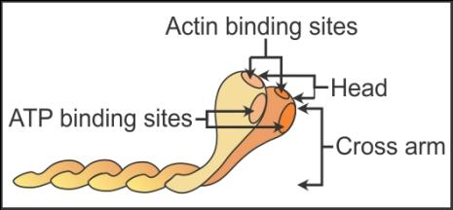
Meromyosin structure

Slide 17


Slide 18
Number the following cylindrical structures in order from largest(1) to smallest(5)
*Myofibril
*Fascicle
*Myofilaments
*Muscle fibre
*muscle

Slide 19
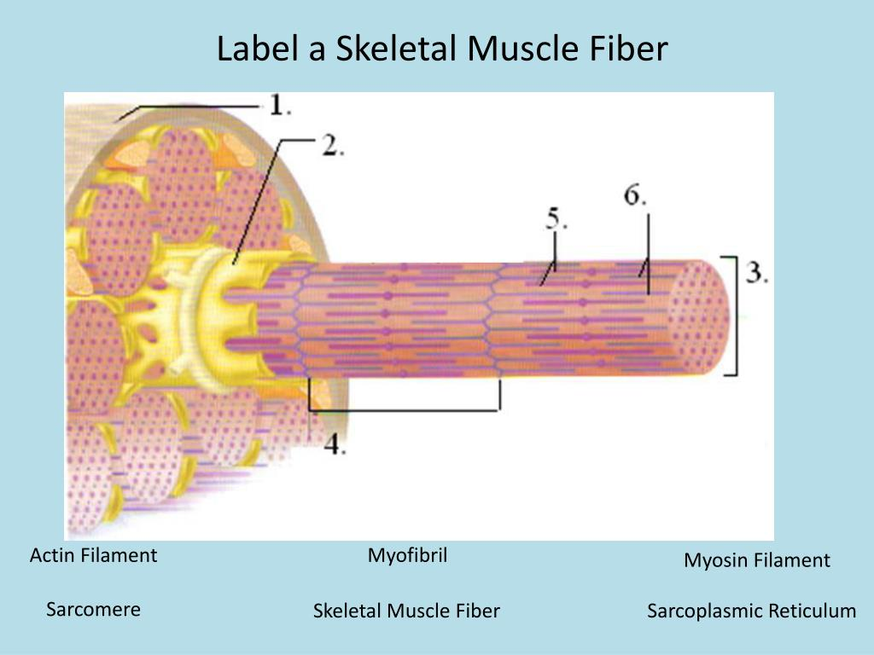

Slide 20
Match the follwing
A | B
Z line | Made of Actin protein
M line | The part of A band not overlapped by I band
H zone | Present at the middle of I band
I band | Made of Myosin protein
A band | Present at the middle of A band

Slide 21

Htt
http://www.cliffnotes.com
http://www.khanacademy.org

Slide 22

Home Assignments
(HOTS /VB questions)
Which property of muscles is used effectively in muscular movement ?
Which compound provides energy for muscle contraction ?
What causes muscle fatigue during rigorous exercises ?

Slide 23

Very short answer questions
Why the muscle fibre is syncitium ?
Name the monomer of F Actin.
Name the monomers of thick filament of a sarcomere.
Which part of Myosin act as ATPase ?

Slide 24

Diagrammatic skill development
Draw the diagram of myofibril showing the sarcomere .
Draw the diagram of Actin filament and label four different types of protein it is made up with.
Draw the diagram of meromyosin showing HMM & LMM.

Slide 25


