Slide 1
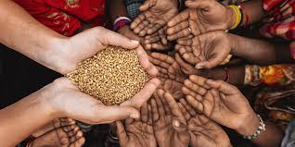
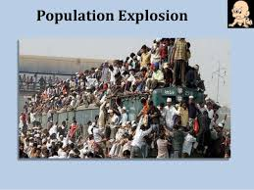
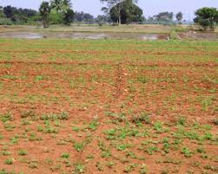

Slide 2
Solution
Traditional farming?
Better management practices?

Slide 3

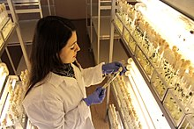
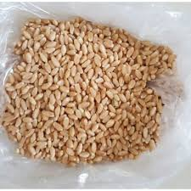
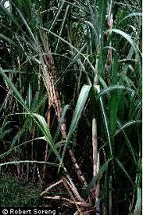
PLANT BREEDING AND ITS USES
Presented by- Ms. Sushila kala (P.G.T.Biology)
K.V.No.5, Jaipur( I shift)

Slide 4
CONTENT TO BE COVERED
PLANT BREEDING
WHAT?
WHY?
USES
HOW?

Slide 5
LESSON PLAN
LESSON PLAN

Slide 6
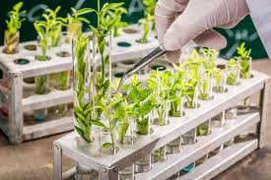
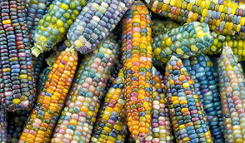
WHAT IS PLANT BREEDING?
Plant breeding is a method of altering the genetic pattern of plants to increase their value and utility for human welfare.
OR
It is a purposeful manipulation of plants to create desired plant types that are better suited for cultivation, give better yield and are disease resistant.

Slide 7
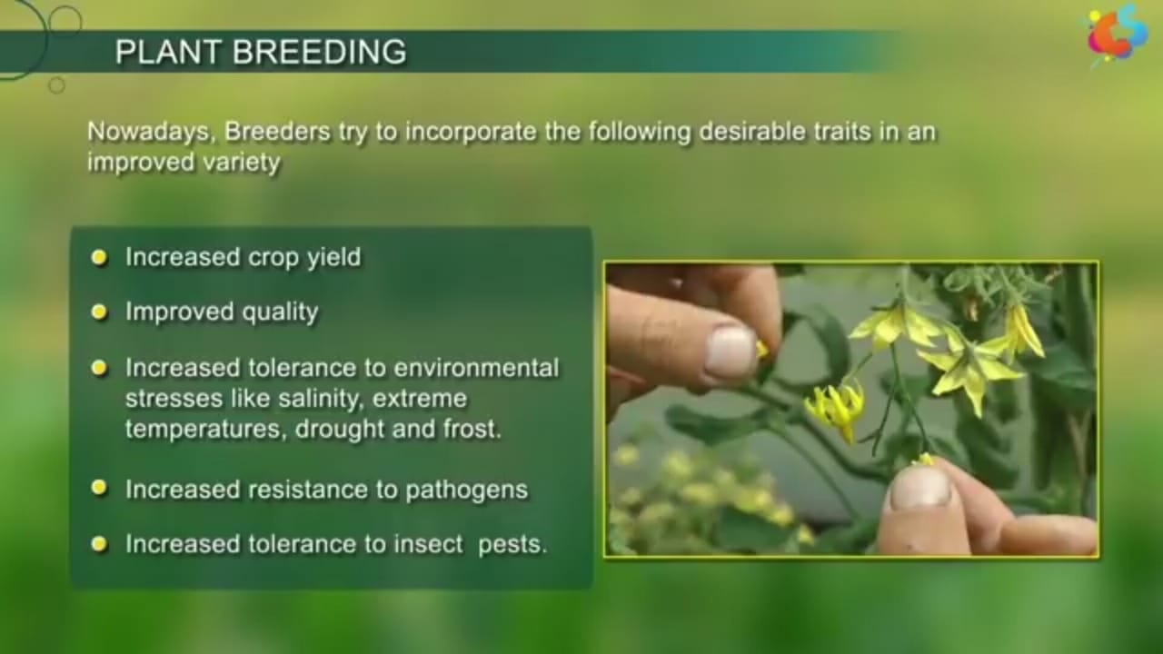
PLANT BREEDING- WHY?

Slide 8
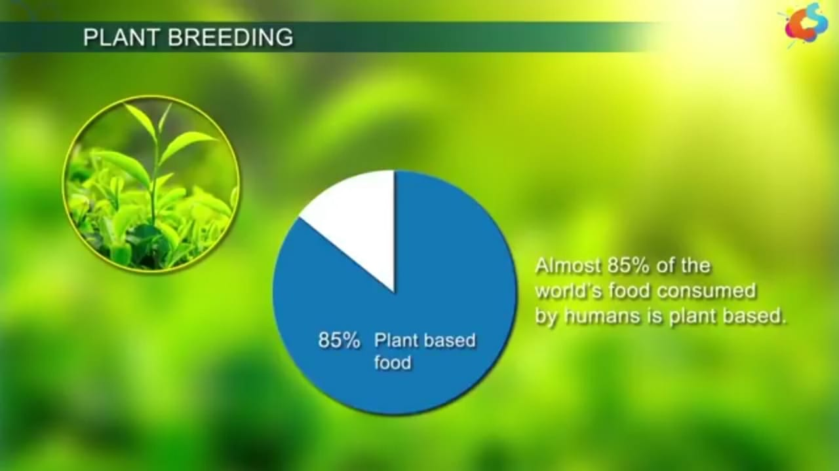
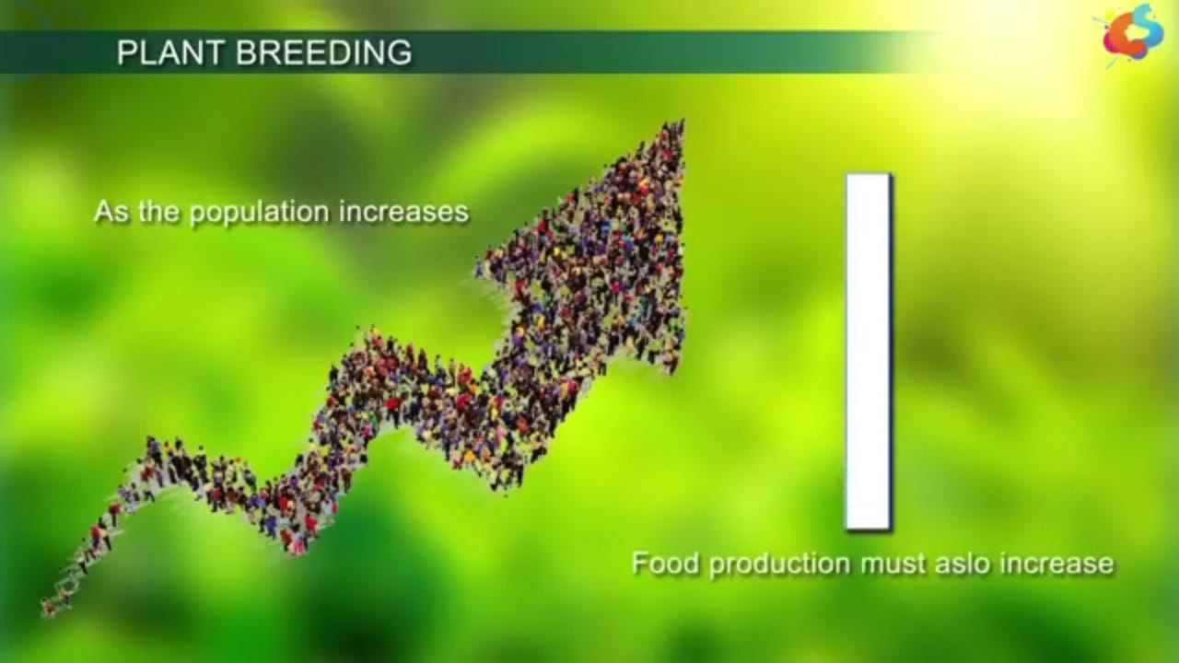
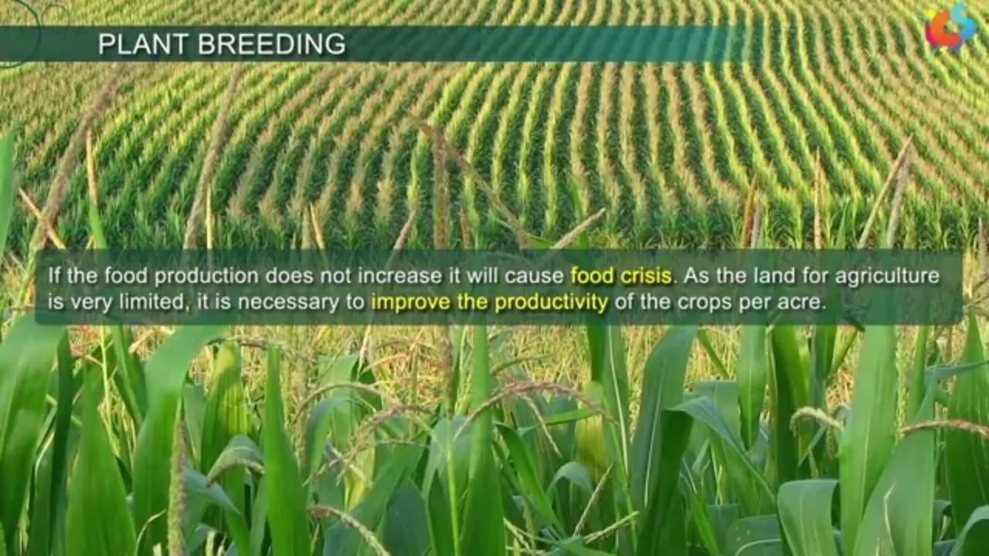
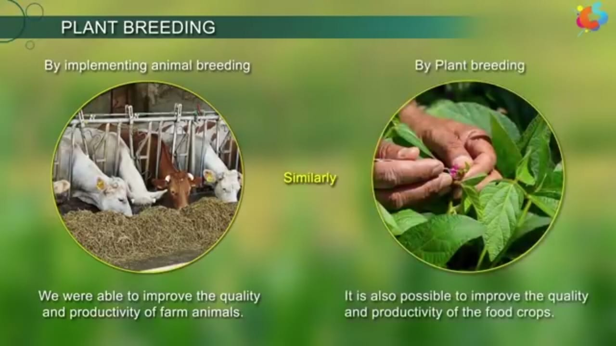

Slide 9
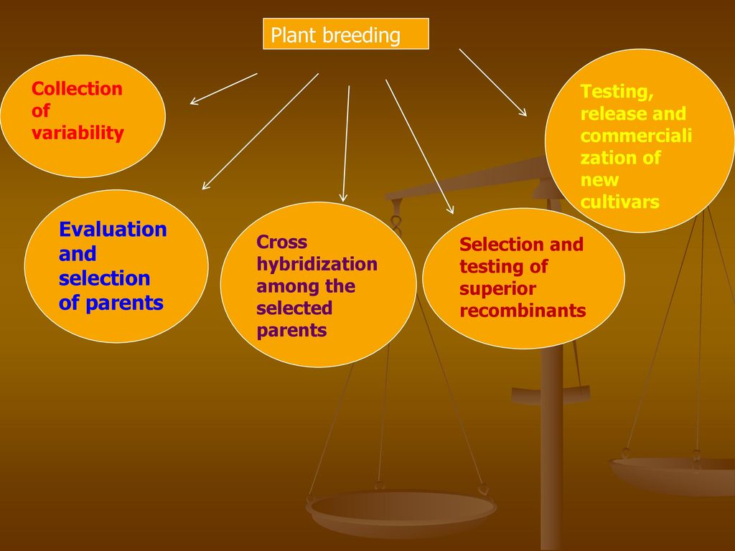
Steps in plant breeding-HOW?

Slide 10
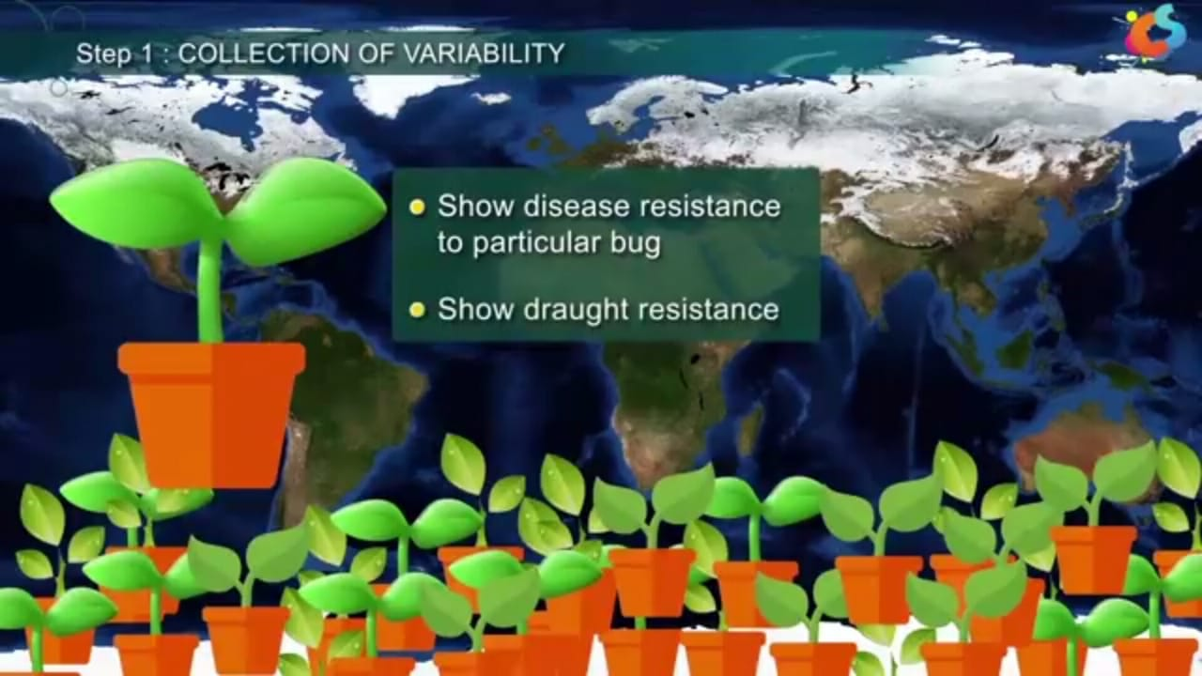
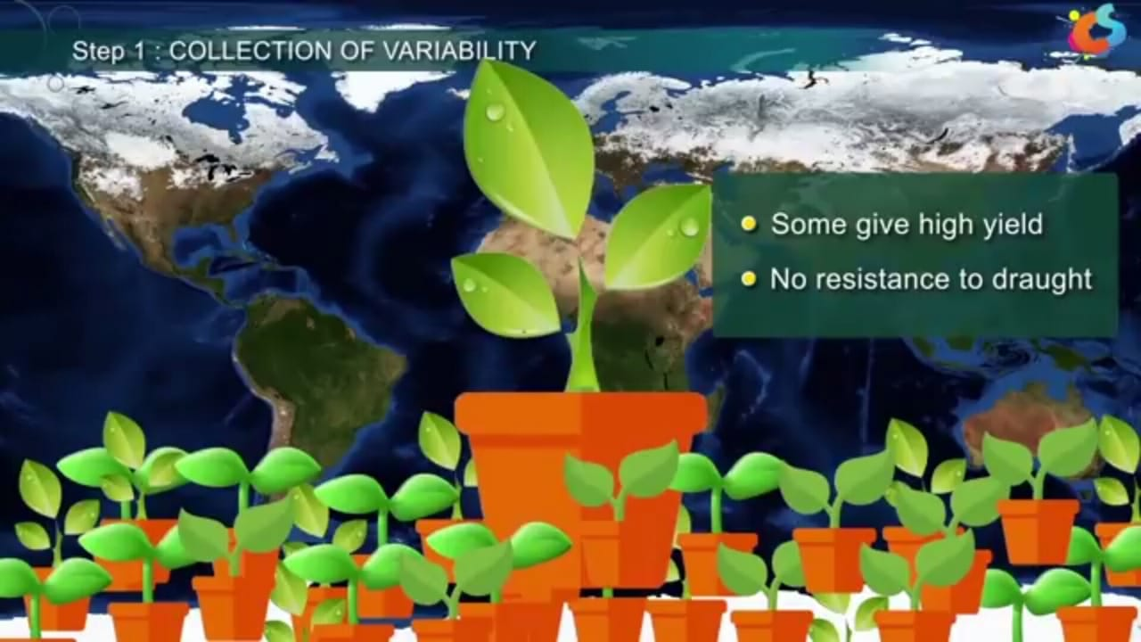
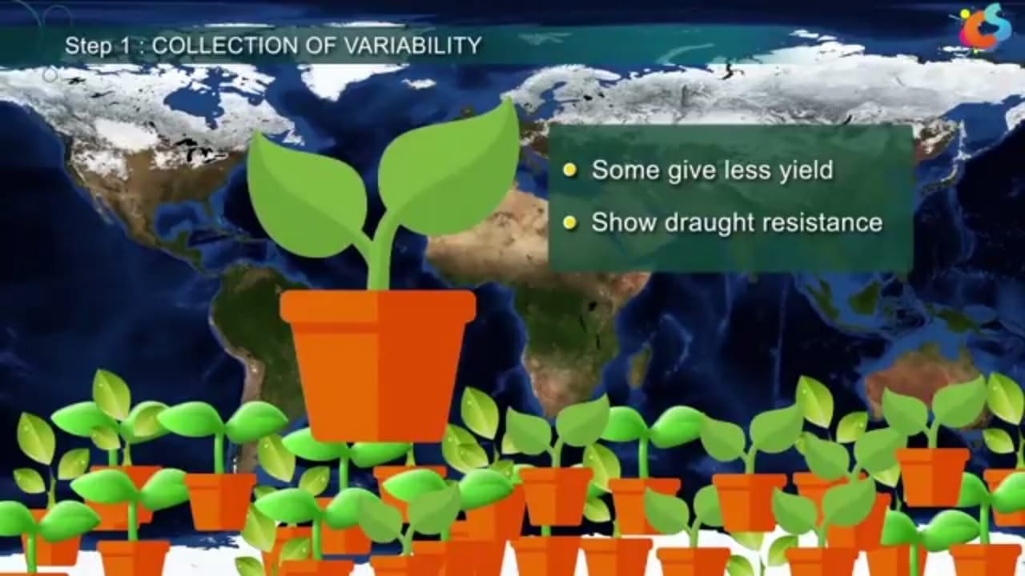
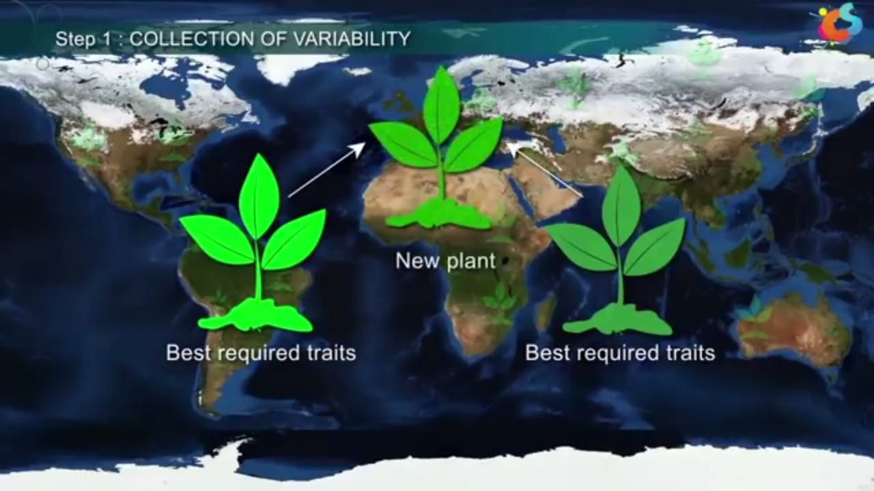
1. COLLECTION OF VARIABILITY

Slide 11
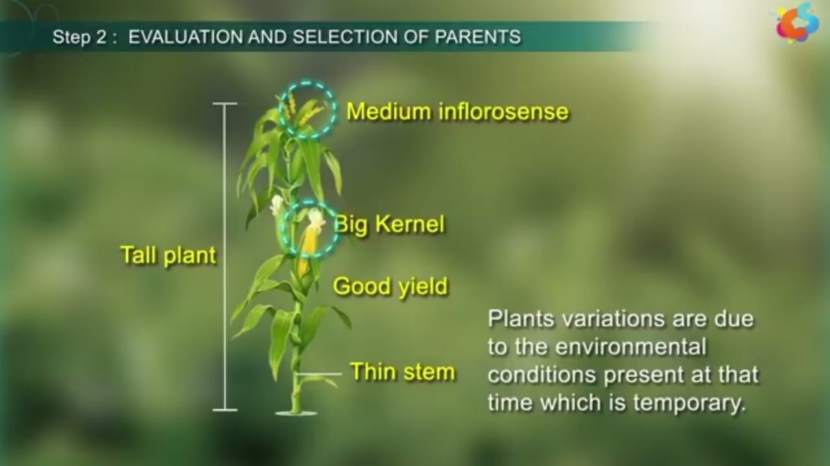
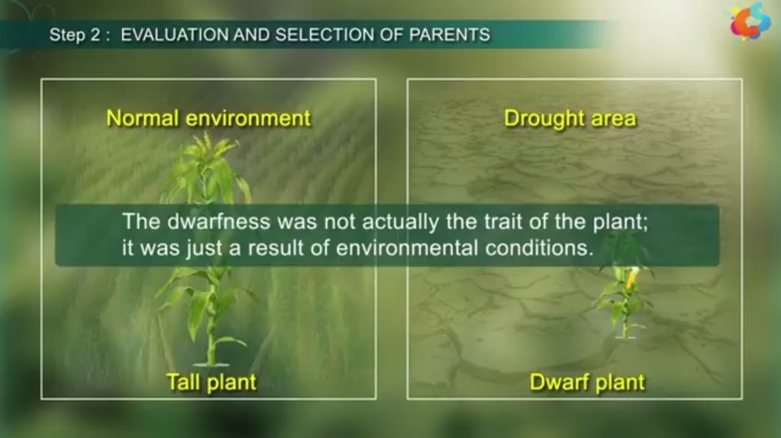
2.EVALUATION AND SELECTION OF PARENTS
IFWE PUT THE PLANT

Slide 12
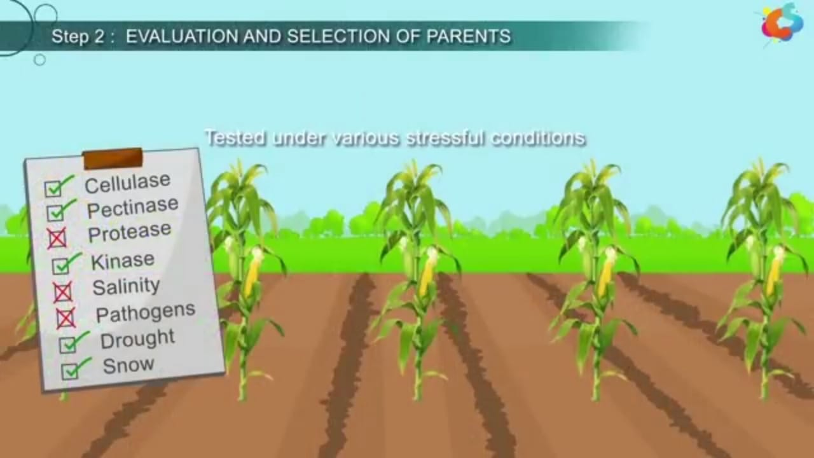

Slide 13
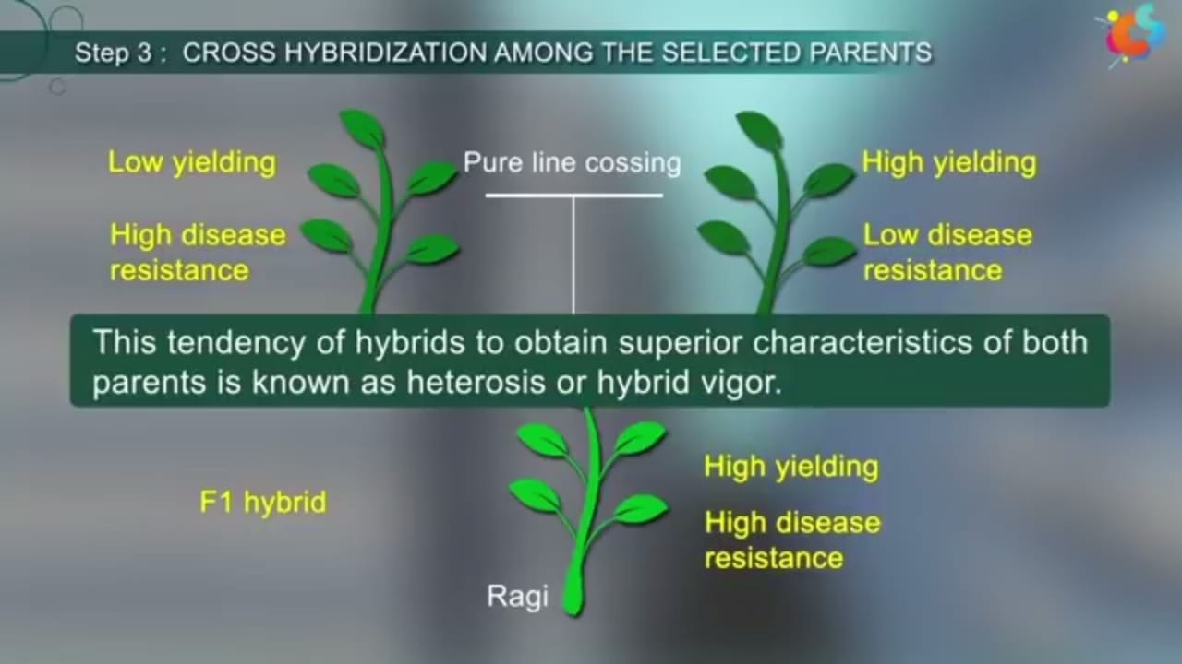
3.CROSS HYBRIDISATION AMONG THE SELECTED PARENTS

Slide 14
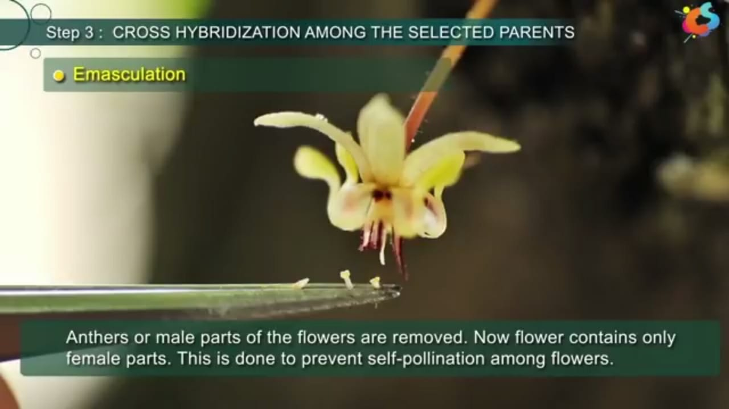
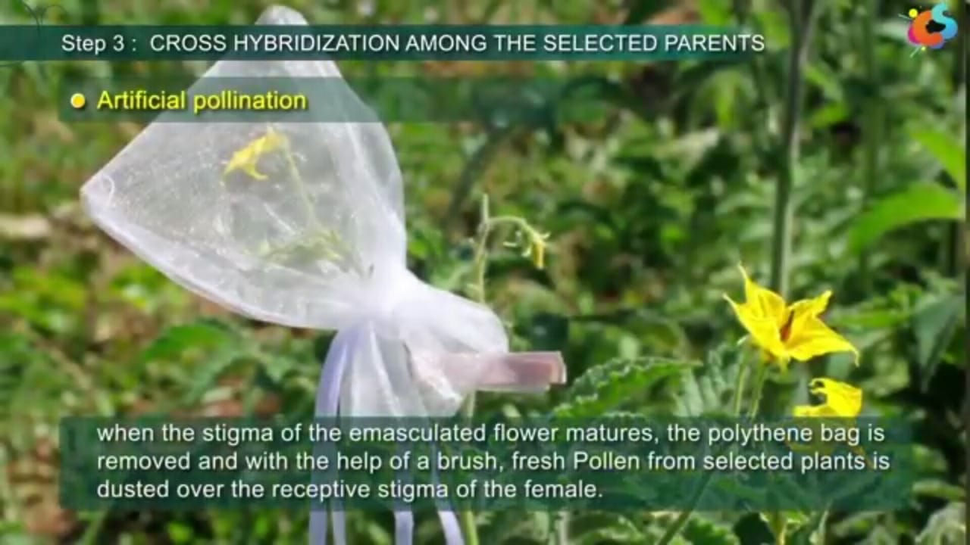
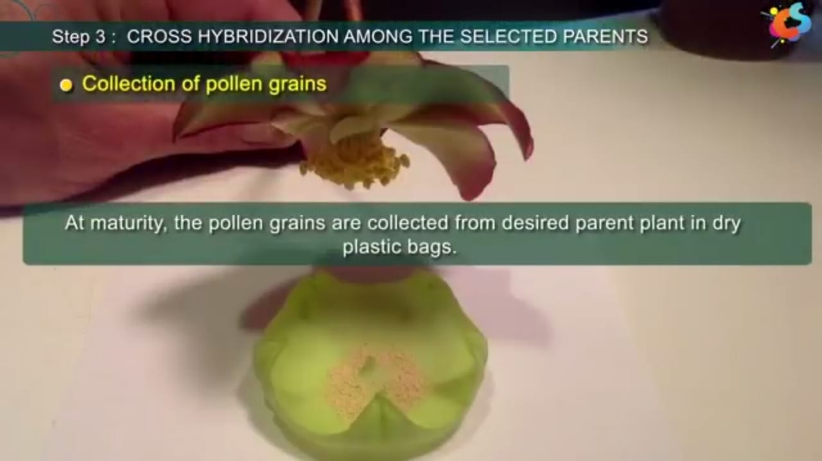
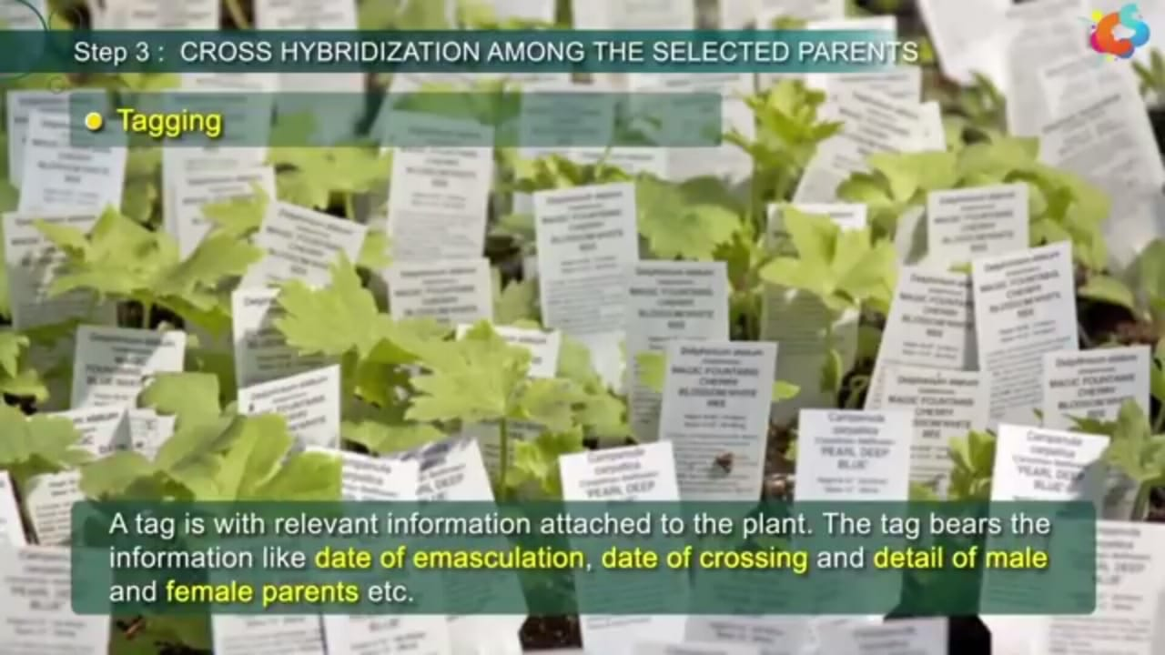
ARTIFICIAL HYBRIDISATION

Slide 15
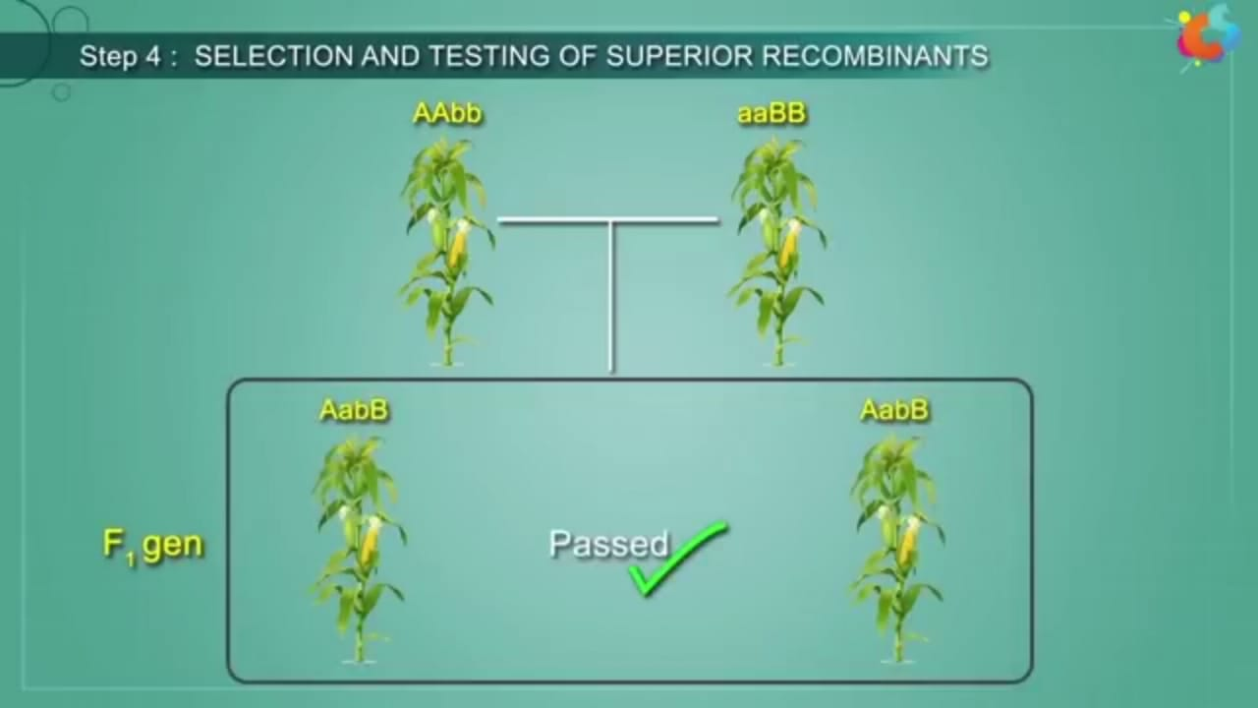
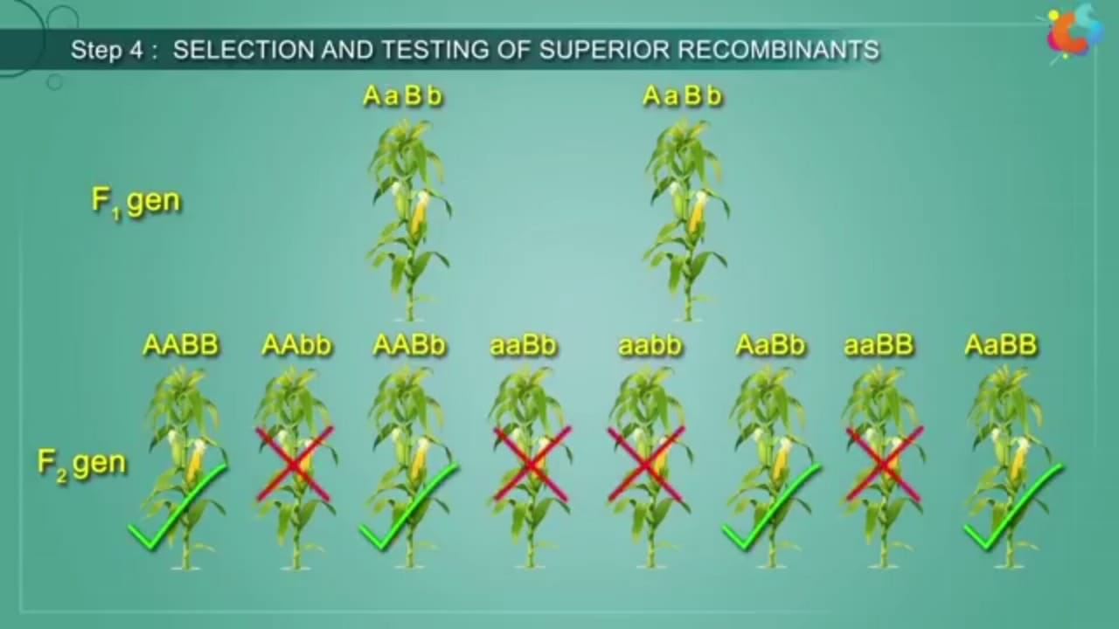
4. SELECTION AND TESTING OF SUPERIOR RECOMBINANTS

Slide 16
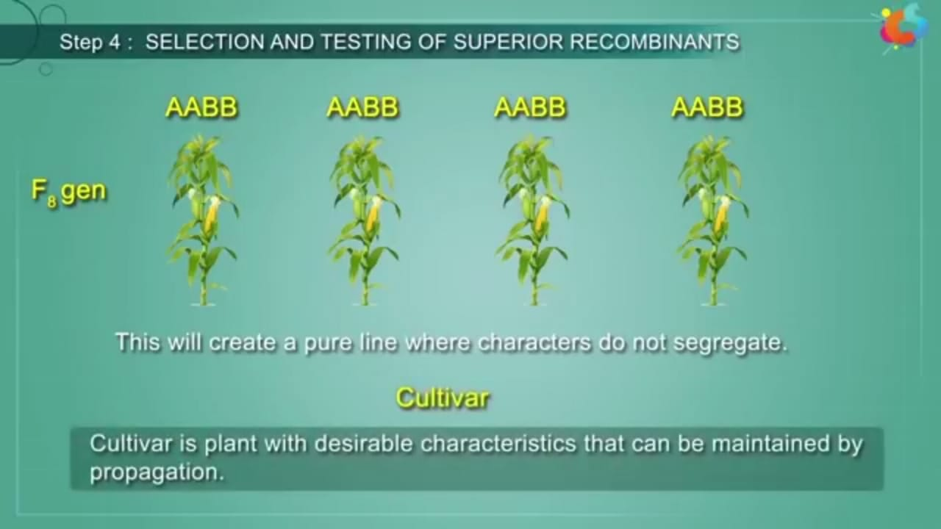
AFTER 7-8 GENERATIONS

Slide 17
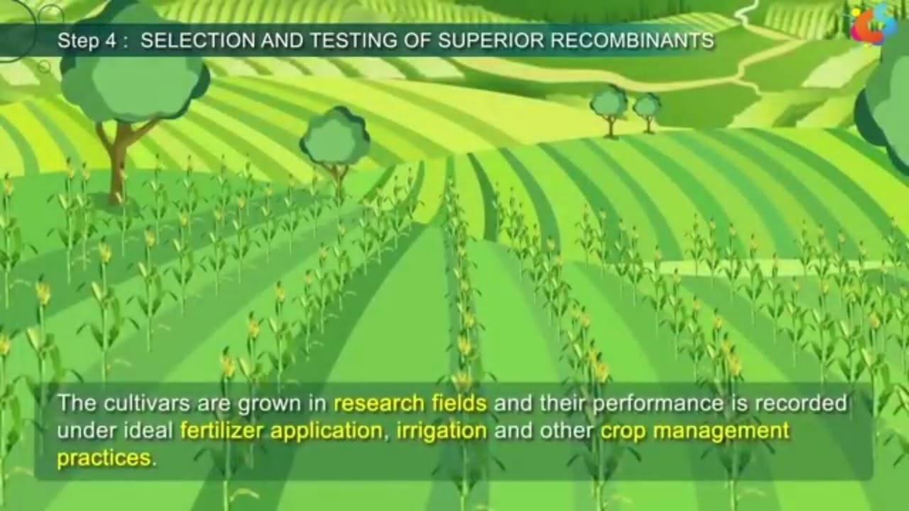
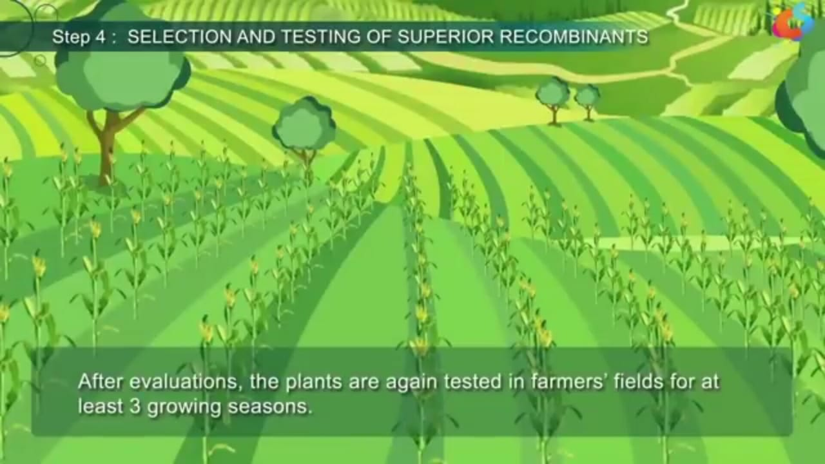
BY ICAR NEW DELHI

Slide 18
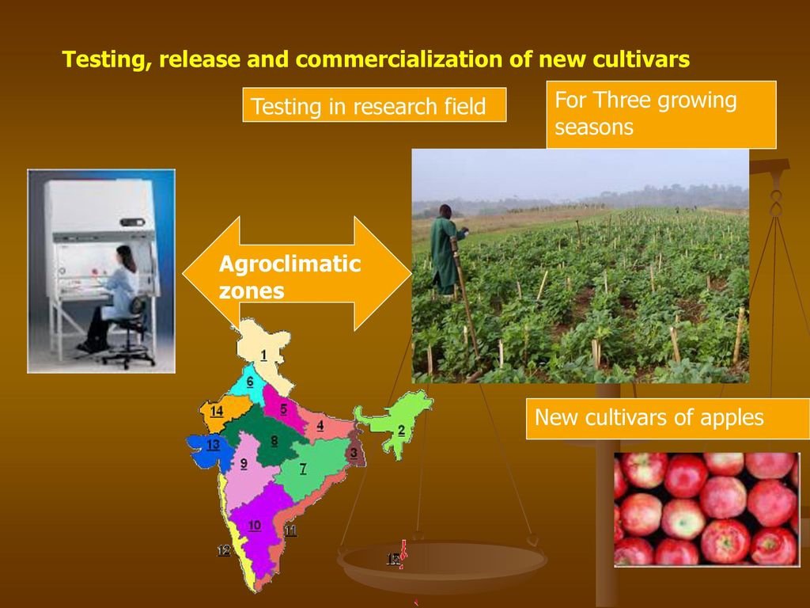
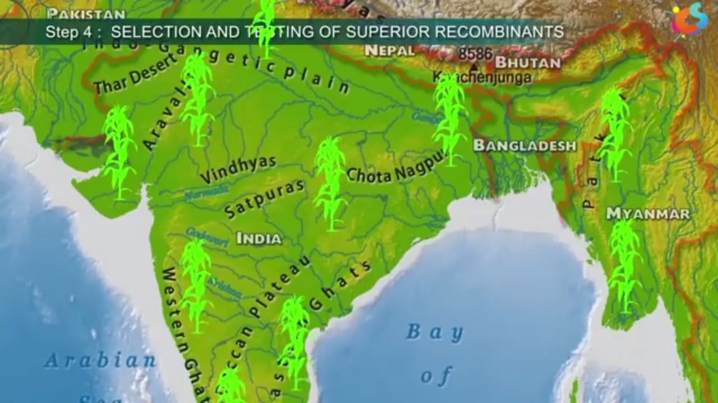
TESTING IS DONE AT SEVERAL LOCATIONS

Slide 19
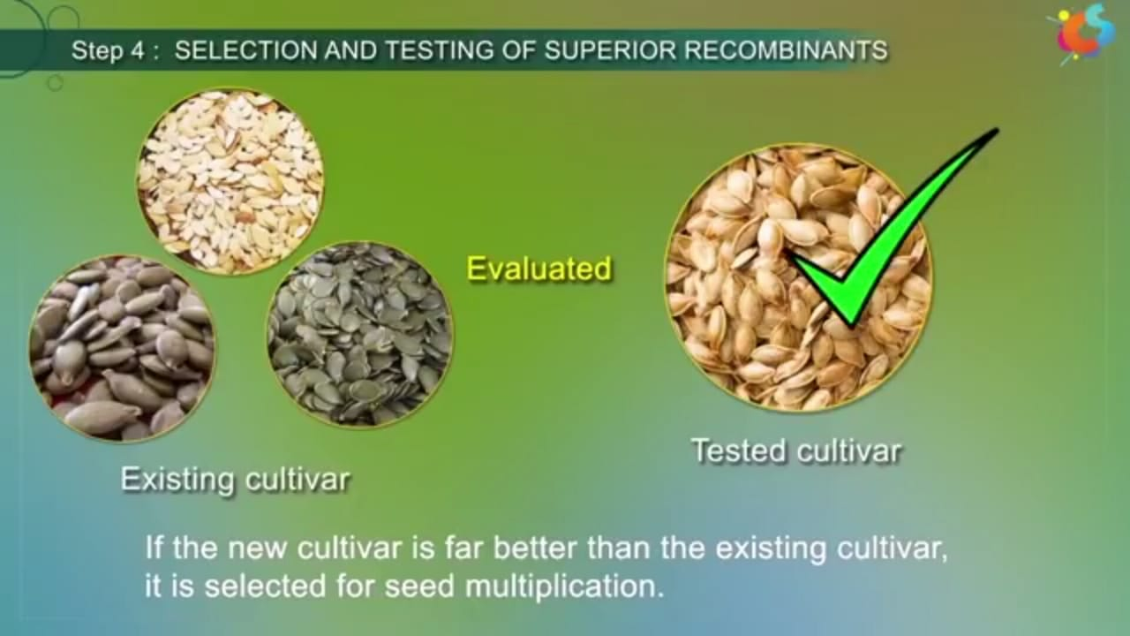
SELECTION AND TESTING OF SUPERIOR RECOMBINANTS (SEEDS)

Slide 20
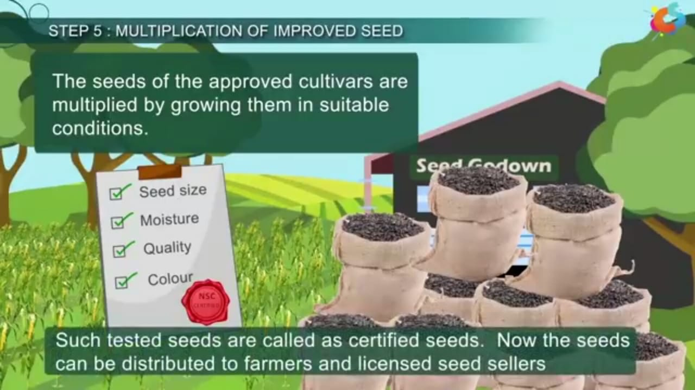
5.MULTIPLICATION OF IMPROVED SEEDS

Slide 21
Modern plant breeding
Modern plant breeding includes not only genetics but covers molecular biology,cytology,systematics,physiology,pathology,entomology,chemistry and statistics etc.
it also includes mutational breeding -by this method it is possible to induce mutations artifically through use of chemicals or radiations and selecting and using the plants that have the desirable character as a source of breeding.

Slide 22
Uses-
1) Plant Breeding for Developing Resistance to Insect Pests:
Crop | Variety | Insect pest
Brassica | Pusa Gaurav | Aphids
Flat bean | Pusa sem2,3 | Jassids, aphids
Okra | Pusa Sawani,Pusa A 4 | Shoot and fruit bores

Slide 23
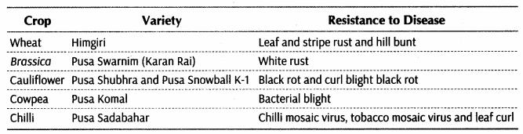
Uses-
2) Production of disease resistant varieties

Slide 24
3. Plant Breeding for Improved Food Quality:
Plant breeding is undertaken for improved nutritional quality of the plants. Following are the objectives of improving:
(1) Protein content and quality
(2) Oil content and quality
(3) Vitamin content and
(4) Micronutrient and mineral content.

Slide 25
RECAPITULATION AND EVALUATION
(TARSIA SOFTWARE)

Slide 26
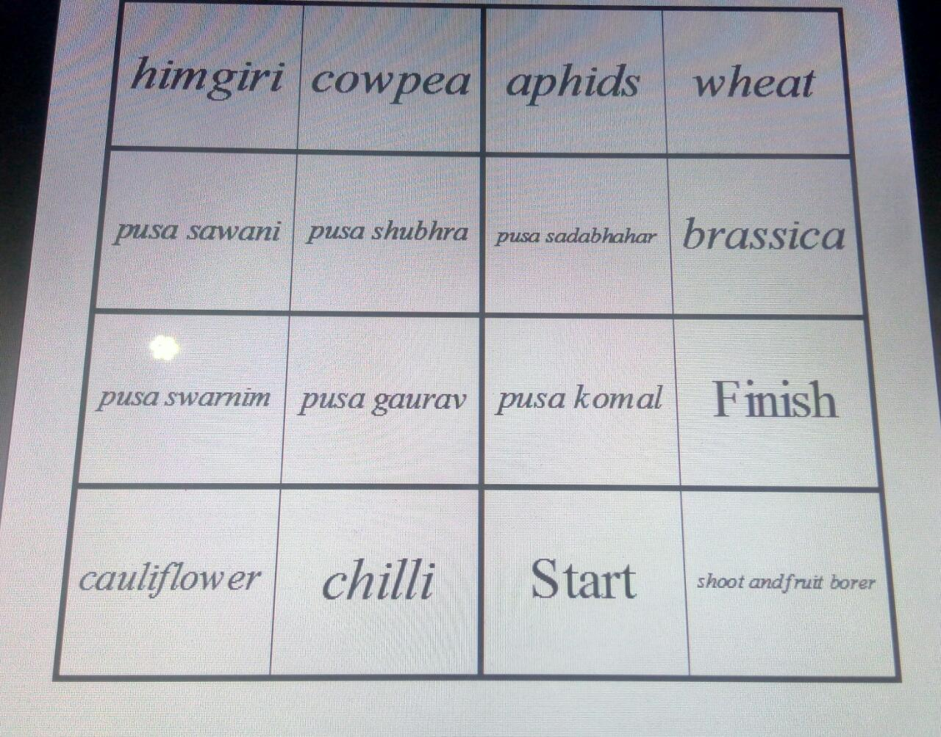
Match the crop with its variety by assigning them number

Slide 27
Recapitulation
Q 1) Breeding for disease resistance requires -
A good source of resistance
Planned hybridsation
Disease test
All of these
Q 2) Which of the following is not true for inbreeding?
It causes inbreeding depression after a few generations.
It leads to homozygosity.
It is used to obtain pureline.
It always increase the productivity.
Q 3) Breeding crops for improved nutritional quality is refered to as-
a) Biomining b) Biomagnification c) Biofortification d) Bioremedication
Q 4) sonaliaka and kalyan sona are high yielding variety of-
a) Rice b) wheat c) maize d) sugarcane

Slide 28
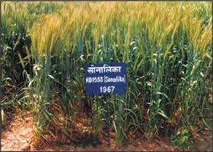
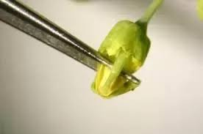
PICTURE BASED QUESTIONS

Slide 29
SUGGESTED SITES AND VIDEOS
Scholarswing channel on you tube
Shiksha house.com
Agriculture’s point
VIDEO PRESENTATION
VIDEO PRESENTATION

