Slide 1
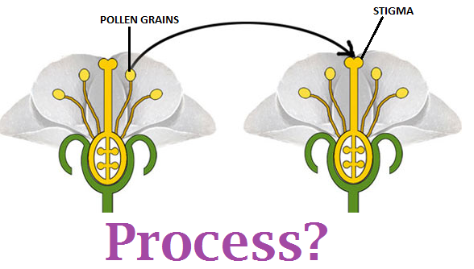


Slide 2
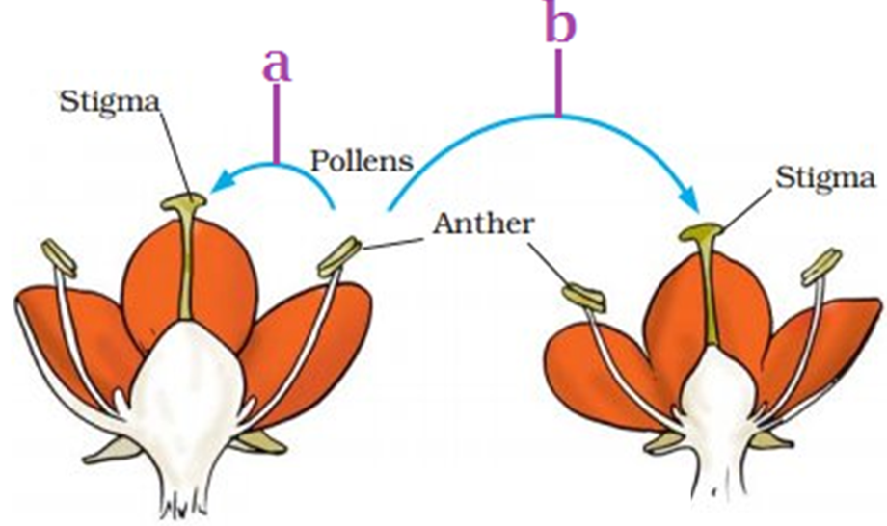


Slide 3
SELF
INCOMPATIBILITY
DICHOGAMY
_{OUTBREEDING}
_{DEVICES}
UNISEXUALITY
HERKOGAMY

Slide 4


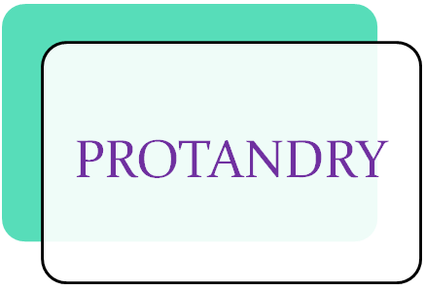
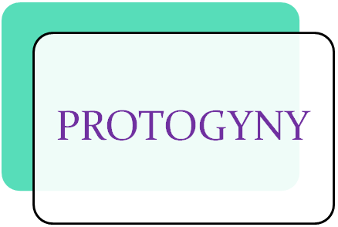

Slide 5

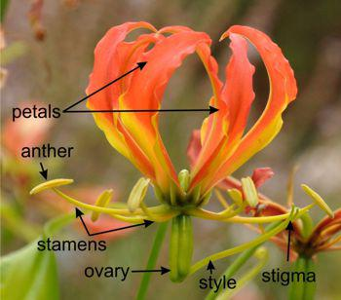
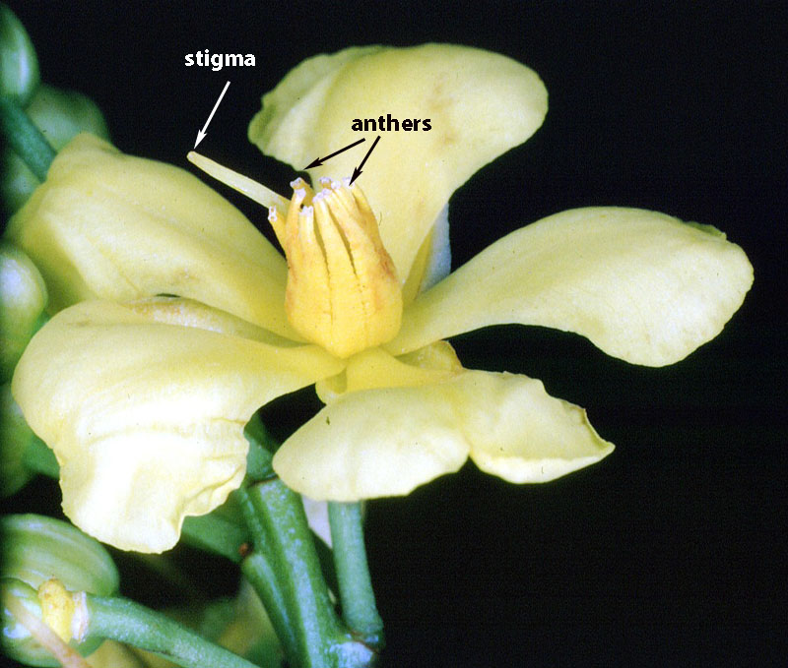

Slide 6

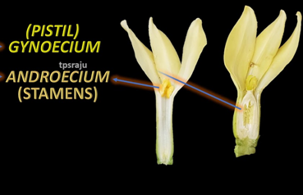
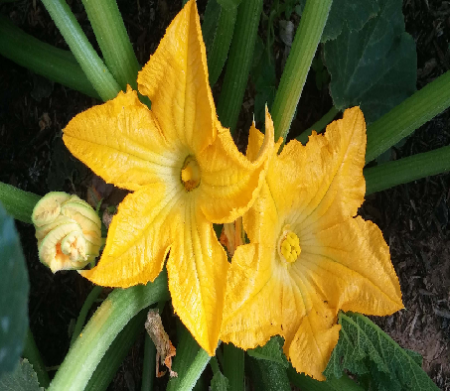

Slide 7

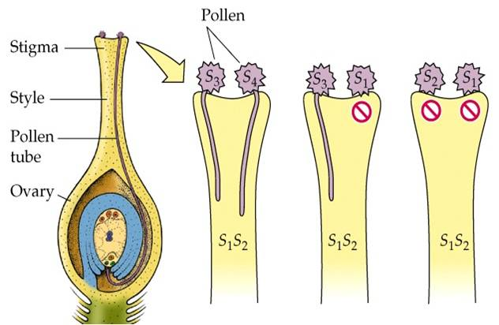

Slide 8

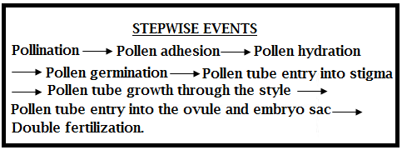

Slide 9
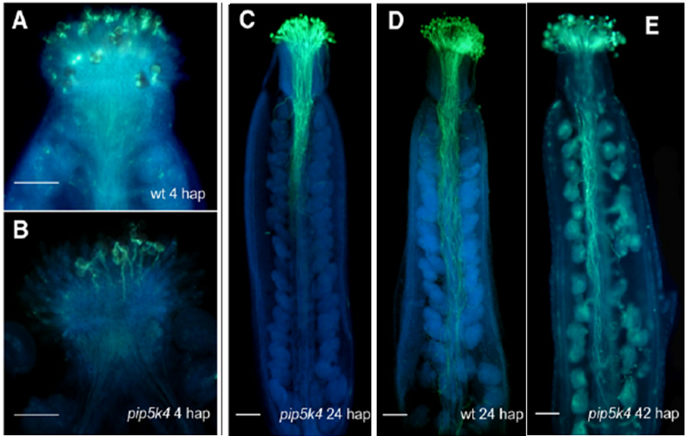

Slide 10


Slide 11
 | ¹
²
 | ³
 |  |  |  |  |  |  |  |  |  |  | ⁴
 |  |  | ⁵
⁶
 | ⁷
 |  |  |  |  | ⁸
 | ⁹
Across:
1 | Process of production of offsprings as a resut of self pollination.
2 | Transfer of pollengrains from anther to stigma of the same flower or different flower.
3 | condition in which stamens of a flower mature before carpels.
6 | Fusion of male gamete and female gamete.
7 | Spatial separation of anthers and stigma in bisexual flower to prevent self pollination.
8 | Condition of flowers whose female parts mature before the male ones.
9 | Flowers that possesses either stamens or carpels but not both.
Down:
1 | Condition of self pollen prevented from germination on stigma.
4 | Non synchronisation in pollen release and stigma recptivity.
5 | Crossing of plants within a species which are not genetically closely related.

Slide 12
HOME ASSIGNMENT
Do outbreeding devices completely prevent self pollination? Explain.
What are the principle significance of pollen pistil interaction?

Slide 13

THANK YOU

