Slide 1
Barrier methods of birth control and their significance in STDs
PREPARED BY: MANAS RANJAN TRIPATHY
PGT BIOLOGY
KENDRIYA VIDYALAYA NO.1 SAMBALPUR,BHUBANESWAR REGION

Slide 2
Objective:
Review of reproductive systems
To learn about the various methods of contraception or birth control to prevent pregnancy and STIs
Notes:
Consider using this video as a review: How Pregnancy Happens video: https://www.youtube.com/watch?v=n04NPtZI4QQ

Slide 3
Birth Control
(Contraception)

Slide 4
INTRODUCTION
Sexually active people can choose a number of methods to reduce the
possibility of pregnancy.
Nevertheless, no method of birth control available today offers perfect
protection against sexually transmitted infections (sexually transmitted
diseases, or STDs), except abstinence.
In simple terms, all methods of birth control are based on either preventing
a man's sperm from reaching and entering a woman's egg (fertilization) or
preventing the fertilized egg from implanting in the woman's uterus (her womb)
and starting to grow.
New methods of birth control are constantly being developed.
This ongoing evolution of contraceptive technology allows a couple the flexibility to change their choice of birth control based on their personal circumstances at the time.

Slide 5
CHARACTERISTICS OF IDEAL CONTRACEPTIVES
USER
FRIENDLY
NON INTER
FERING
EASILY
AVAILABLE
CONTRACEPTIVES
EFFECTIVE
NO OR
LEAST
SIDE
EFFECT

Slide 6
METHODS OF BIRTH CONTROL
BIRTH
CONTROL
NATURAL
BARRIER
IUDs
ORAL
CONCTR-
ACEPTIVE
INJECTABLE
AND
IMPLANTS
SURGICAL

Slide 7
BARRIER METHOD OF BIRTH CONTROL
Barrier
Condom
Diaphragm/
Cervical caps/
vaults
Spermicidal
cream

Slide 8
STIs and Pregnancy Prevention
Abstinence
Hormonal Methods
Non-hormonal Methods
Notes:
Ways to prevent STIs and Pregnancy
Note: hormonal methods will not prevent STIs

Slide 9
What is the most effective method of preventing pregnancy and STIs?
Abstinence

Slide 10
Barrier methods
(non-hormonal)

Slide 11
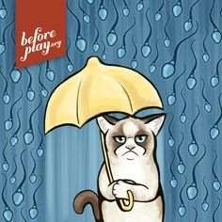
Barrier methods
-Barrier methods work by preventing the passage of sperm into the female genital tract.
Types:
Male & Female Condoms, Diaphragm and Cervical Cap

Slide 12
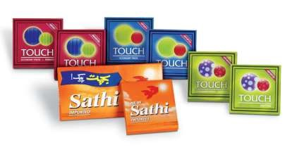
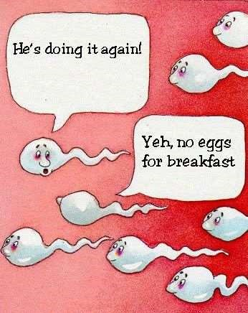

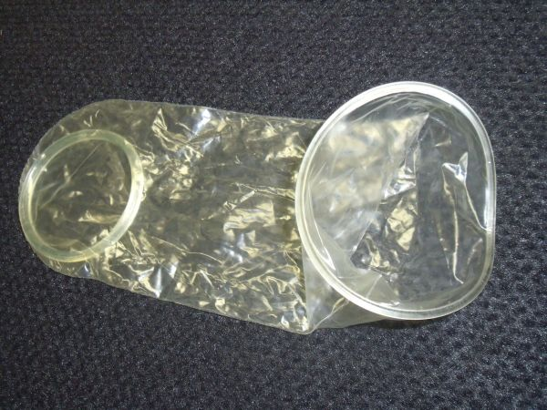
Condom (male)
Thin latex or polyurethane that fits over an erect penis
Catches sperm during ejaculation to prevent it from entering the vaginal/cervical canal
Typical effectiveness is 82%
Reduces but does not eliminate the spread of STIs and HIV

Slide 13


Slide 14
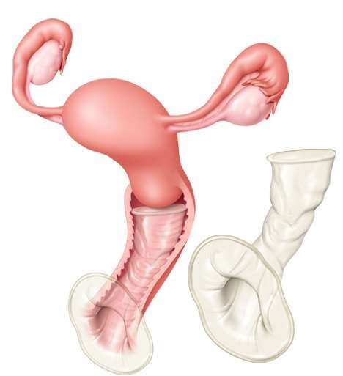
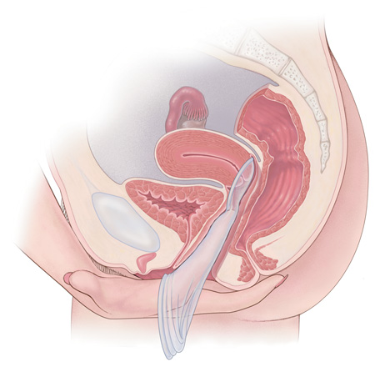
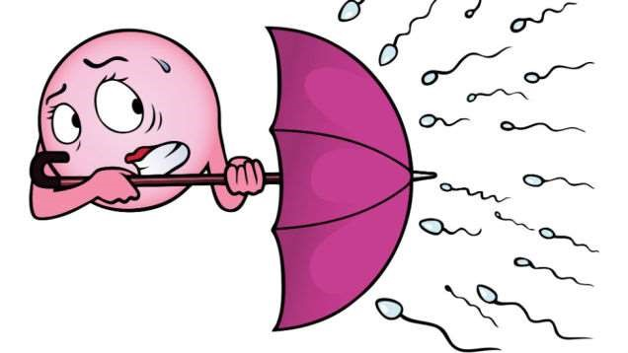
Condom (female)
Polyurethane sheath inserted into the vagina
Provides a physical barrier to prevent sperm from entering cervical canal
Sperm is trapped in the condom, which is thrown away after use
Typical effectiveness rate is 79%

Slide 15
Advantages
: - Condoms are effective in preventing STIs, including HIV.
-Cheap
-Widely available
Disadvantages: ▪ Require high degree of motivation.
-Less effective than either the pill or the IUDs.
-Latex allergy, recurrent vaginal infections such as bacterial vaginosis or candida and recurrent urinary tract infection are possible side effects.
-Cervical cap difficult to insert and remove and much more likely to experience dislodgement.

Slide 16
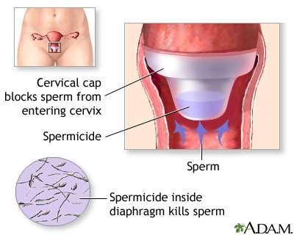
CERVICAL CAPS
Caps fit snugly over the cervix. It is a silicone rubber device designed to be easier to fit, and less likely to slip, than the traditional diaphragm.

Slide 18
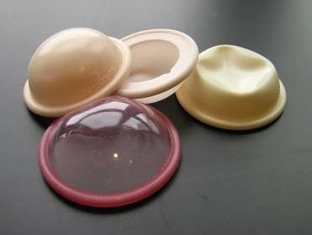
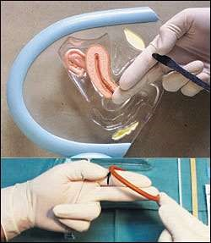
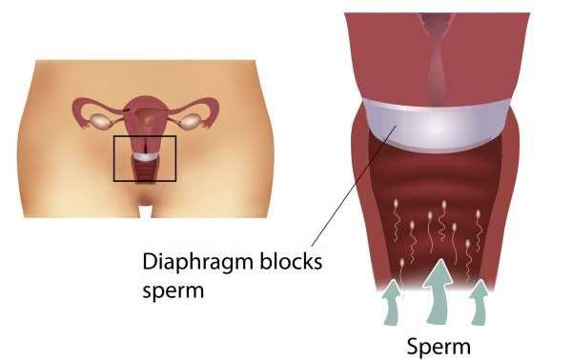
DIAPHRAGM
Shallow, Dome shaped cup with flexible rim ▪Health Professional must fit the diaphragm ▪Inserted 6 hours prior to intercourse ▪Size of the diaphragm is determined before insertion

Slide 19
ADVANTAGES
It has no effect on a woman’s natural hormones.
It does not affect milk supply if you are breastfeeding.
It can be inserted hours before sex
Because the spermicide used with the diaphragm can increase the risk of getting HIV from an infected partner,

Slide 20
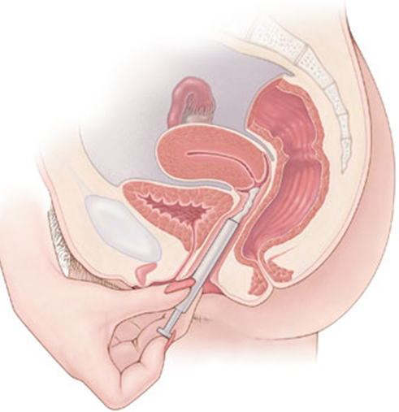
Sponge and Spermicides
The sponge is a soft, disposable, device with a spermicide
Typical effectiveness is 76%-88%
Fits over the cervix
Traps and absorbs sperm to increase effect of spermicide
Spermicide in the sponge disables the sperm
Effective for up to 12 hours
Spermicides disable sperm
Typical effectiveness is 88%onge
Notes:
** At the discretion of teacher whether to include this method of contraception ** - not widely used
spermicides can cause vaginal irritation which can increase the risk of STI transmission

Slide 21
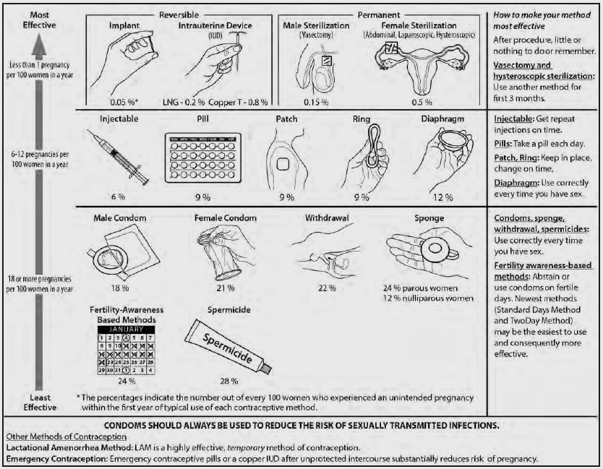

Slide 22


Slide 23
STDs
SL.NO | Disease | CAUSATIVE AGENT
1 | syphilis | Treponema pallidium
2 | gonorrhea | Neisseria gonorrhoeae
3 | chlamydiasis | Chlamydia trachomatis
4 | trichomoniasis | Trichomonas vaginalis
5 | AIDS | Human Immunodeficiency Virus
6 | Hepatitis-B | Hepatitis virus
7 | Genital herpes | Herpes simplex virus Human papiloma virus

Slide 24
SUMMARY
-All barrier methods have high failure rates when used typically.
-Diaphragms and caps must be fitted by a health professional.
-Male condoms reduce the risk of sexually transmitted disease including HIV.
-Spermicides should not be used alone and if used frequently and in large quantities may increase the risk of HIV transmission.

Slide 25
Evaluation
1. What is a barrier method?1
2. The popular brand of condom used is......................1
3. Name the barriers used to prevent STDS and AIDS?1
4. What are used with the barriers to increase the contraceptive efficiency?1
5. Mention the advantages of use of condoms.2
6. Mention the working of a diaphragm2
7. How a condom work?2
8. How the cervical caps prevent conception?2
9. List out the various types of barriers used for minimizing the population growth with their uses in tabular format3
10. Extract out the methods to prevent STIs other than barrier methods. Whether these methods are 100%safe?5

Slide 26
Suggested readings:
1-NCERT TEXT BOOB
2-BIOLOGY BY SARITA AGARWAL
3-ELEMENTARY BIOLOGY BY TRUEMAN
4-SHIKSHA HOUSE .COM

Slide 27
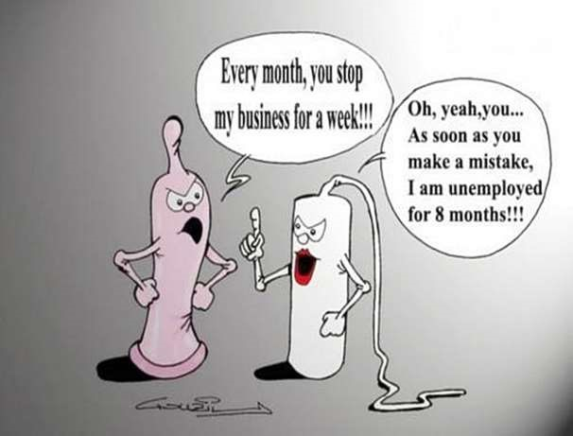
THANK YOU

