Slide 2
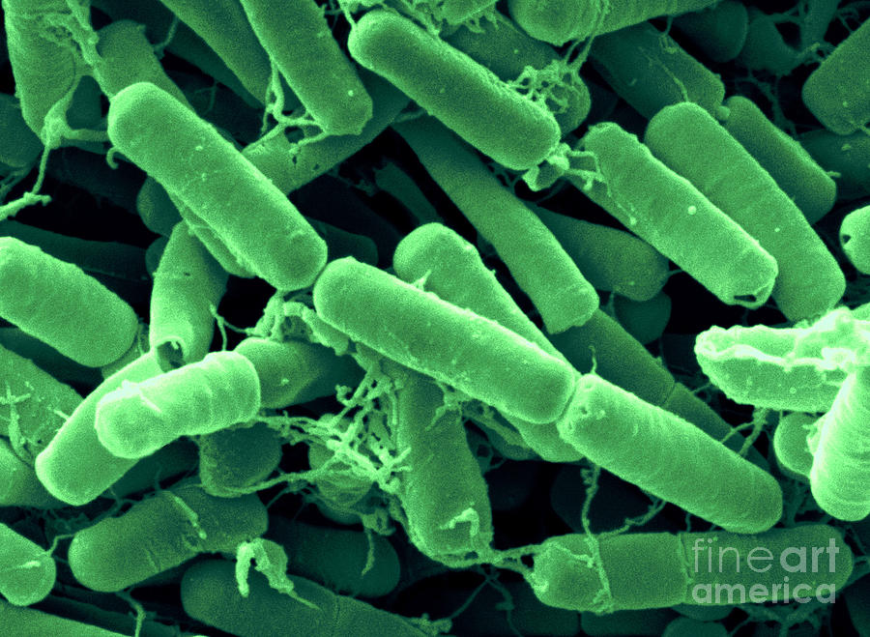

Slide 3
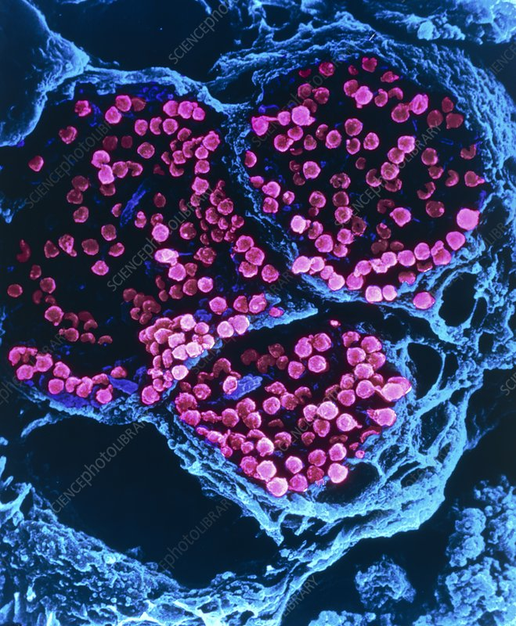

Slide 4
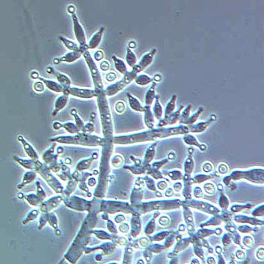

Slide 5
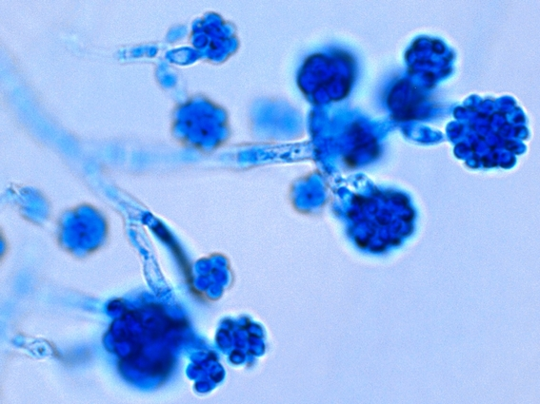

Slide 6
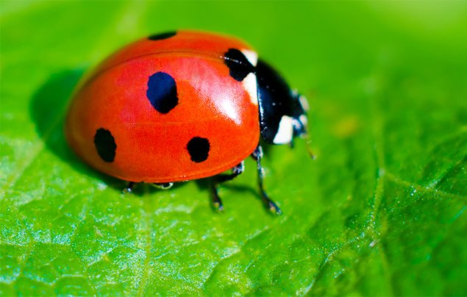

Slide 7
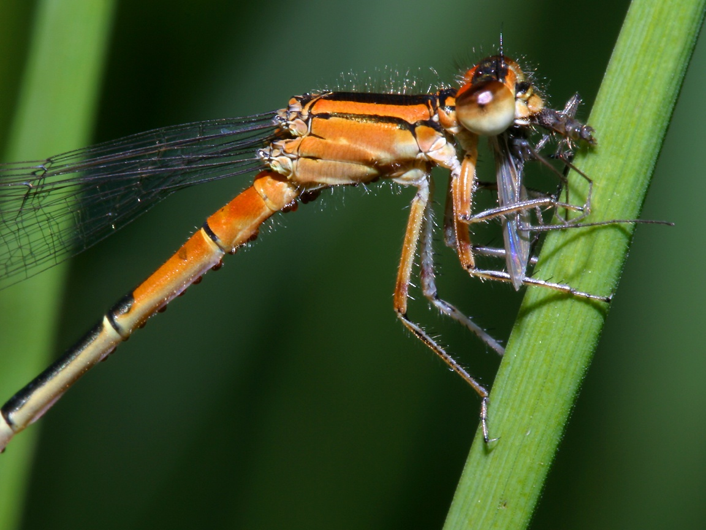

Slide 8
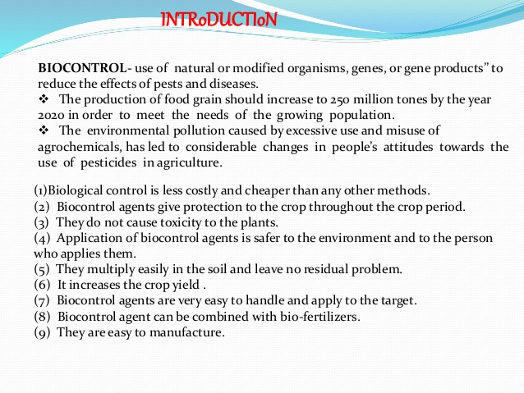

Slide 9
OBJECTIVES
Reducing pesticide load.
Relies on natural pest control.
Key belief that biodiversity furthers health and sustainability.
To create a system where pests are not eradicated, but instead are kept manageable levels.
Habitat manipulations.

Slide 10
BIOCONTROL AGENTS
CONTROLS
Ladybird and Dragonflies.
Bacillus thuringiensis.
Trichoderma.
Baculovirus (family Nucleopolyhedrovirus)
1. Aphids and mosquitoes.
2. Butterfuly caterpiller.
3. Plant root pathogens.
4. Insect and arthopods (species-specific narrow spectrum insecticidal applications)

Slide 11
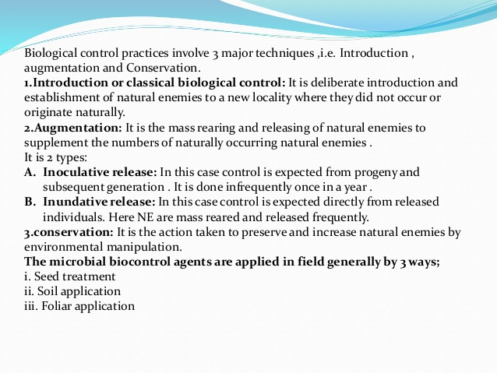

Slide 12
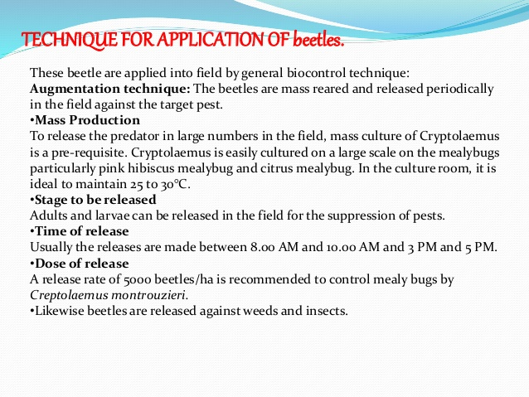

Slide 13
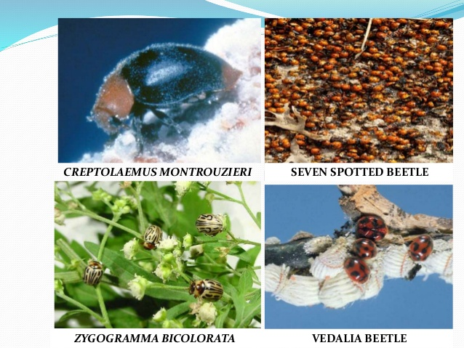

Slide 14
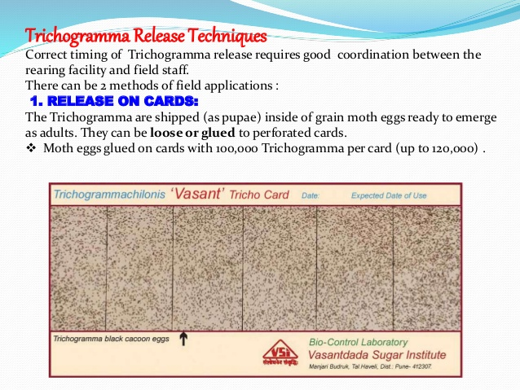

Slide 15
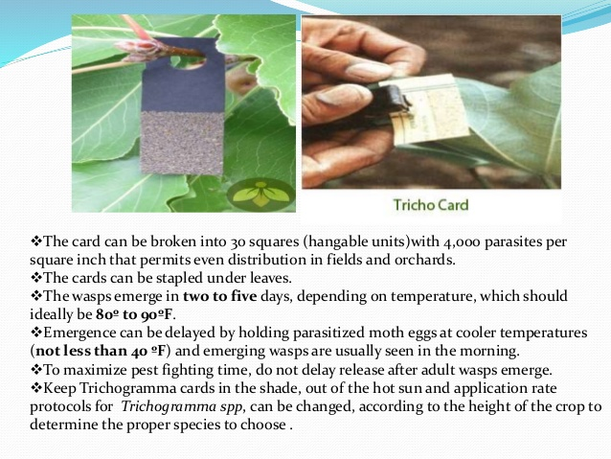

Slide 16
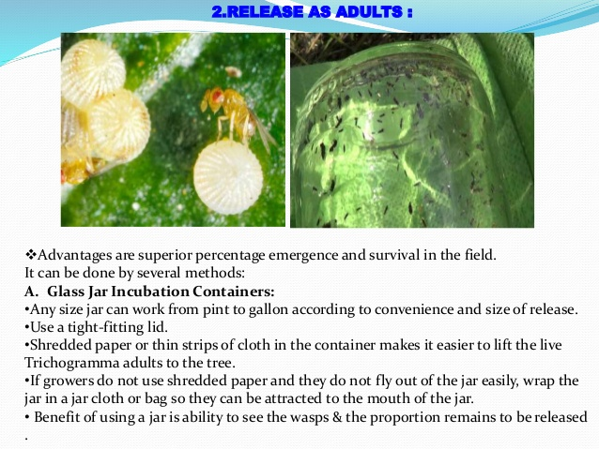

Slide 17
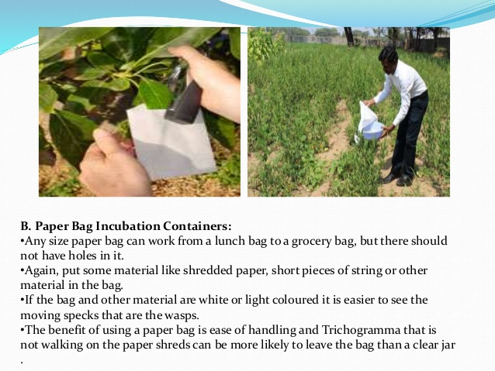

Slide 18
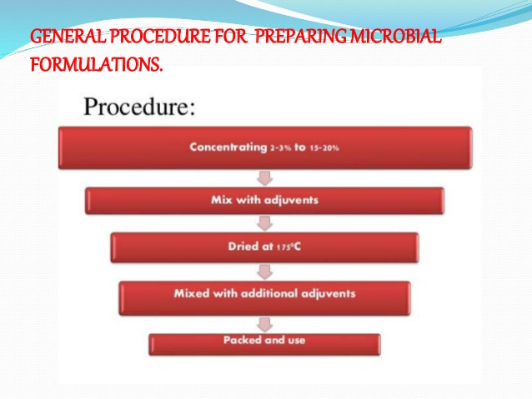

Slide 19
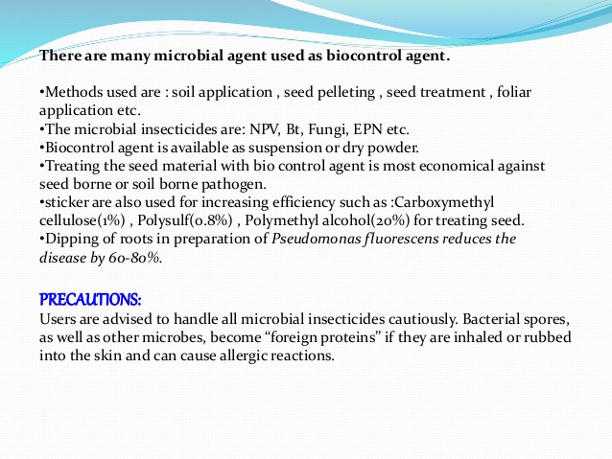

Slide 20
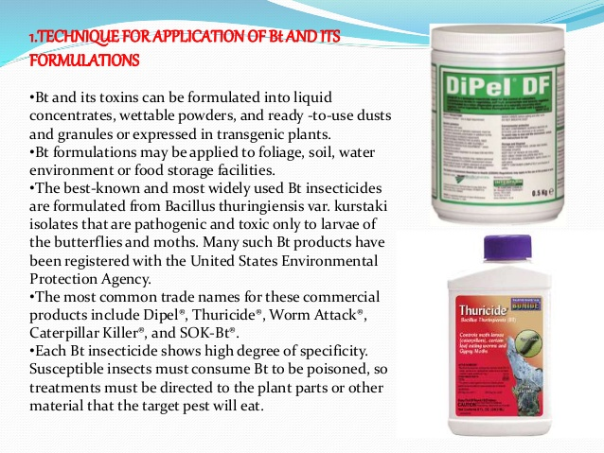

Slide 21
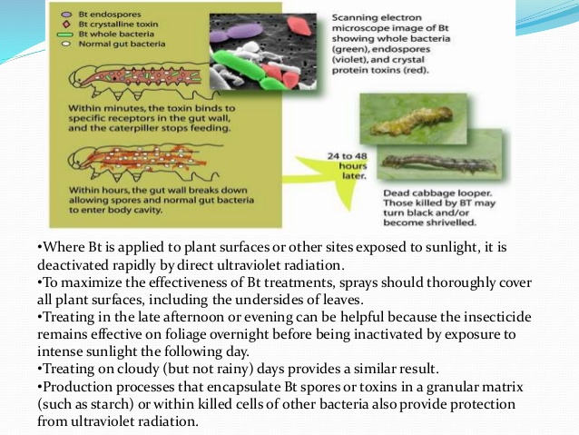

Slide 22
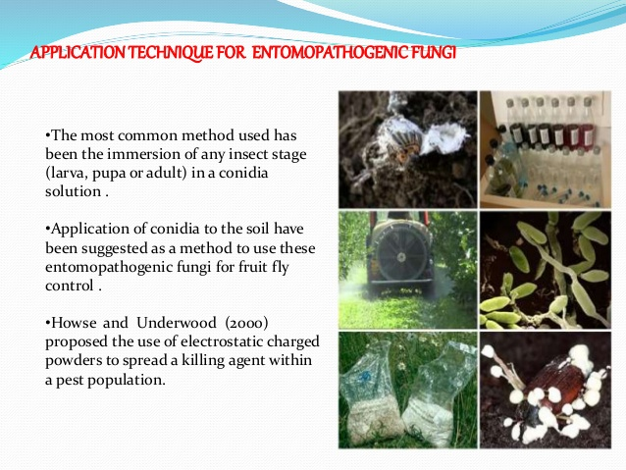

Slide 23
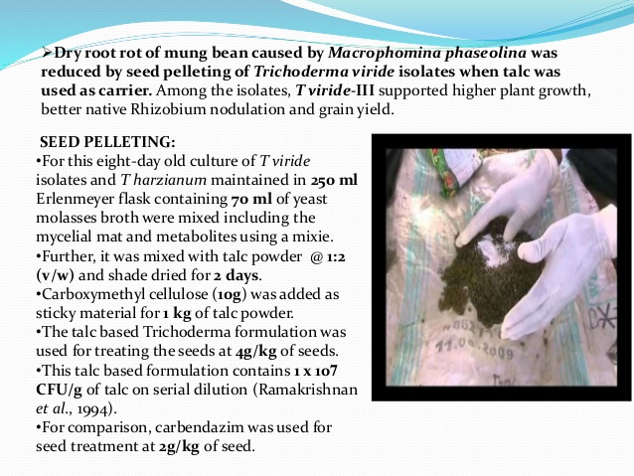

Slide 24
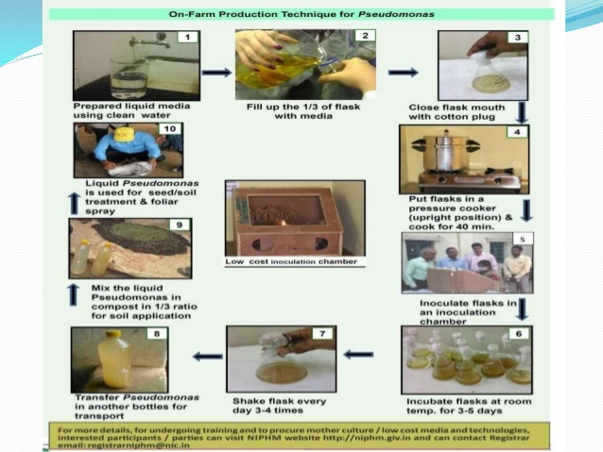

Slide 25
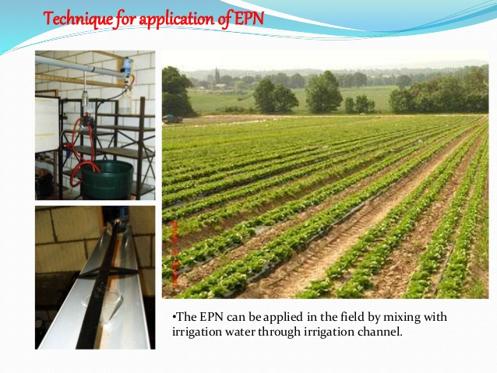

Slide 26
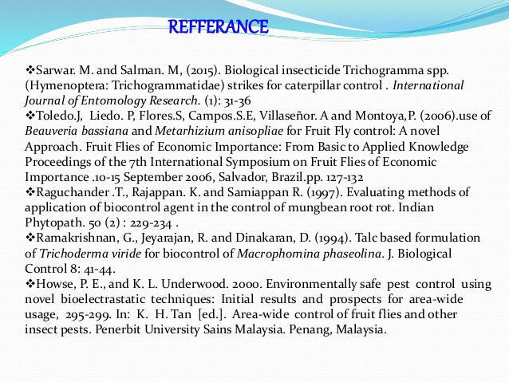

Slide 27
FEW USEFUL LINKS
https://www.youtube.com/watch?v=0d7rzRFSiPw
https://www.youtube.com/watch?v=-eY0RBPKxM0
https://www.youtube.com/watch?v=FxRZ2w_2cn8
https://www.youtube.com/watch?v=Mq7rdfIm6IU
https://www.youtube.com/watch?v=Tt3-bkreJ3A
https://www.youtube.com/watch?v=nNWWIzBVqRA
https://www.youtube.com/watch?v=urUjqgo0WRE
https://www.youtube.com/watch?v=KIkQLCVitzE

Slide 28
